Slide 1
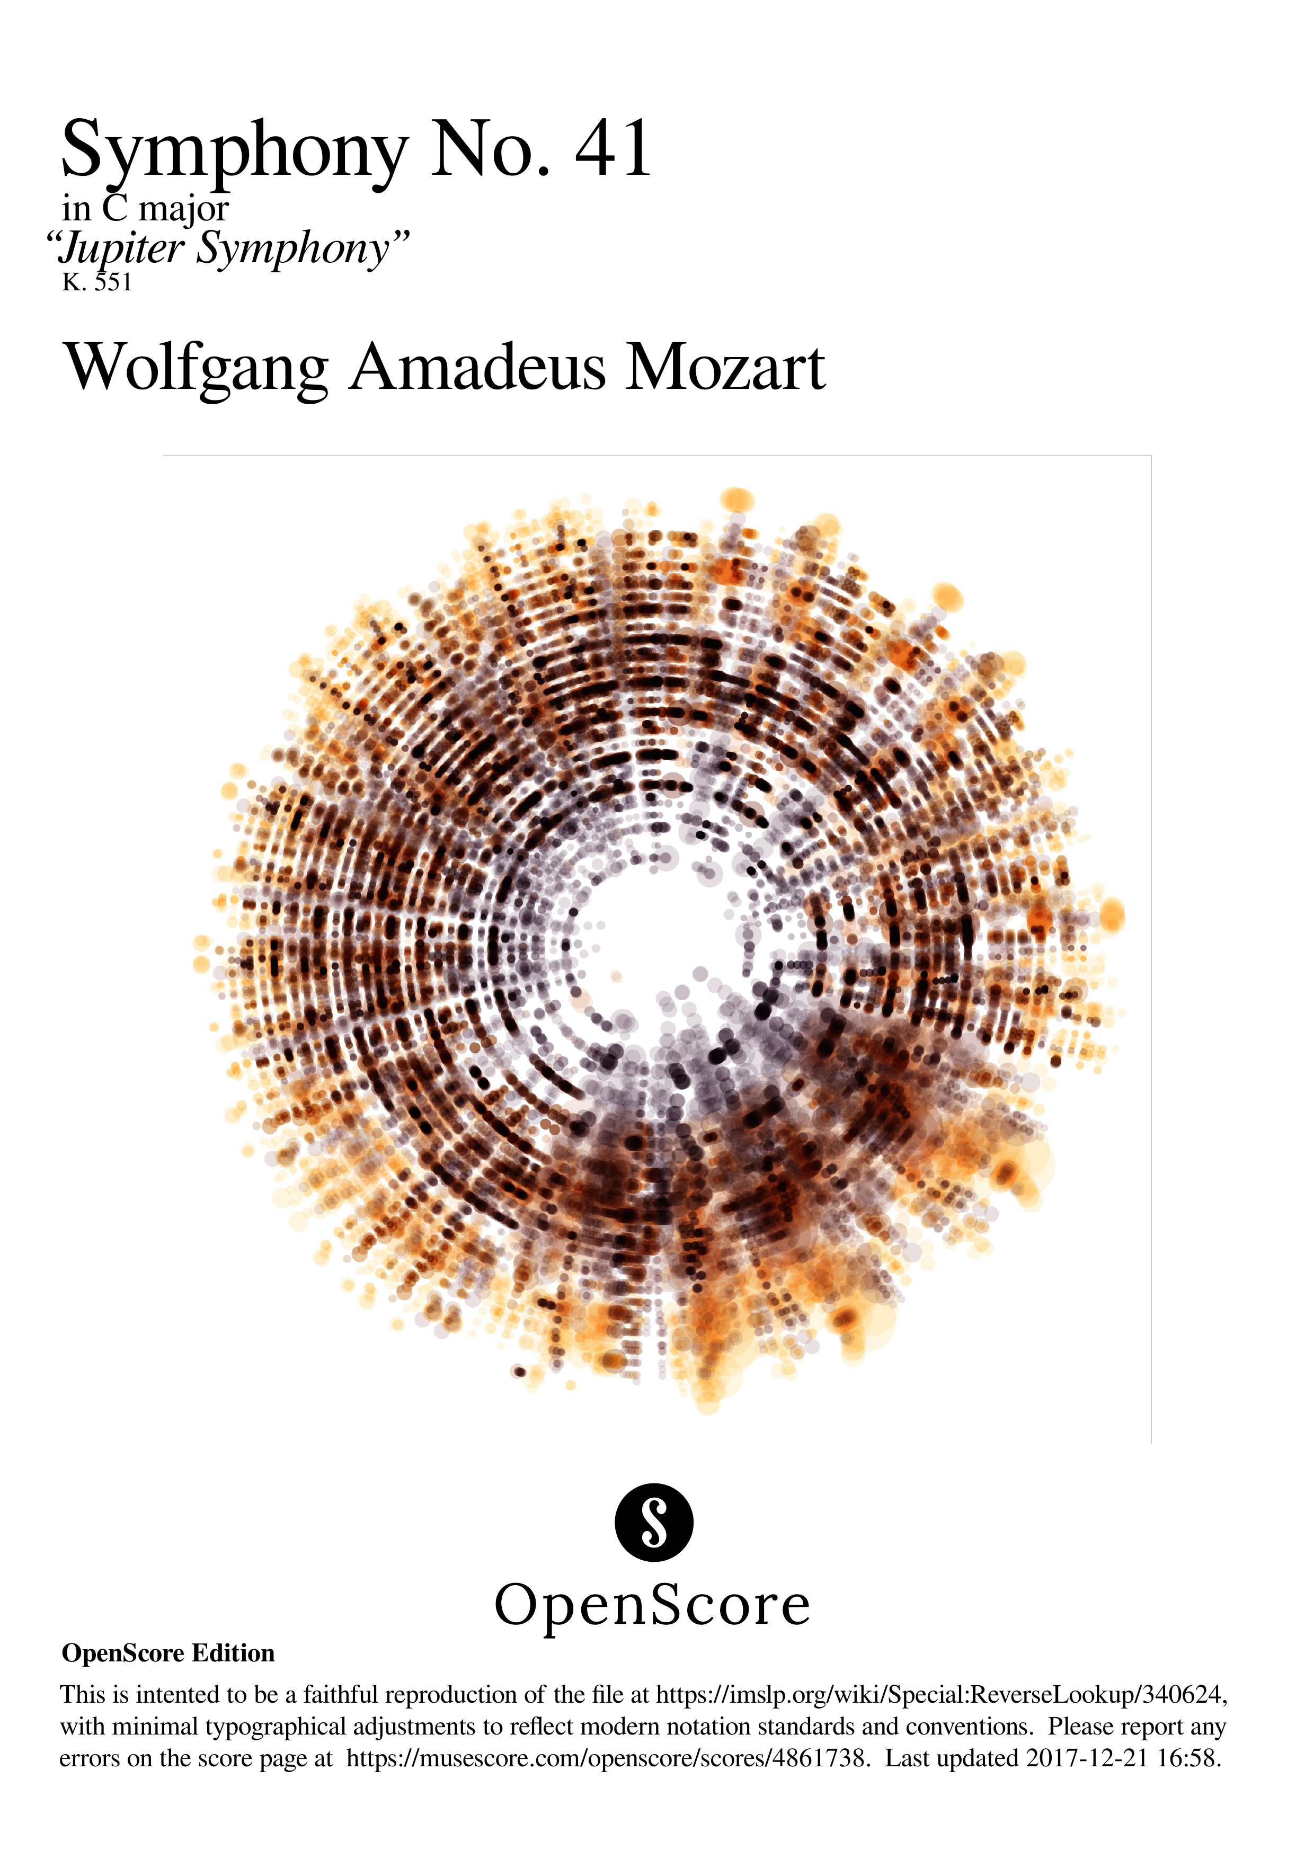

Slide 2
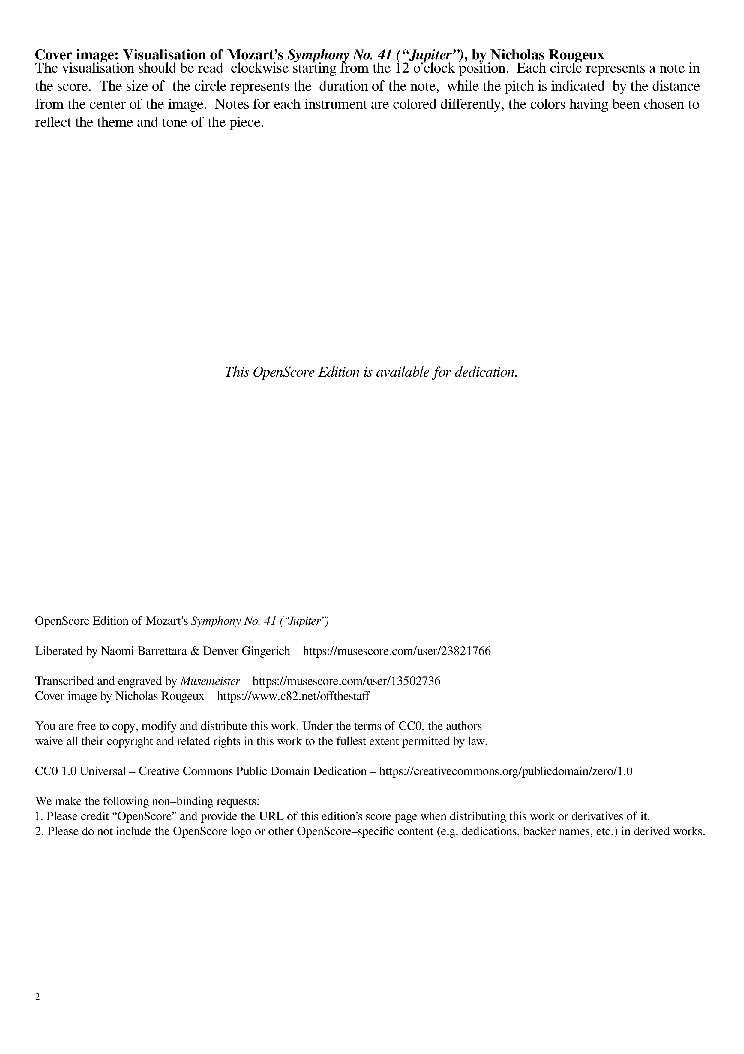

Slide 3
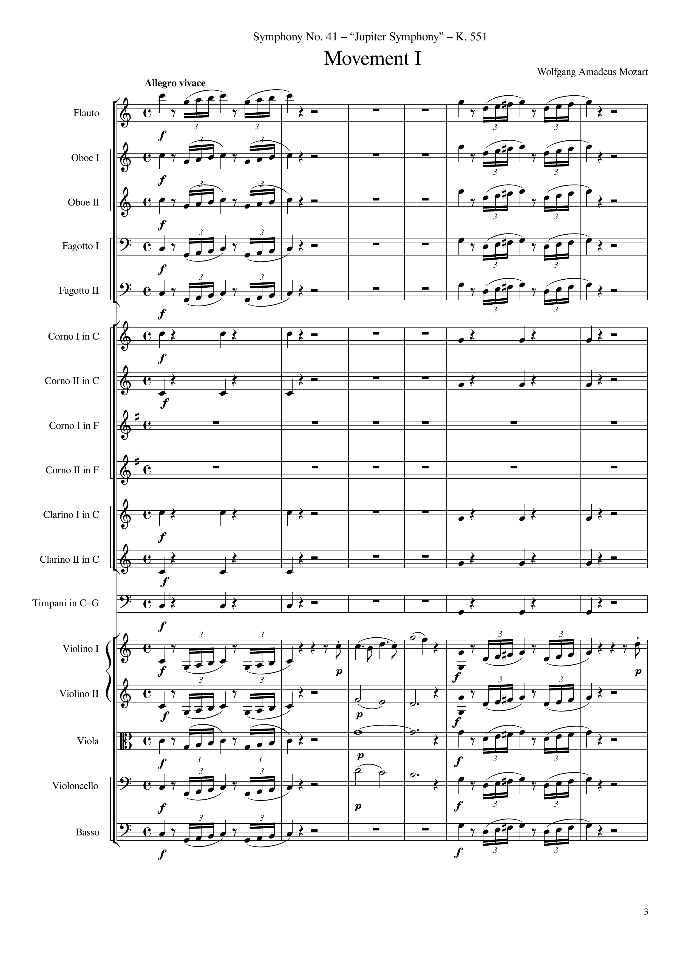
mel
mel
mel
mel
mel
mel
mel
mel
mel
mel
rhythm+harm
rhythm+harm
rhythm+harm
rhythm+harm
rhythm+harm
rhythm+harm
rhythm+harm
rhythm+harm
rhythm+harm
rhythm+harm
mel
mel
mel
mel
mel
harm
mel
mel
harm
mel
mel
harm
mel
mel
mel
0
24

Slide 4
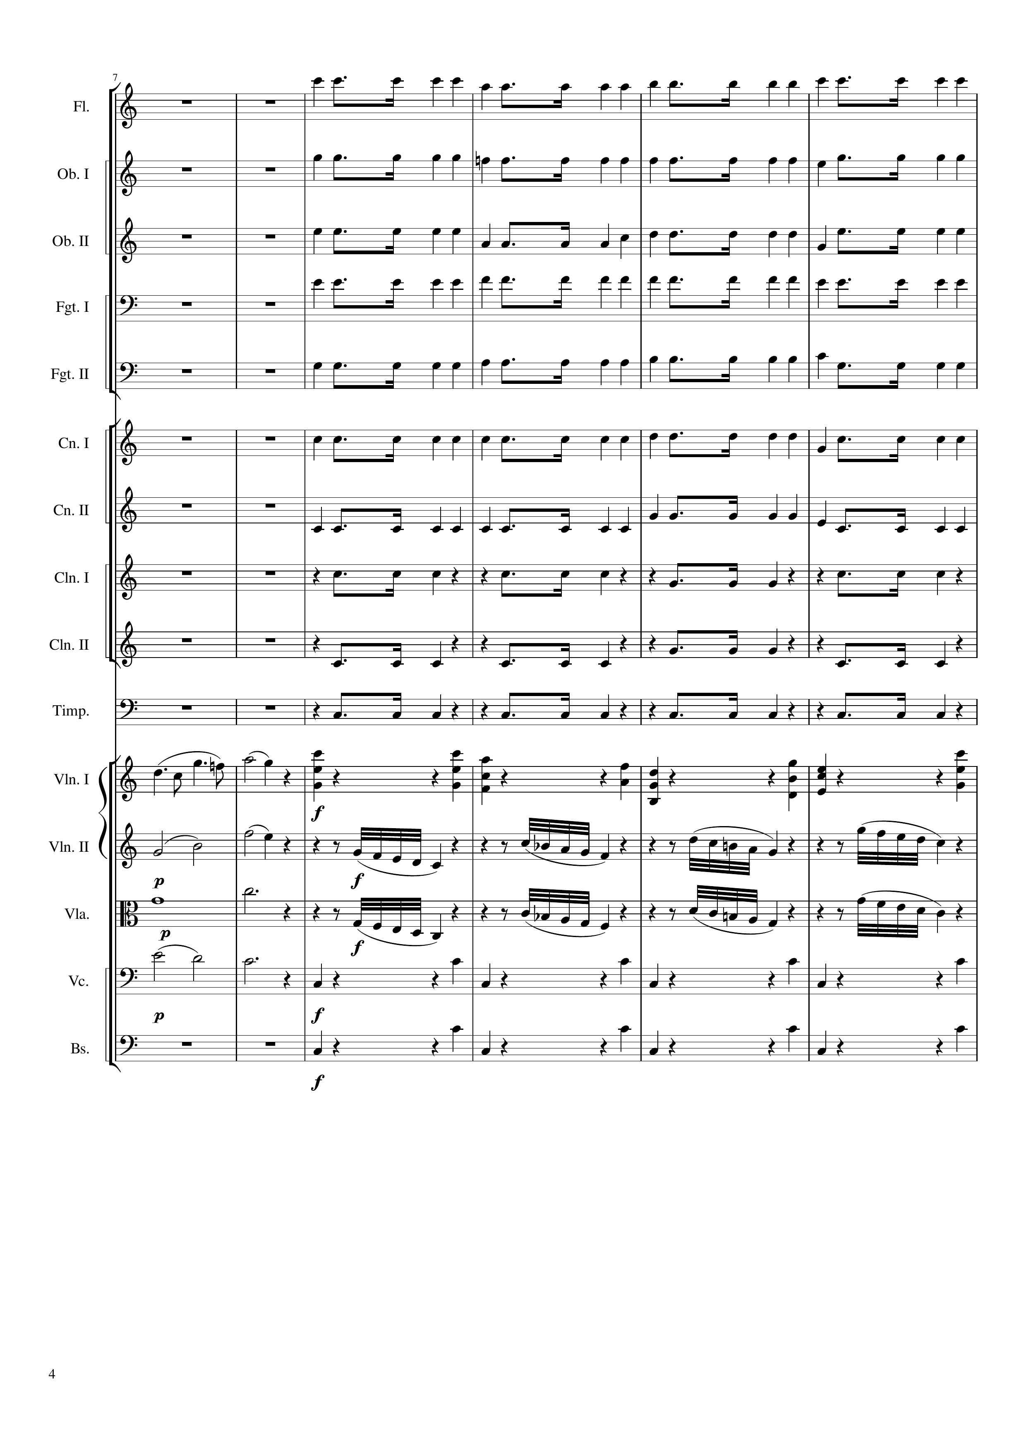
rhythm+harm
rhythm+harm
rhythm+harm
rhythm+harm
rhythm+harm
rhythm+harm
rhythm+harm
rhythm+harm
rhythm+harm
rhythm
mel
mel+rhythm+harm
harm
mel
harm
mel
harm
rhythm
rhythm
24
48

Slide 5
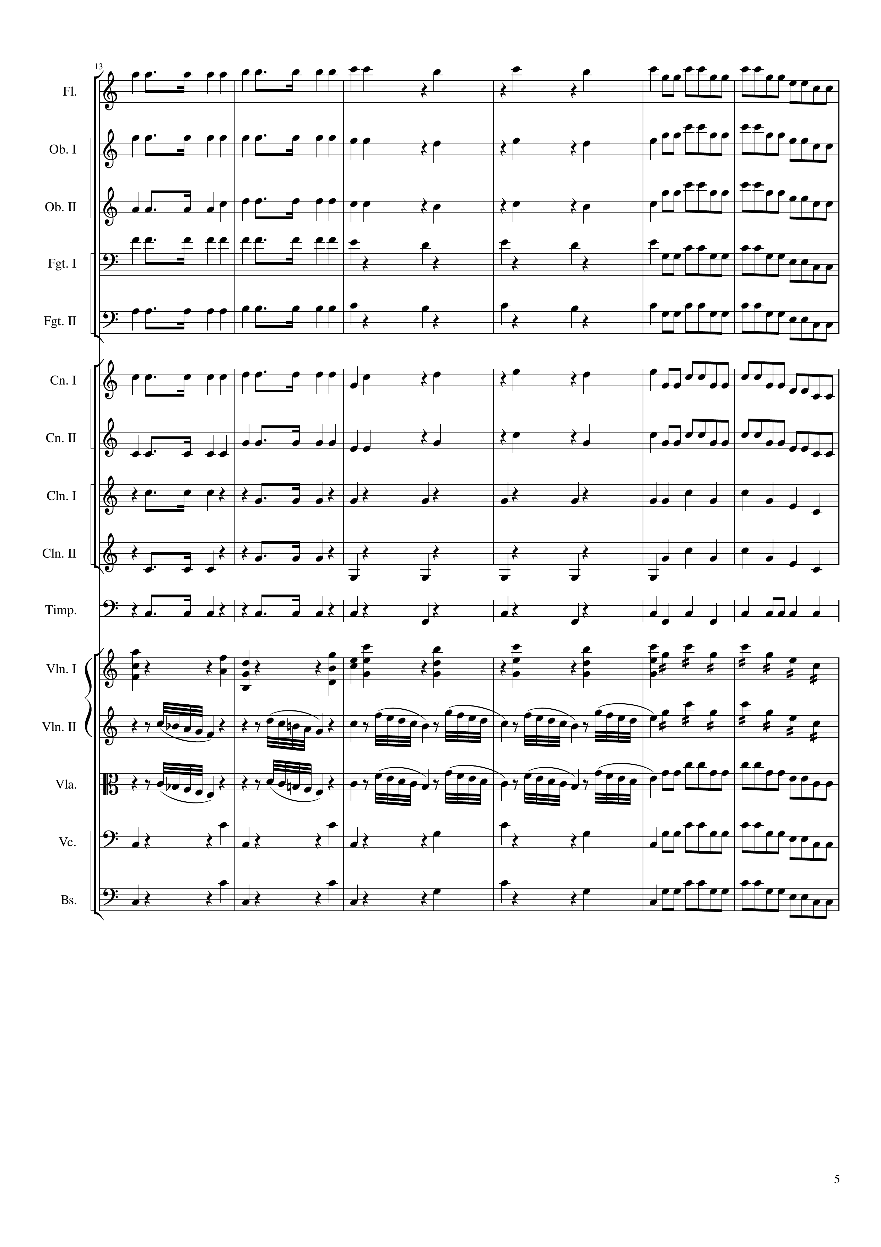
rhythm+harm
mel+rhythm
rhythm+harm
mel+rhythm
rhythm+harm
mel+rhythm
rhythm+harm
mel+rhythm
rhythm+harm
mel+rhythm
rhythm+harm
mel+rhythm
rhythm+harm
mel+rhythm
rhythm+harm
mel
rhythm+harm
mel
rhythm
rhythm+harm
rhythm
mel+rhythm+harm
mel+rhythm
mel
mel+rhythm
mel
mel+rhythm
rhythm
rhythm+harm
mel+rhythm
rhythm
rhythm+harm
mel+rhythm
48
56
64
72

Slide 6
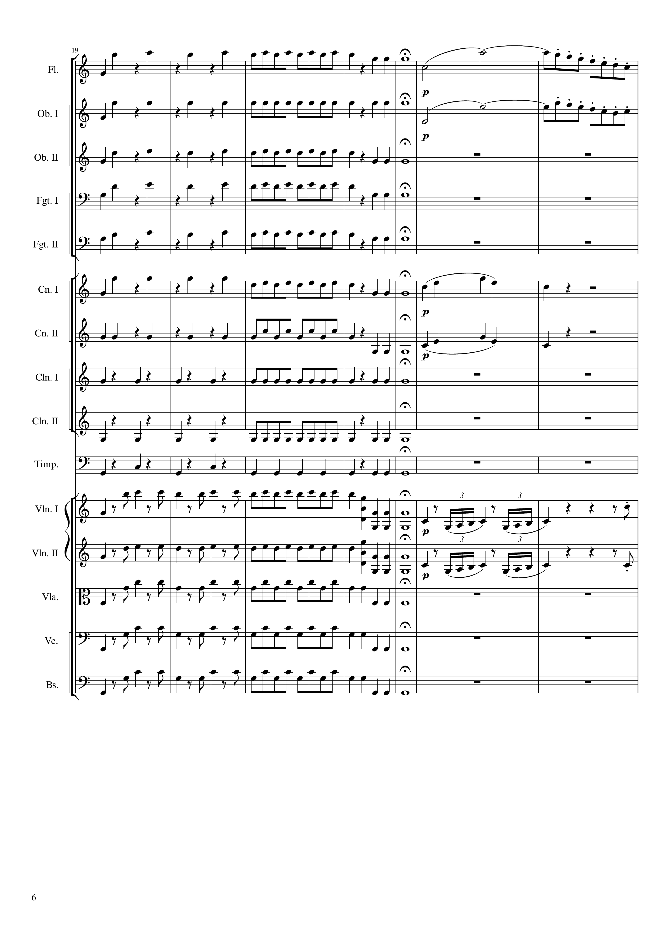
rhythm+harm
mel
mel
rhythm+harm
rhythm
mel
rhythm+harm
mel
rhythm+harm
mel
rhythm+harm
mel
rhythm+harm
mel
rhythm
rhythm+harm
mel
rhythm
rhythm+harm
rhythm
rhythm+harm
rhythm
rhythm+harm
rhythm
mel
mel
mel
mel
mel
mel
mel
72
92
100

Slide 7
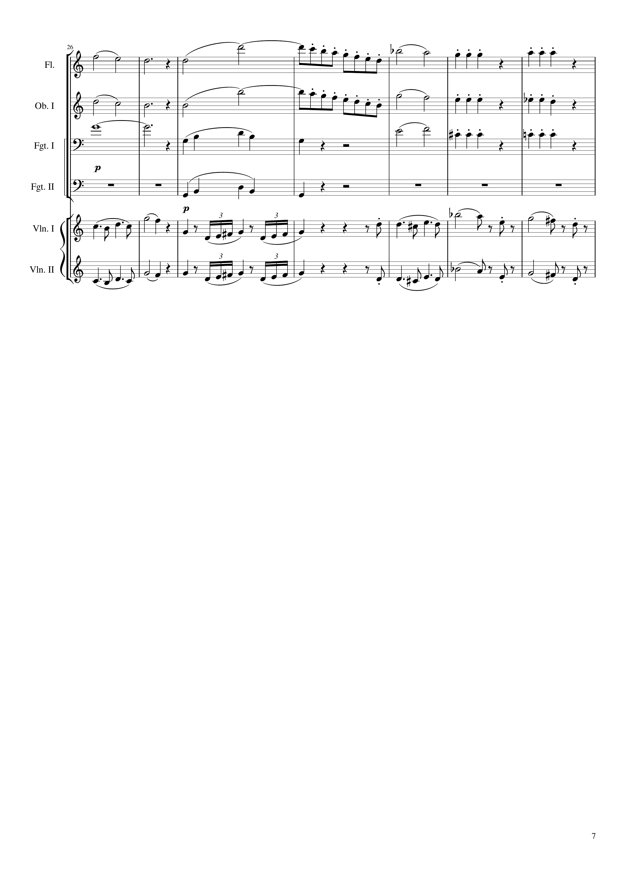
mel
mel
rhythm+harm
mel
mel
rhythm+harm
harm
rhythm
mel
rhythm+harm
rhythm
mel
mel
100
120
128

Slide 8
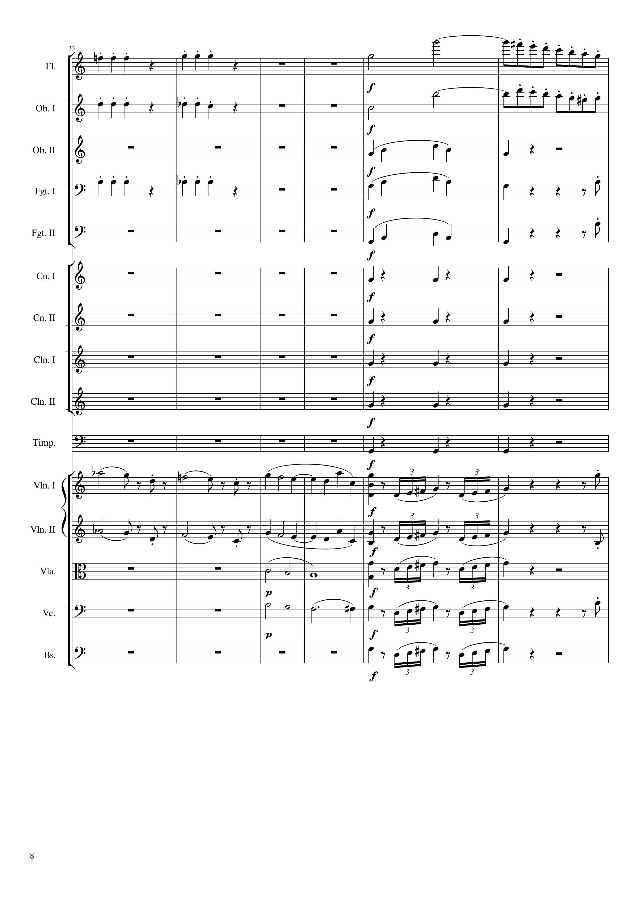
rhythm+harm
mel
rhythm+harm
mel
rhythm
rhythm+harm
rhythm
mel
rhythm
mel
rhythm+harm
rhythm+harm
rhythm+harm
rhythm+harm
rhythm+harm
mel
mel
mel
mel
mel
mel
harm
mel
harm
mel
mel
mel
128
144
152

Slide 9
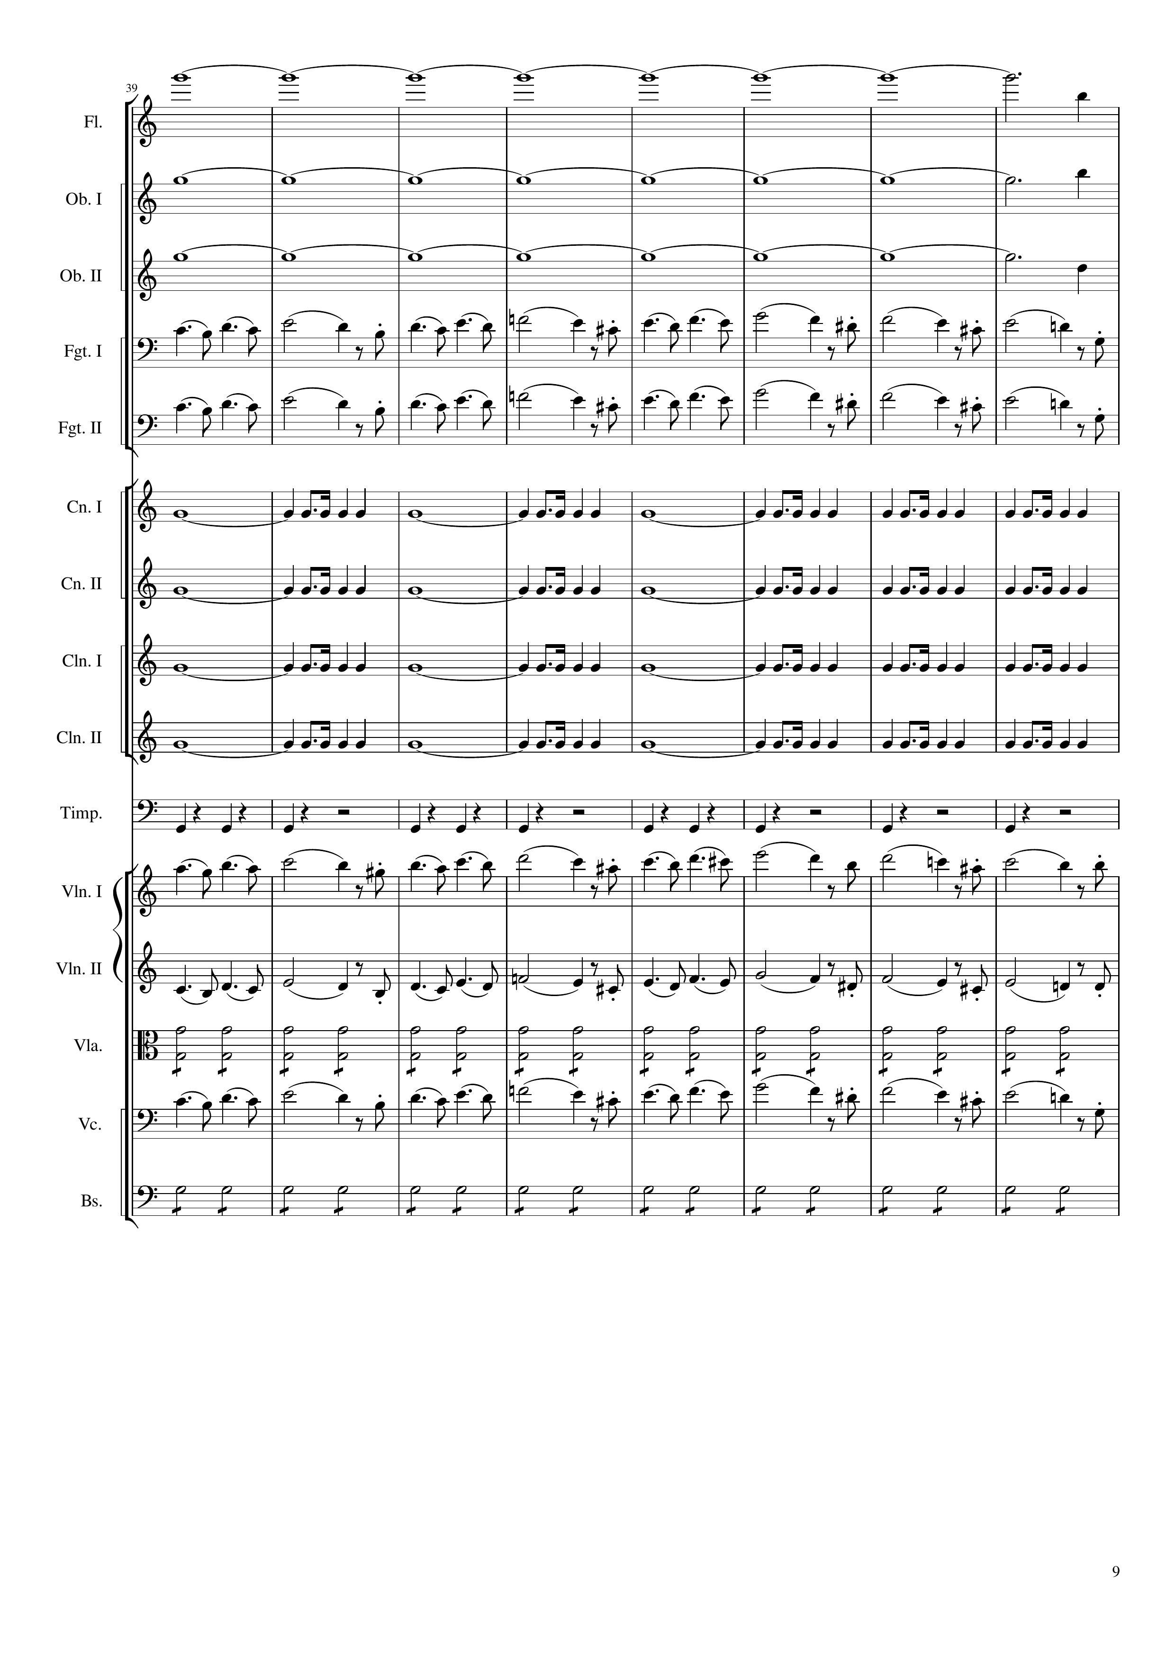
harm
harm
harm
mel
mel
rhythm
rhythm
rhythm
rhythm
rhythm
mel
mel
rhythm
mel
rhythm
152
184

Slide 10
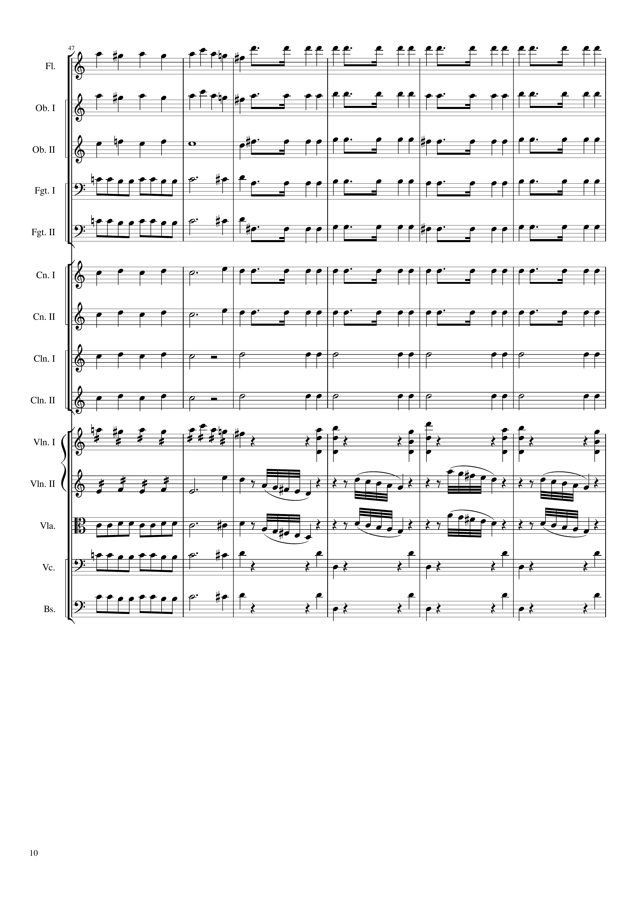
mel
rhythm+harm
mel
rhythm+harm
rhythm+harm
rhythm+harm
rhythm+harm
rhythm+harm
rhythm+harm
rhythm+harm
rhythm+harm
rhythm+harm
rhythm+harm
rhythm+harm
rhythm+harm
rhythm
rhythm+harm
rhythm
mel+rhythm
mel+rhythm+harm
rhythm+harm
mel
rhythm+harm
mel
rhythm+harm
rhythm
rhythm+harm
rhythm
184
192
208

Slide 11
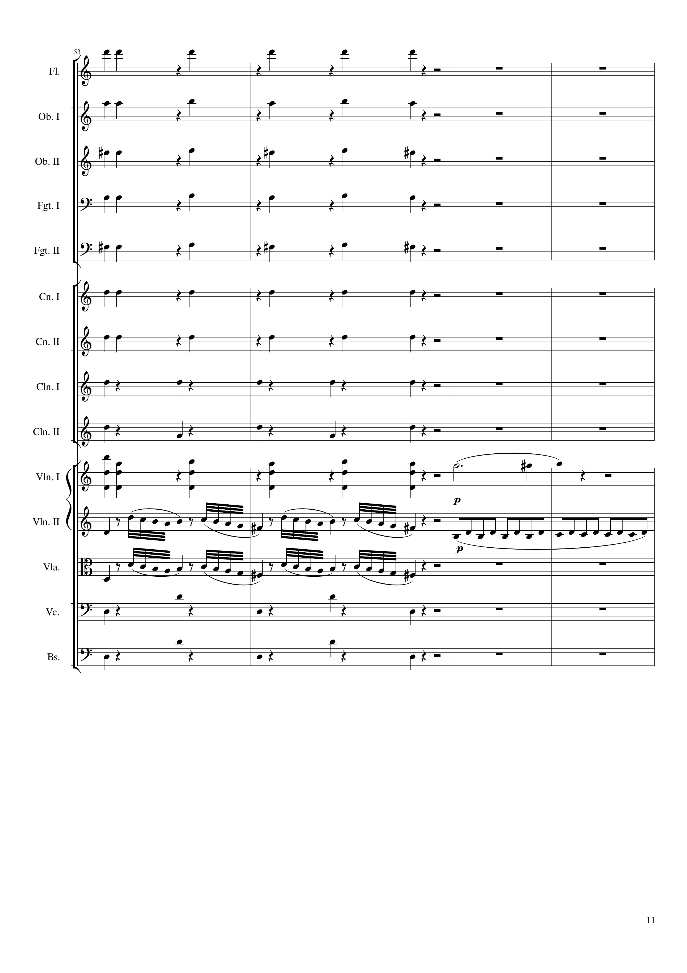
rhythm+harm
rhythm+harm
rhythm+harm
rhythm+harm
rhythm+harm
rhythm+harm
rhythm+harm
rhythm+harm
rhythm+harm
mel+rhythm+harm
mel
mel
rhythm
mel
rhythm+harm
rhythm+harm
208
220
228

Slide 12
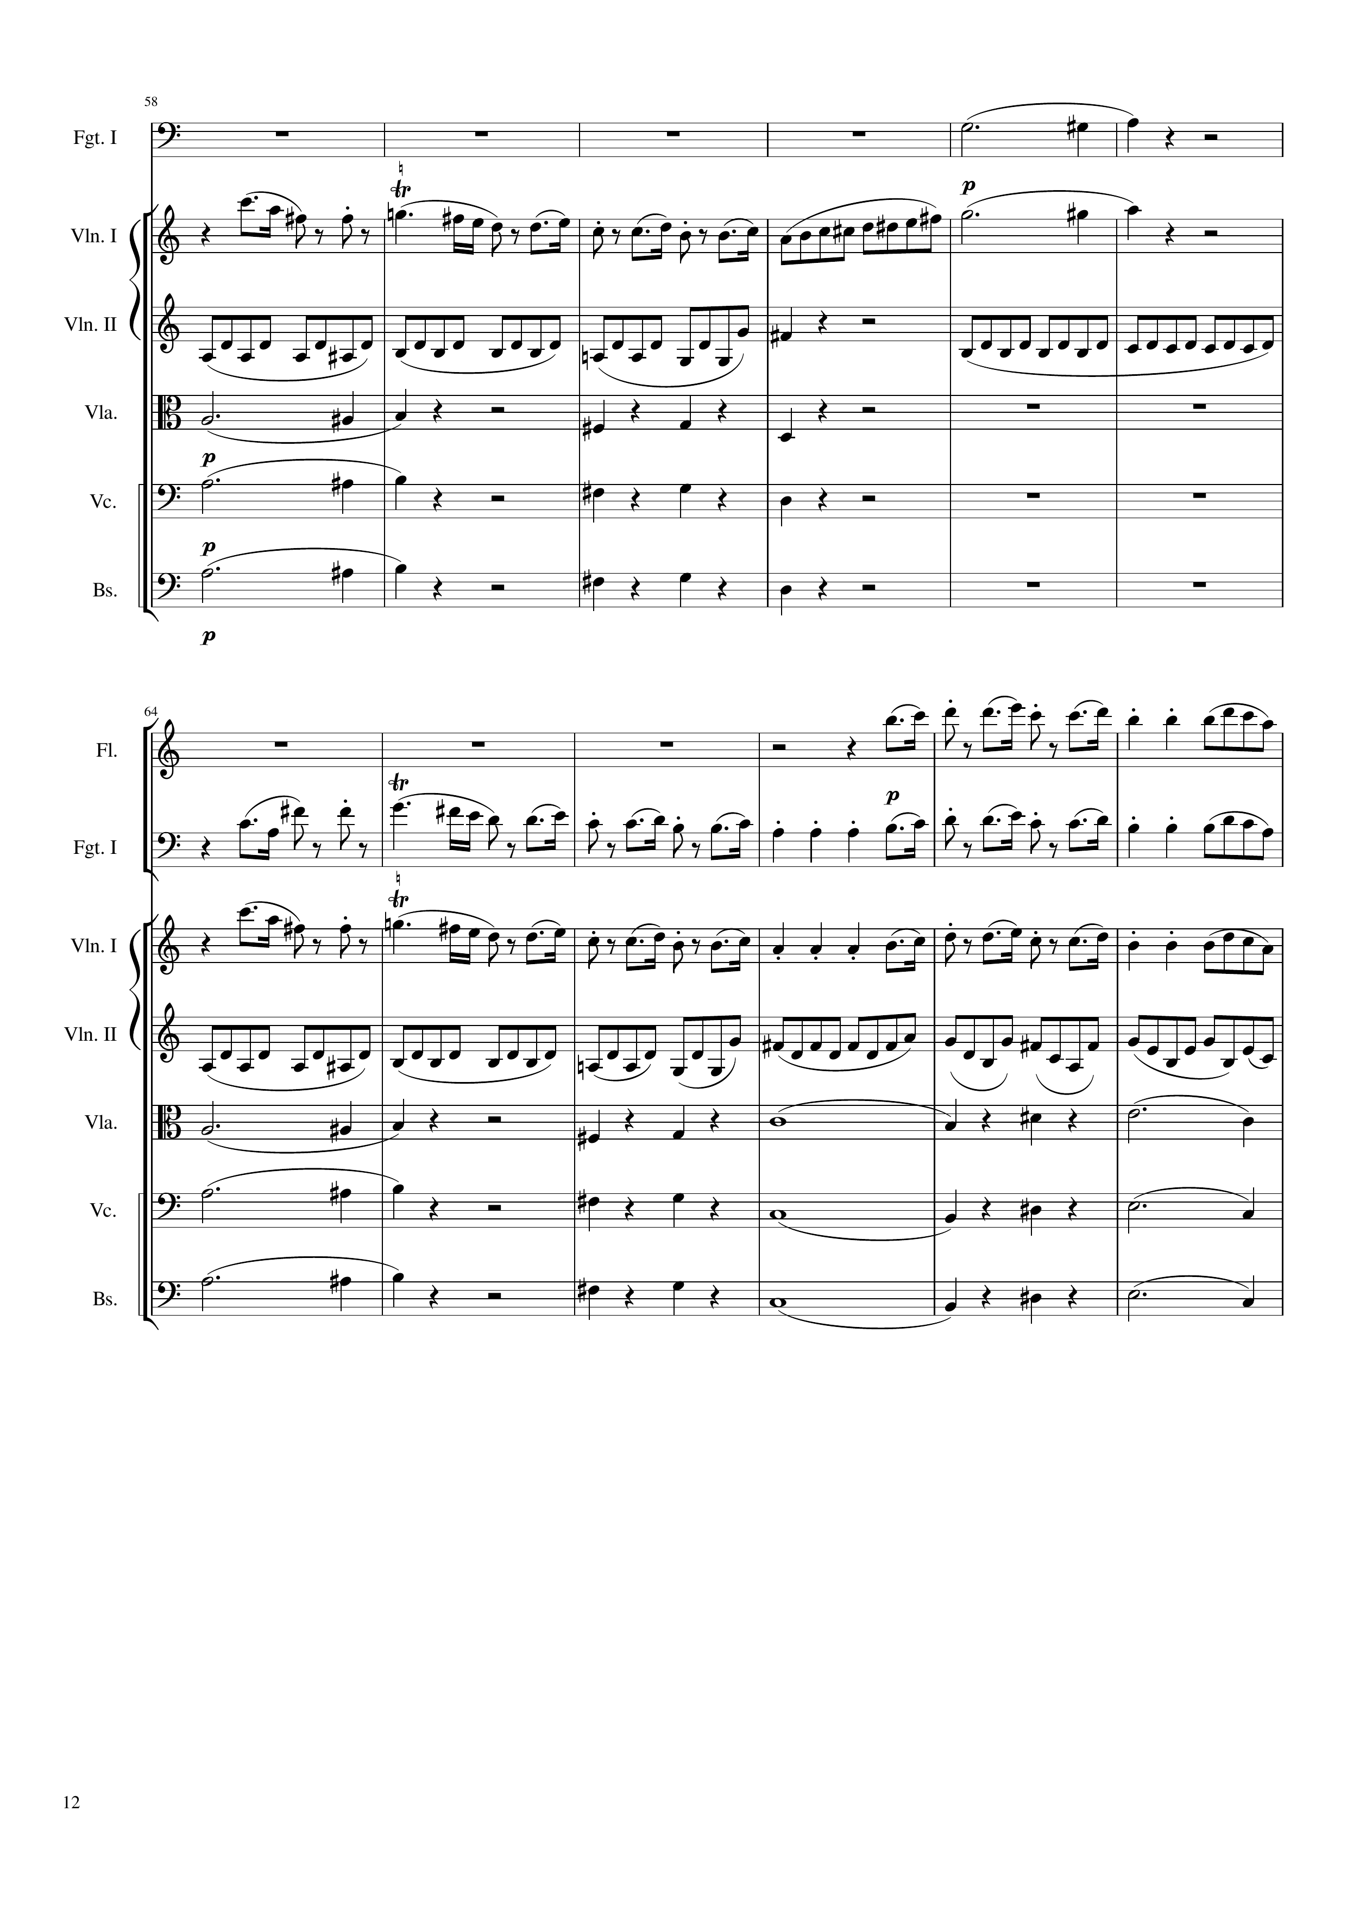
mel
mel
rhythm
mel+harm
rhythm+harm
mel+harm
rhythm+harm
mel+harm
rhythm+harm
228
252
mel
mel
mel
rhythm
mel+harm
rhythm+harm
mel+harm
rhythm+harm
mel+harm
rhythm+harm
252
276

Slide 13
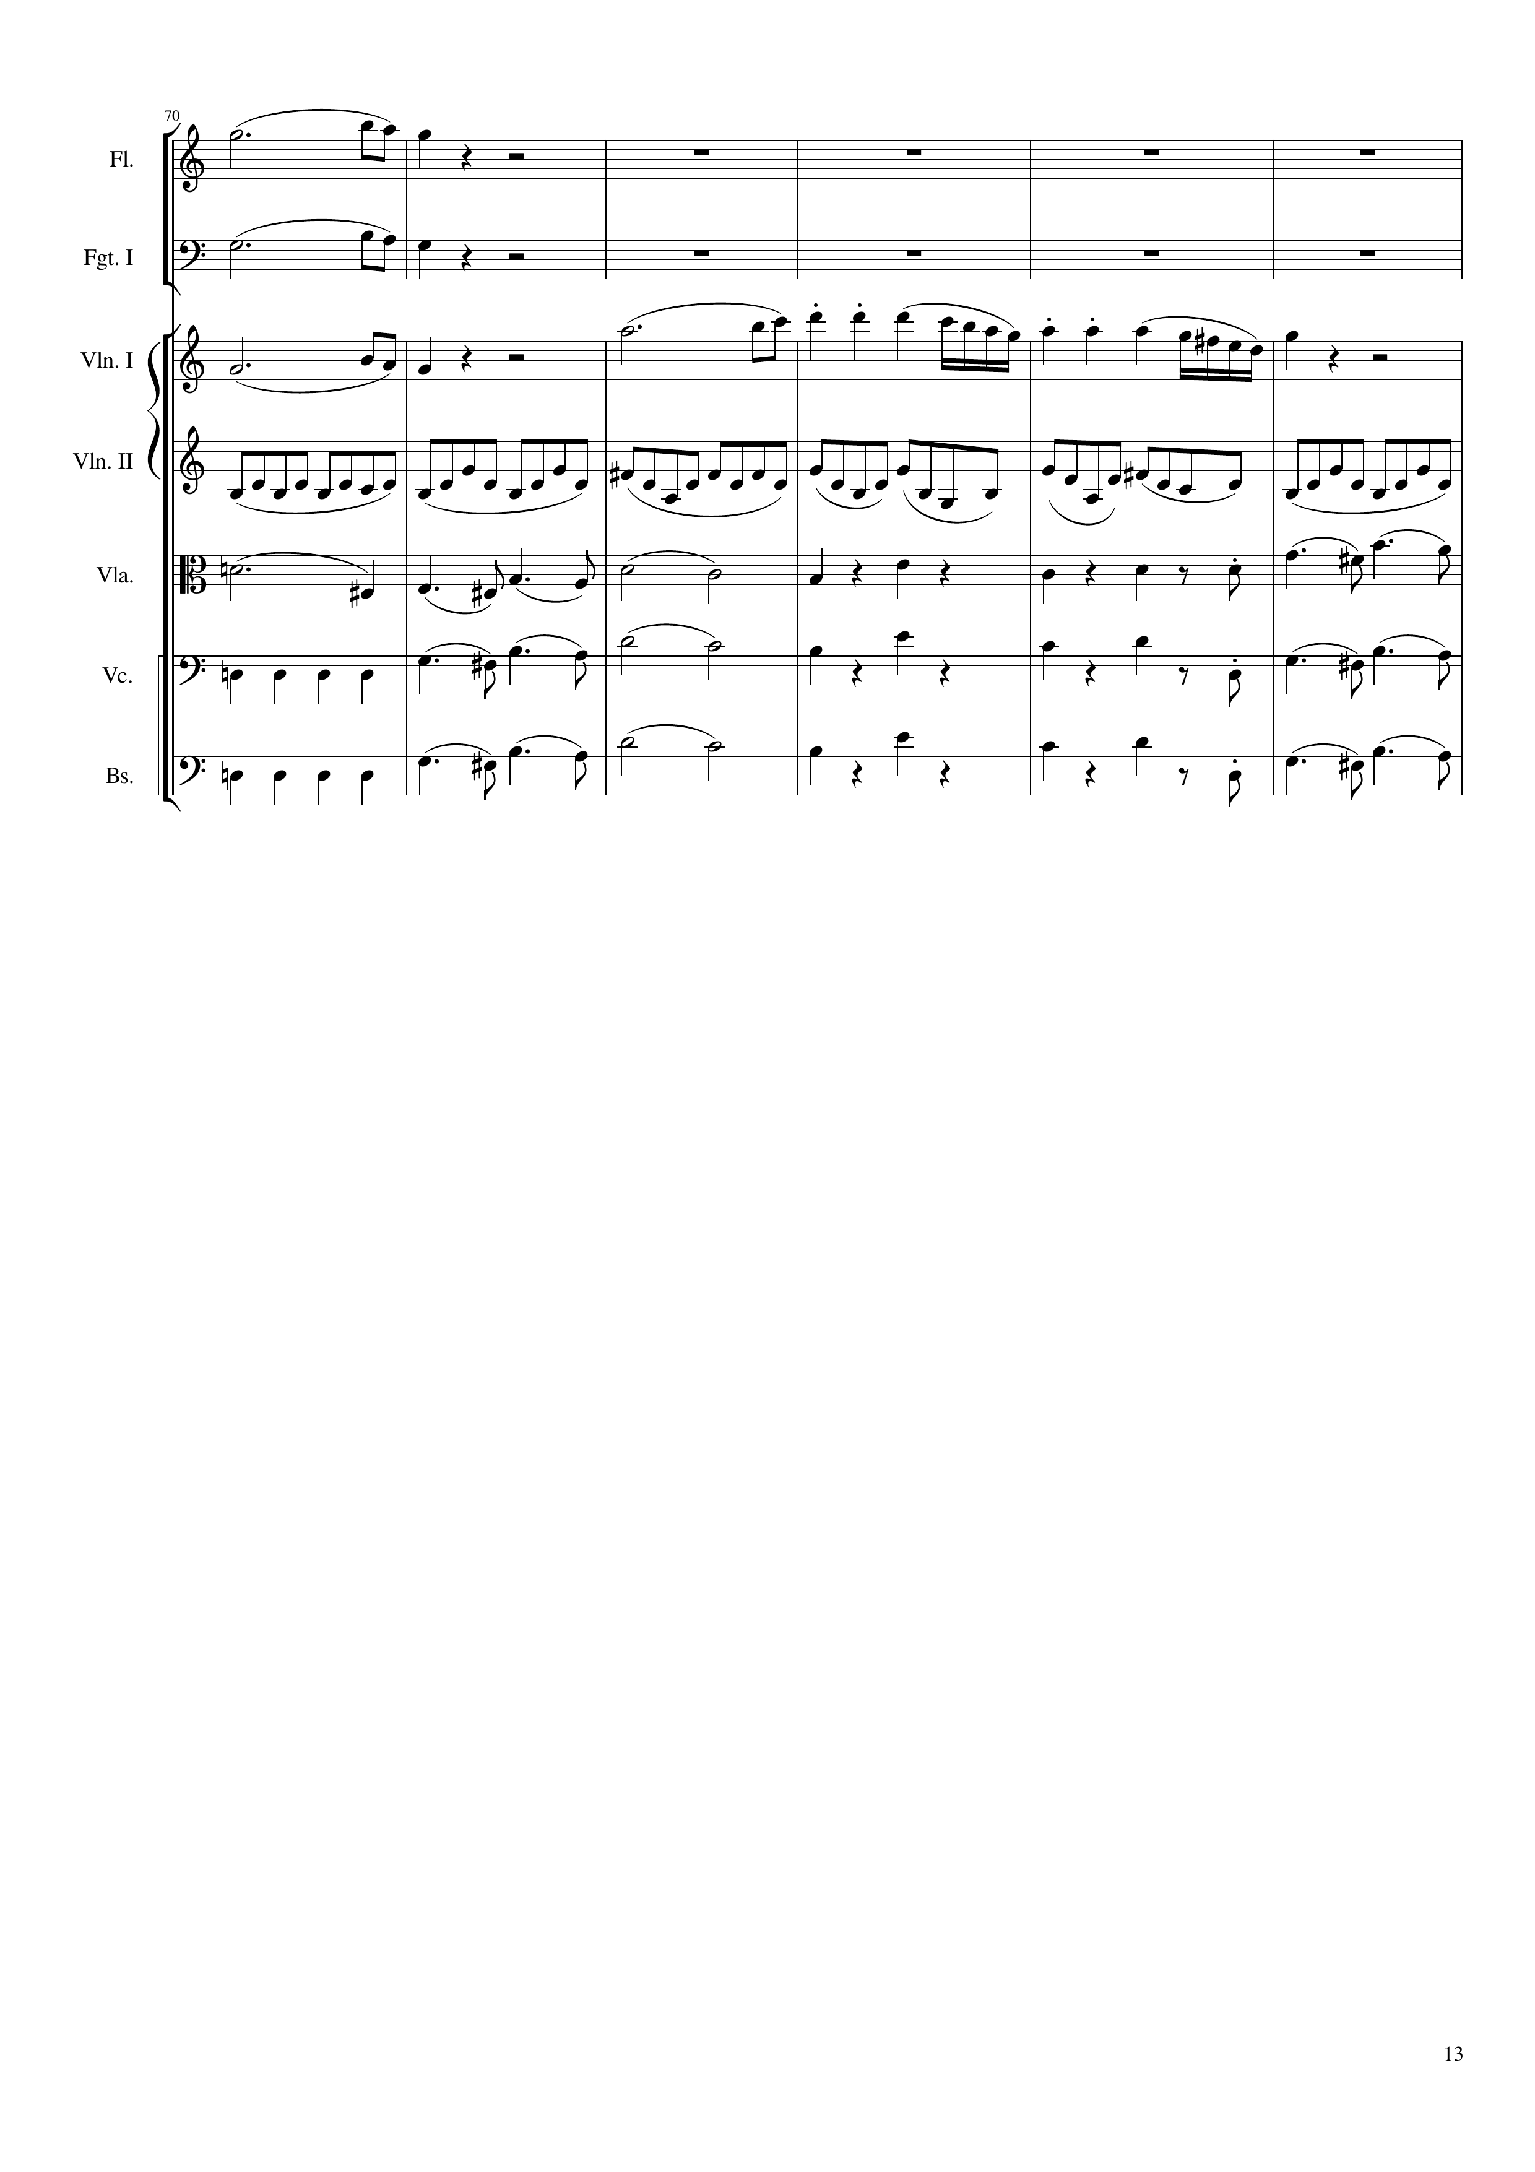
mel
mel
mel
rhythm
rhythm+harm
mel
rhythm+harm
mel
rhythm+harm
mel
rhythm+harm
mel
rhythm+harm
mel
rhythm+harm
mel
276
300

Slide 14
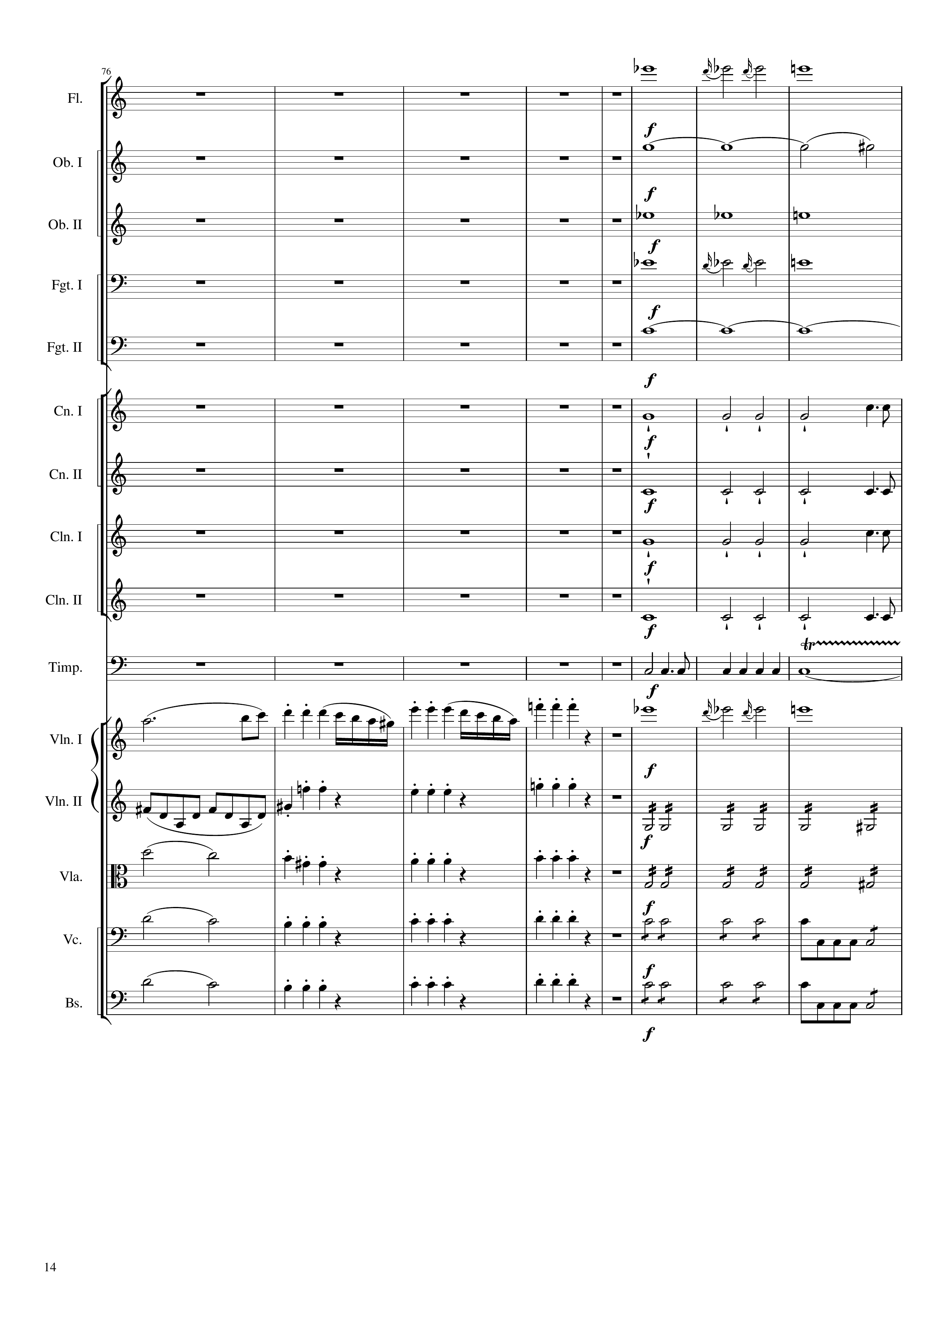
mel
harm
harm
mel
harm
rhythm
rhythm
rhythm
rhythm
rhythm
mel
mel
rhythm
rhythm+harm
rhythm
mel
rhythm+harm
rhythm
mel
rhythm+harm
rhythm
mel
rhythm+harm
rhythm
300
316
332

Slide 15
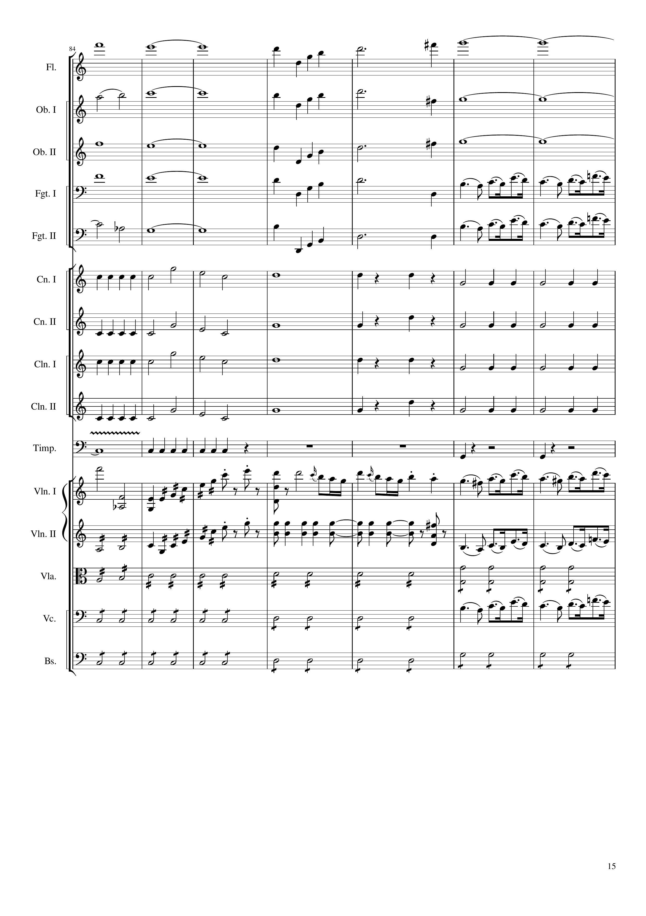
mel
mel
harm
harm
mel
harm
harm
mel
harm
mel
mel
harm
mel
rhythm
mel
rhythm
rhythm
mel
rhythm
rhythm
mel
rhythm
rhythm
mel
rhythm
rhythm
rhythm
mel
rhythm
mel
rhythm
mel
rhythm
rhythm
mel
rhythm
332
344
360
Notes:
3:22

Slide 16
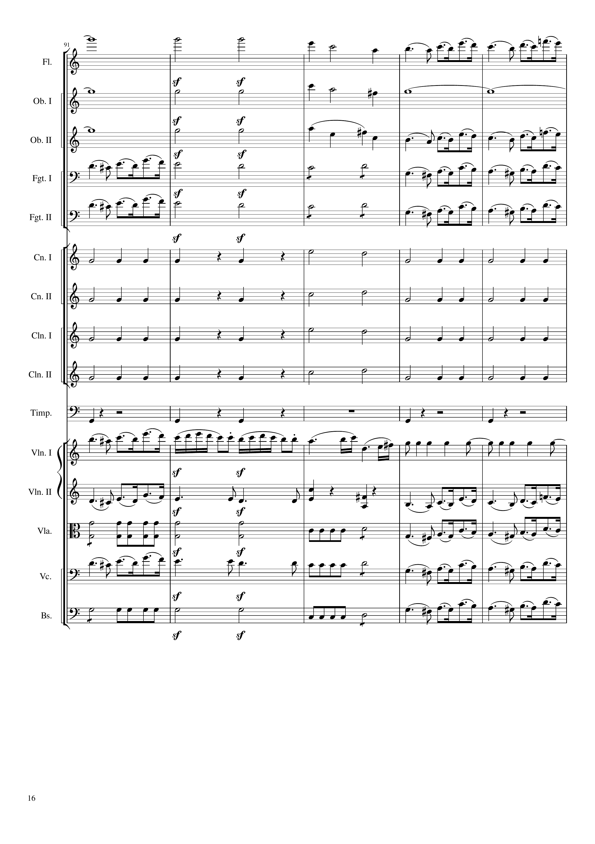
harm
rhythm+harm
mel
harm
rhythm+harm
harm
harm
rhythm+harm
mel
mel
rhythm+harm
mel
mel
rhythm+harm
mel
rhythm
rhythm+harm
rhythm
rhythm
rhythm+harm
rhythm
rhythm
rhythm+harm
rhythm
rhythm
rhythm+harm
rhythm
rhythm
mel
rhythm
mel
rhythm+harm
mel
rhythm
rhythm+harm
mel
mel
rhythm+harm
mel
rhythm
rhythm+harm
mel
360
364
372
380

Slide 17
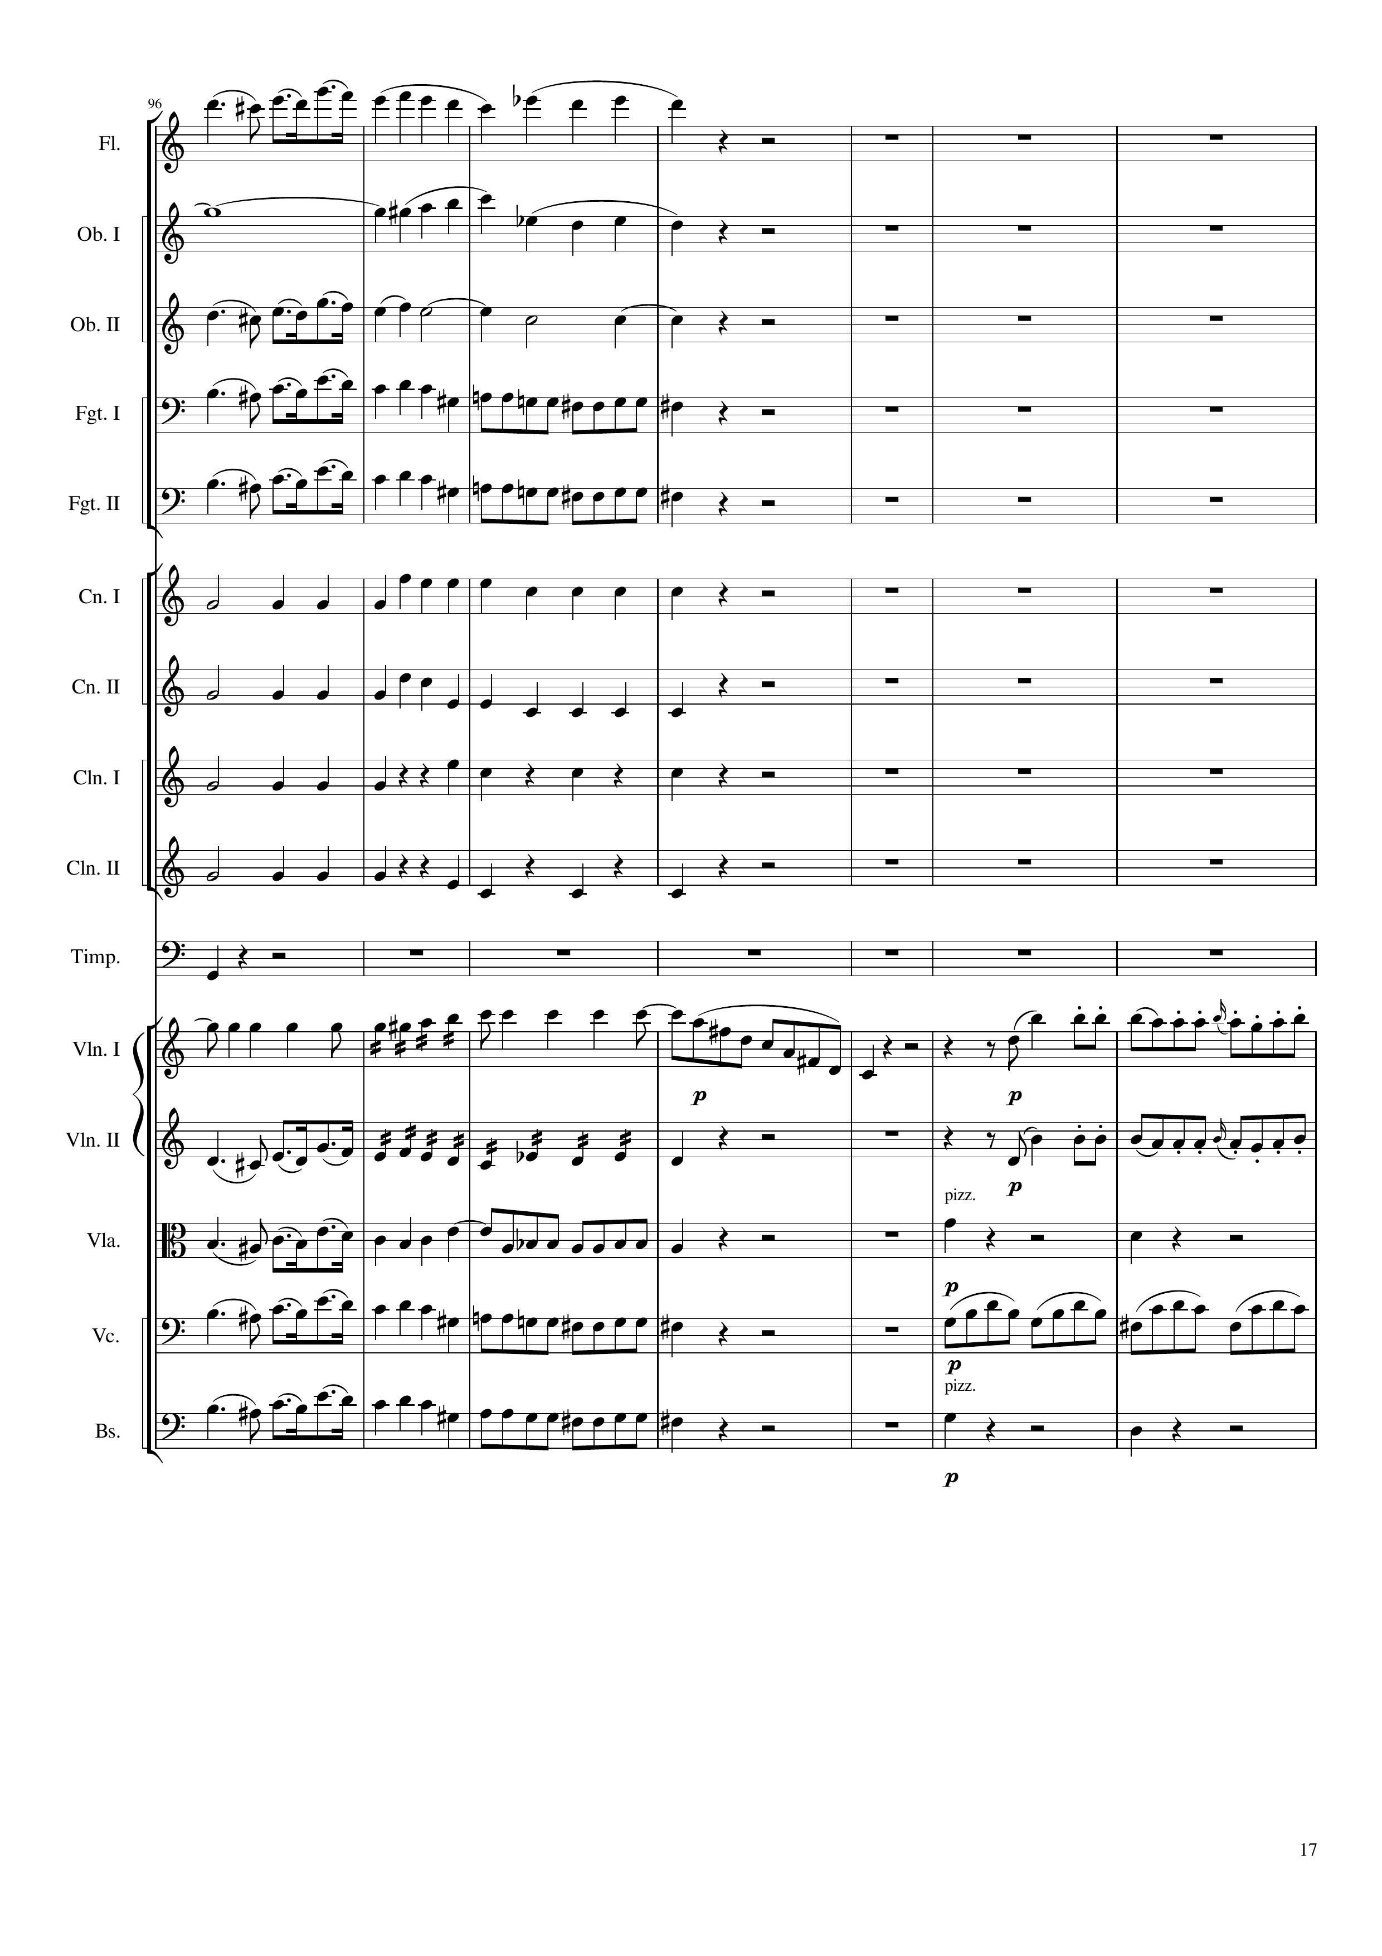
mel
harm
mel
mel
harm
mel
mel+rhythm
mel
mel+rhythm
rhythm
rhythm
rhythm
rhythm
rhythm
rhythm
mel+rhythm
mel
mel
mel+rhythm
mel
mel
mel+rhythm
rhythm+harm
mel
mel+rhythm
rhythm
mel
mel+rhythm
rhythm+harm
380
392
400
408

Slide 18
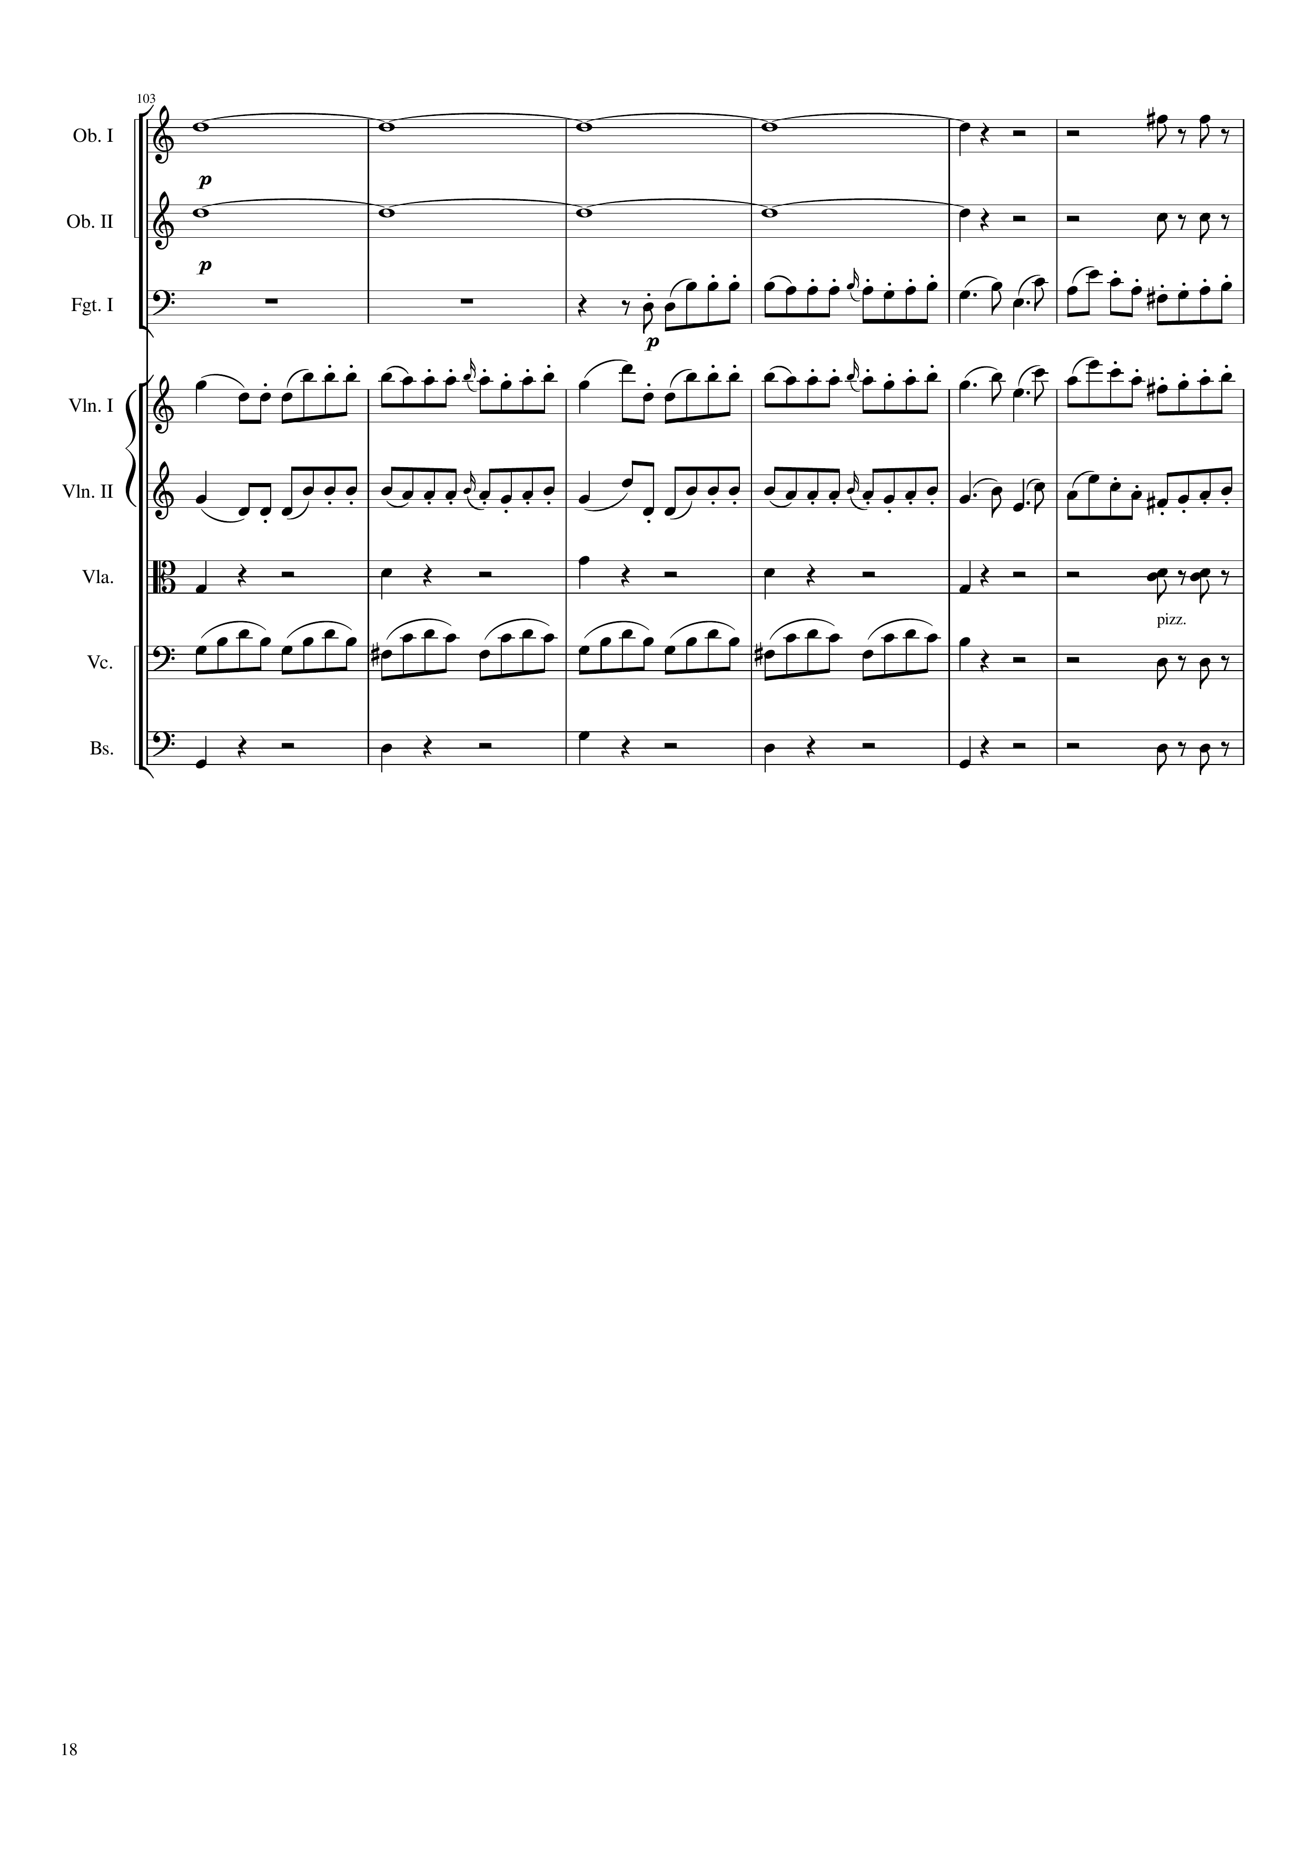
harm
rhythm+harm
harm
rhythm+harm
mel
mel
mel
rhythm+harm
rhythm+harm
rhythm
rhythm+harm
rhythm+harm
rhythm+harm
408
432

Slide 19
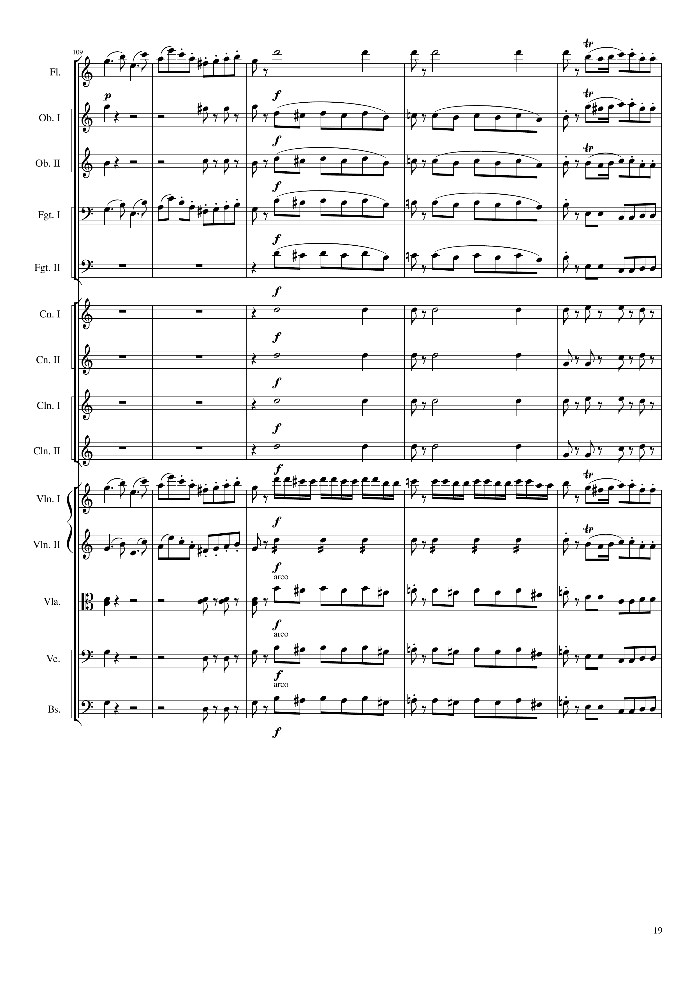
mel
rhythm
mel
rhythm+harm
mel
mel
rhythm+harm
mel
mel
mel
mel
rhythm
mel
rhythm
rhythm
rhythm
rhythm
rhythm
mel
mel+rhythm
mel
mel
rhythm
mel
rhythm+harm
mel
rhythm
rhythm+harm
mel
rhythm
rhythm+harm
mel
rhythm
432
440
452

Slide 20
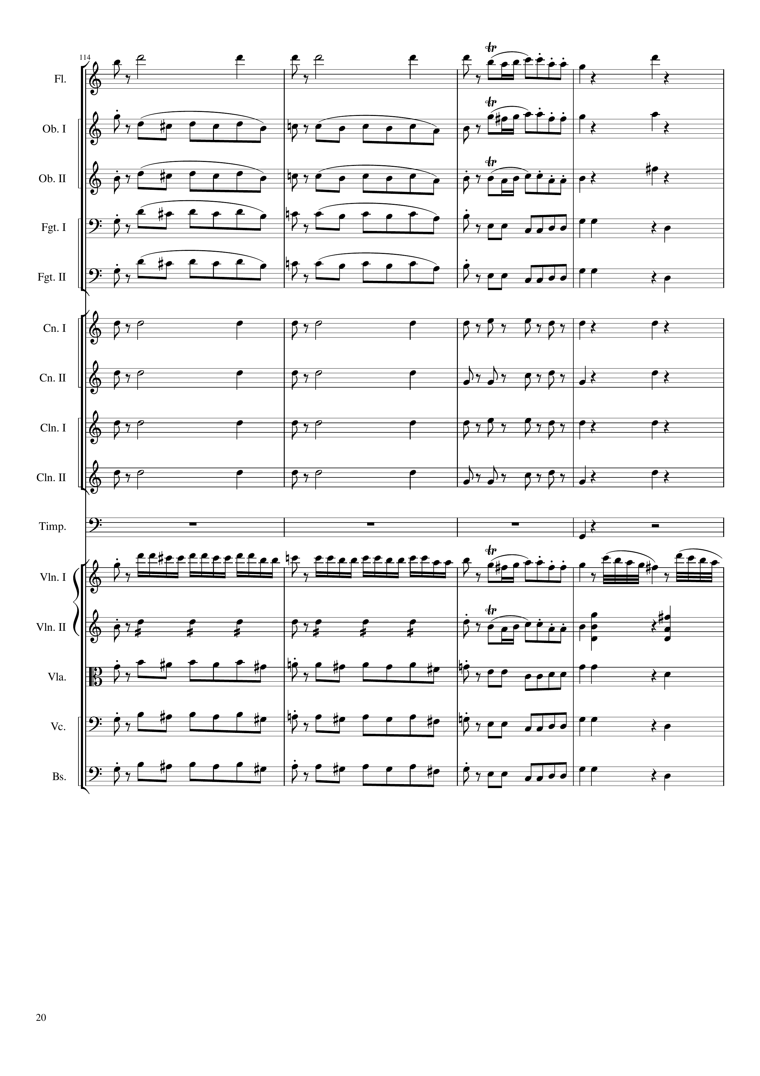
mel
rhythm
mel
rhythm+harm
mel
mel
mel
rhythm+harm
mel
mel
mel
rhythm+harm
rhythm
mel
rhythm
rhythm+harm
rhythm
mel
rhythm
rhythm+harm
rhythm
rhythm+harm
rhythm
rhythm+harm
rhythm
rhythm+harm
rhythm
rhythm+harm
rhythm
mel
mel+rhythm
mel
mel
mel
rhythm
mel
rhythm+harm
rhythm
mel
rhythm
rhythm+harm
rhythm
mel
rhythm
rhythm+harm
rhythm
mel
rhythm
rhythm+harm
452
468

Slide 21
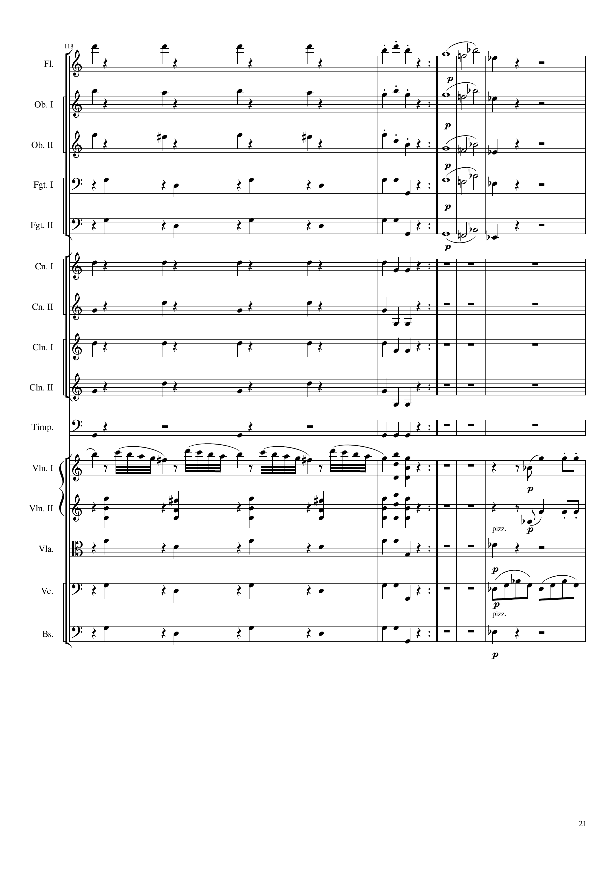
rhythm+harm
mel
rhythm+harm
mel
rhythm+harm
mel
rhythm+harm
mel
rhythm+harm
mel
rhythm+harm
rhythm+harm
rhythm+harm
rhythm+harm
rhythm
mel
mel
rhythm+harm
mel
rhythm+harm
rhythm+harm
rhythm+harm
rhythm
rhythm+harm
rhythm+harm
468
480
972
960
Notes:
4:00
7:38

Slide 22
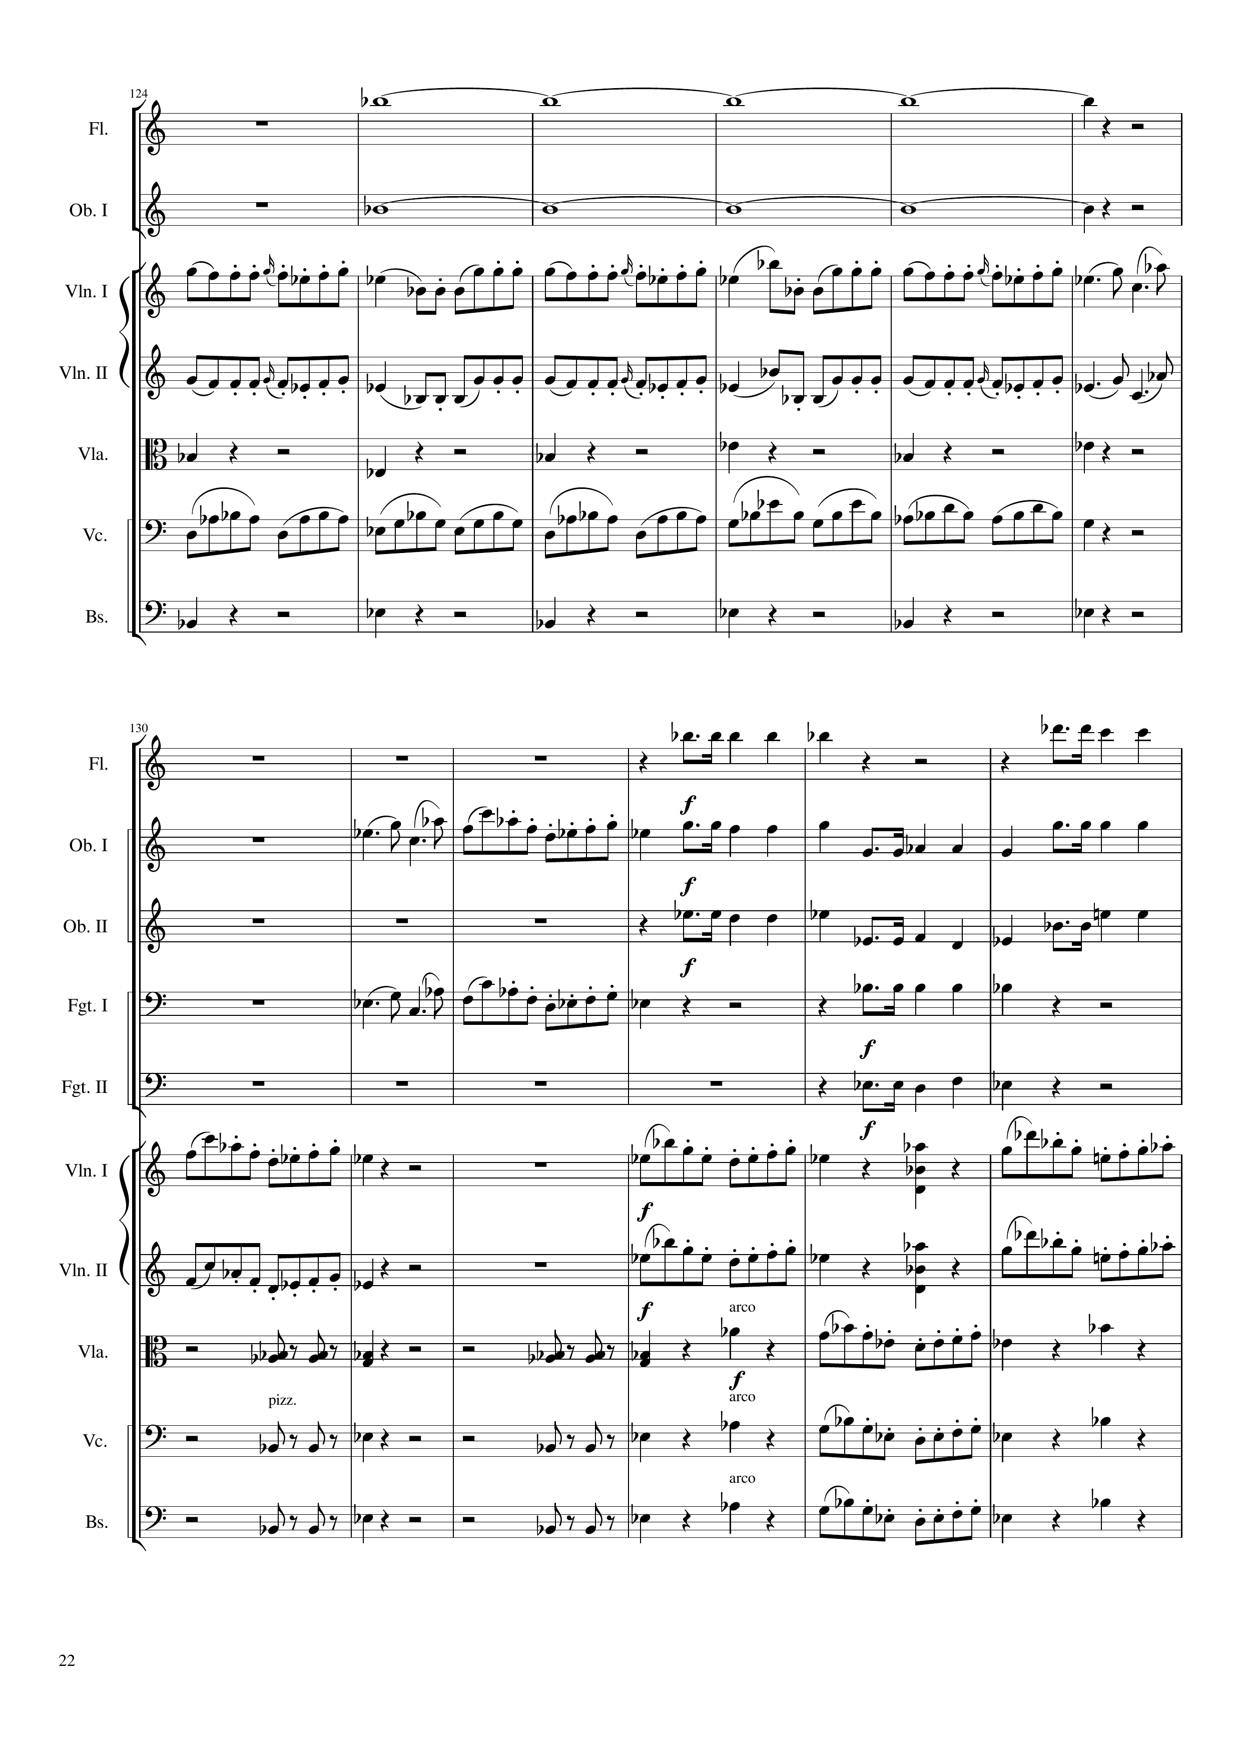
harm
harm
mel
mel
rhythm+harm
rhythm
rhythm+harm
972
996
rhythm
mel
rhythm
rhythm
mel
rhythm
rhythm
mel
mel
mel
mel
rhythm+harm
mel
rhythm+harm
mel
rhythm+harm
mel
996
1008
1020

Slide 23
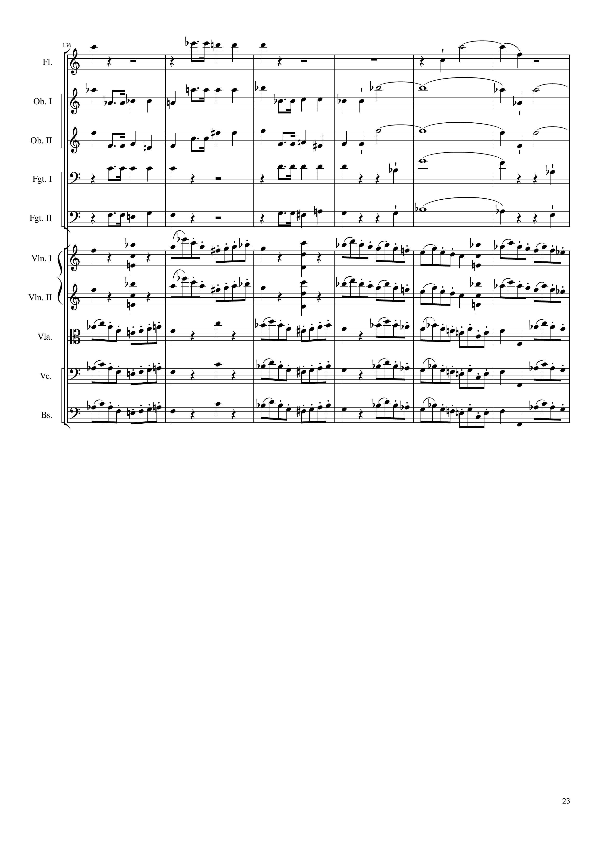
rhythm
harm
rhythm
harm
rhythm
harm
rhythm
harm
rhythm
harm
mel
mel
mel
mel
mel
1020
1032
1044

Slide 24
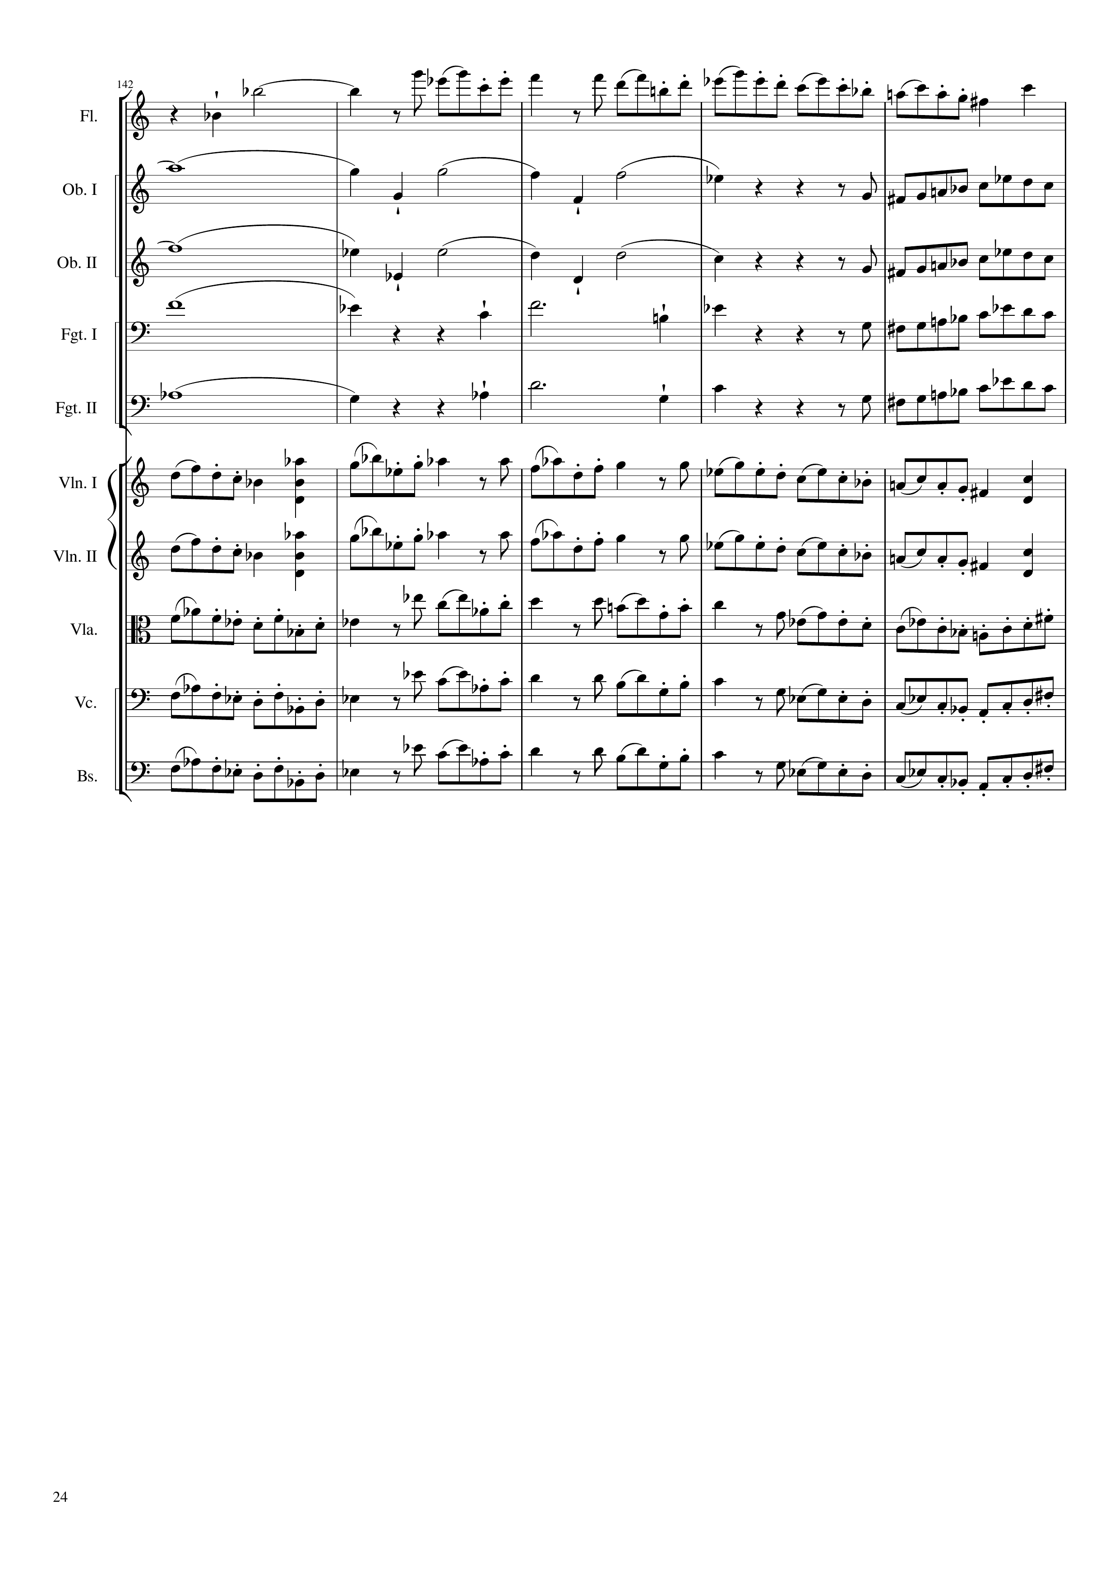
harm
mel
harm
mel
harm
mel
harm
mel
harm
mel
mel
mel
mel
mel
mel
1044
1064

Slide 25
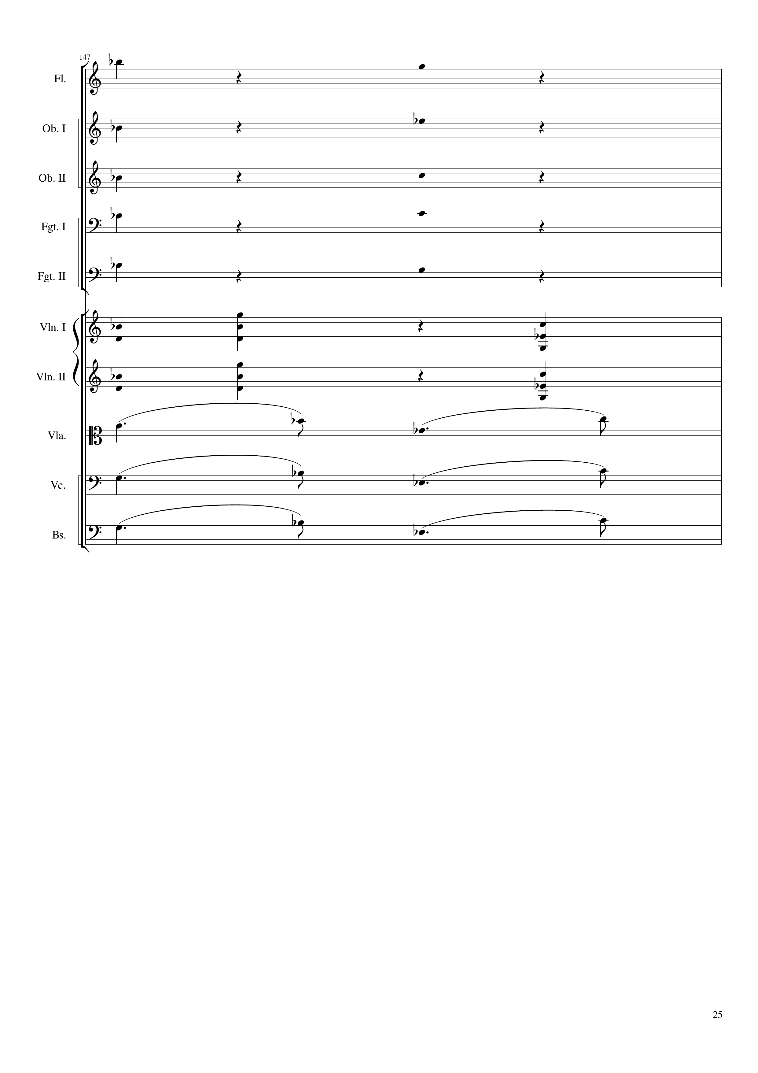
mel
rhythm+harm
mel
rhythm+harm
mel
rhythm+harm
mel
rhythm+harm
mel
rhythm+harm
mel
rhythm+harm
mel
rhythm+harm
mel
mel
mel
1064
1068

Slide 26
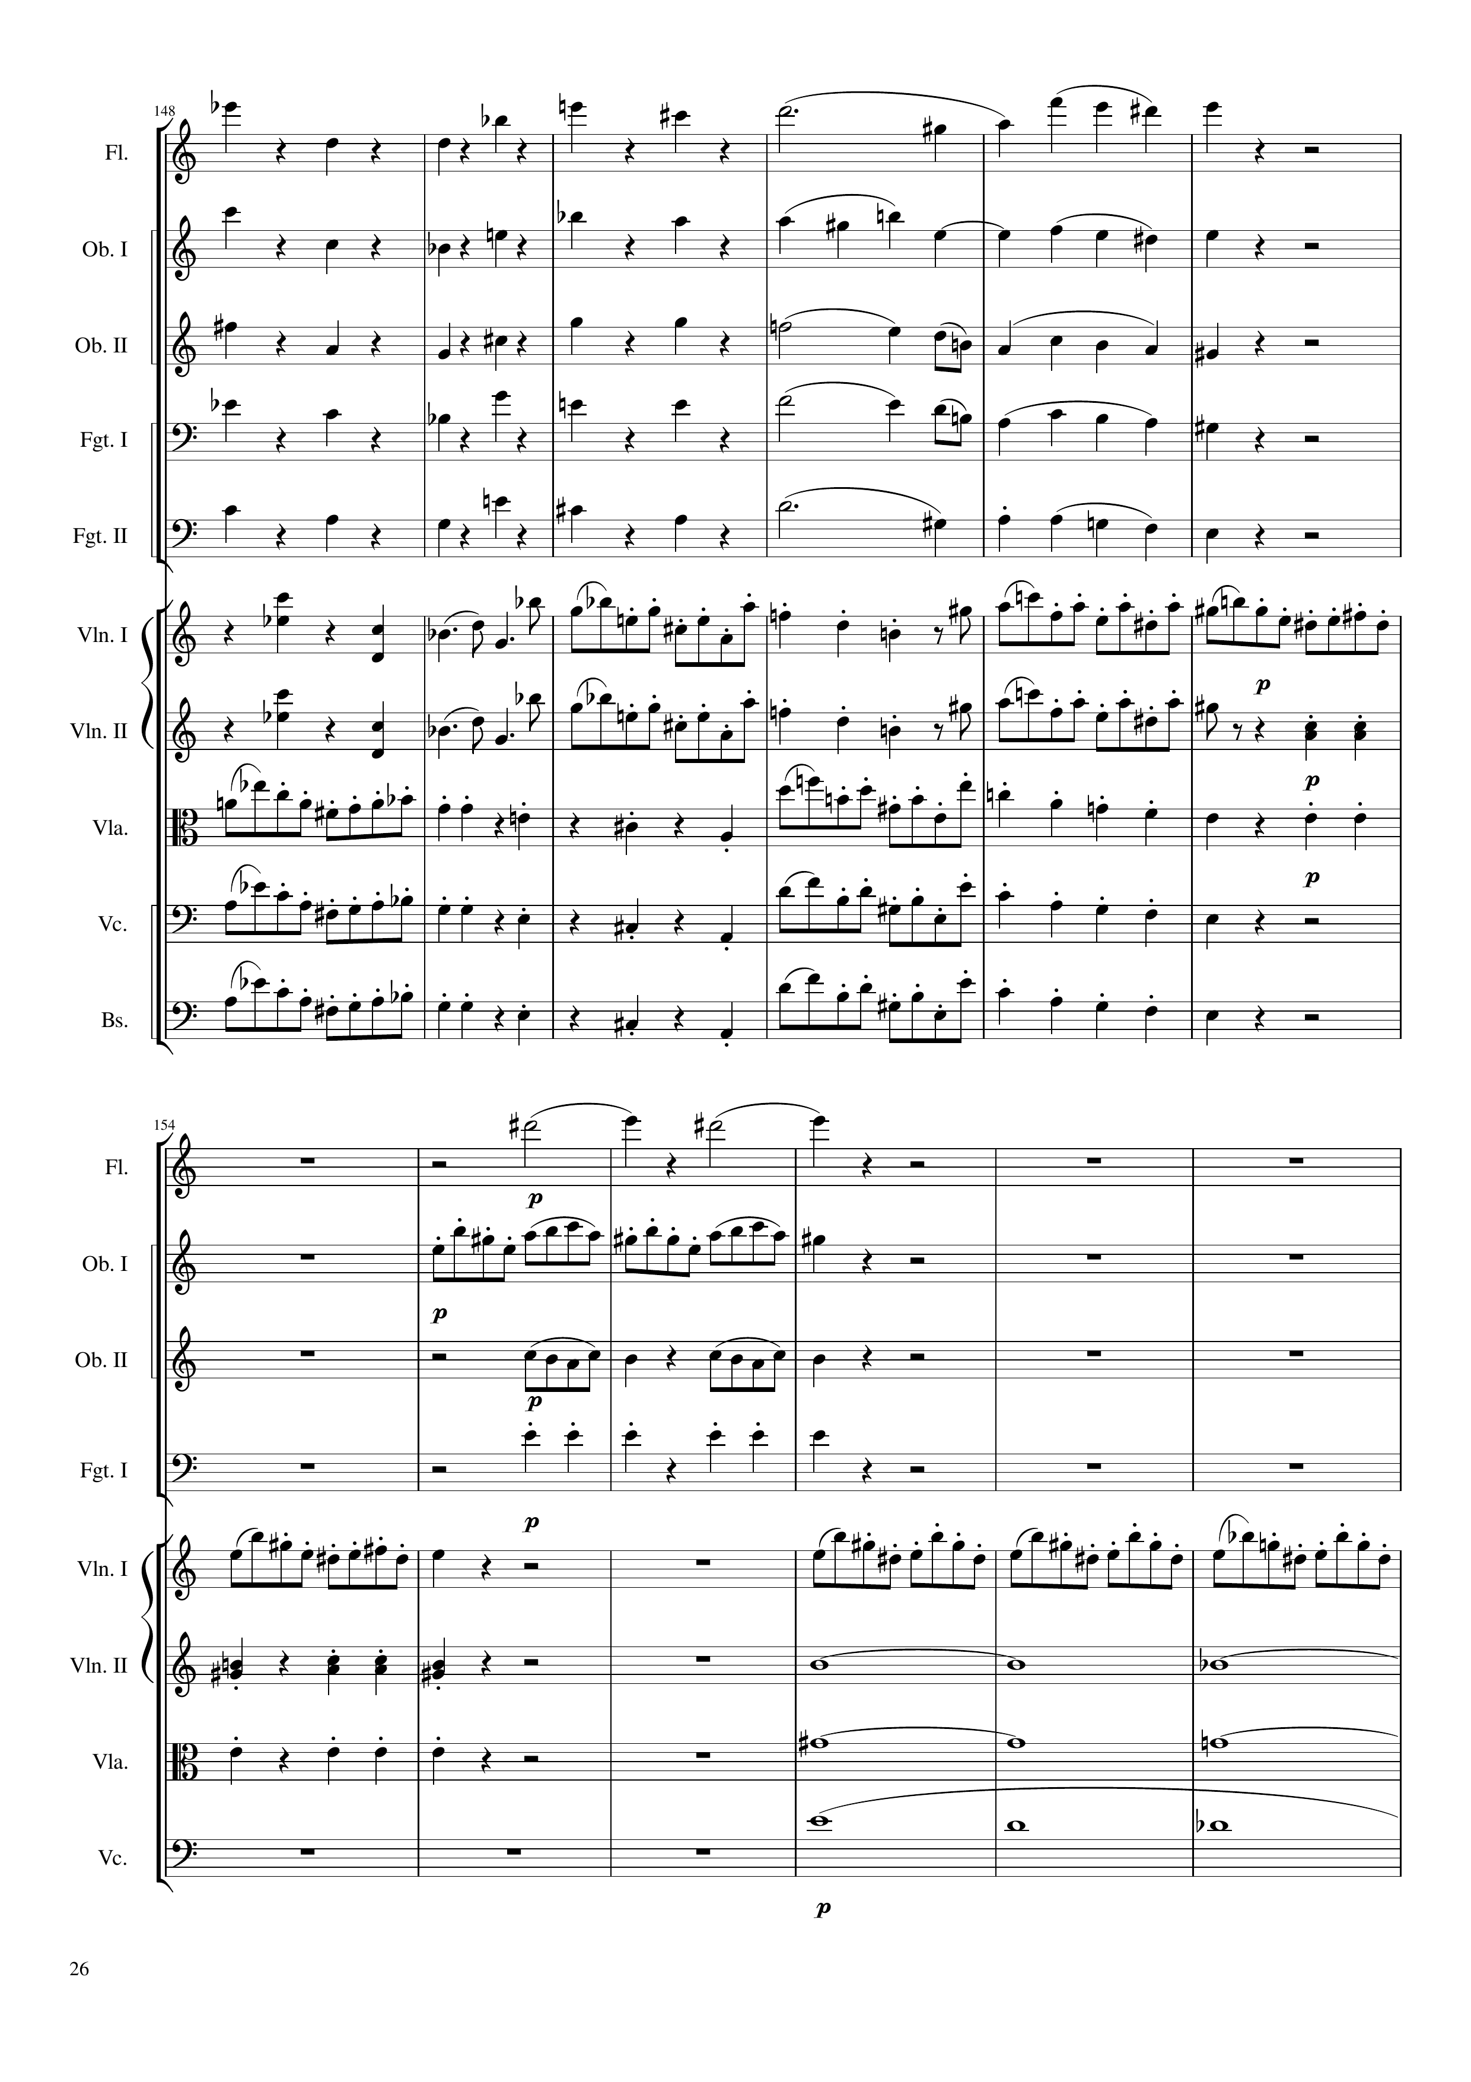
rhythm+harm
rhythm+harm
rhythm+harm
rhythm+harm
rhythm+harm
rhythm+harm
mel
rhythm+harm
mel
rhythm+harm
mel
rhythm+harm
mel
rhythm+harm
mel
rhythm+harm
mel
rhythm+harm
mel
rhythm+harm
mel
rhythm+harm
mel
rhythm+harm
mel
rhythm+harm
1068
1092
rhythm+harm
mel
rhythm
rhythm
mel
mel
rhythm+harm
harm
rhythm+harm
harm
harm
1092
1116

Slide 27
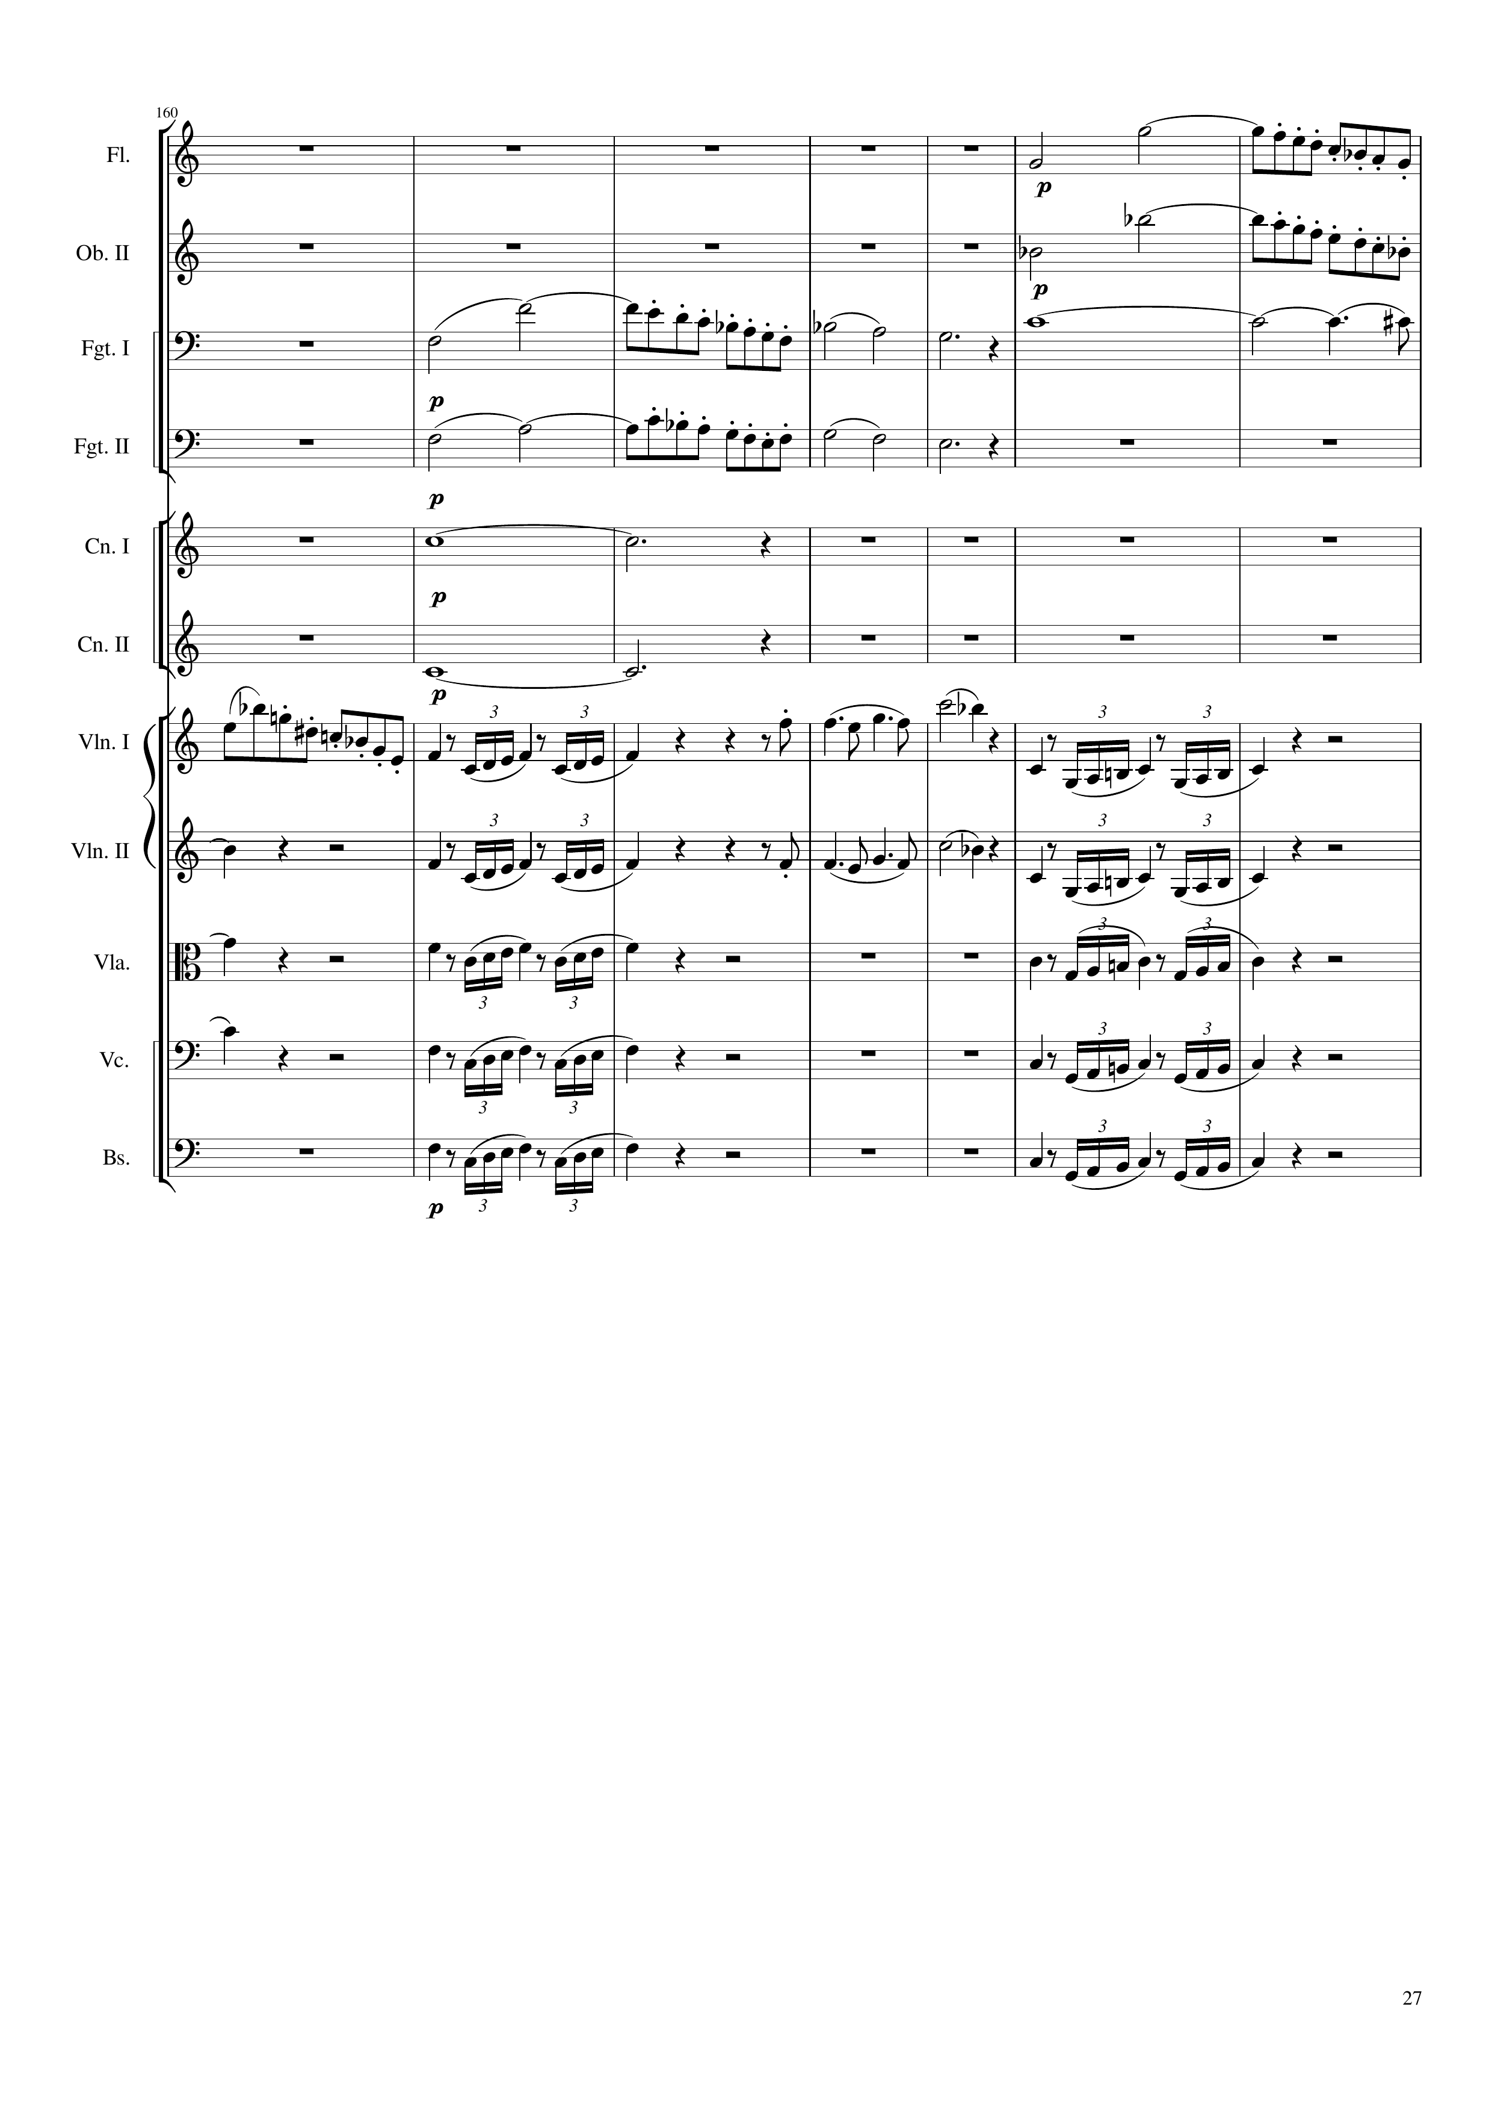
mel
mel
mel
harm
mel
harm
harm
mel
mel
mel
mel
harm
mel
mel
mel
harm
mel
mel
harm
mel
mel
mel
mel
1116
1144
Notes:
8:46

Slide 28
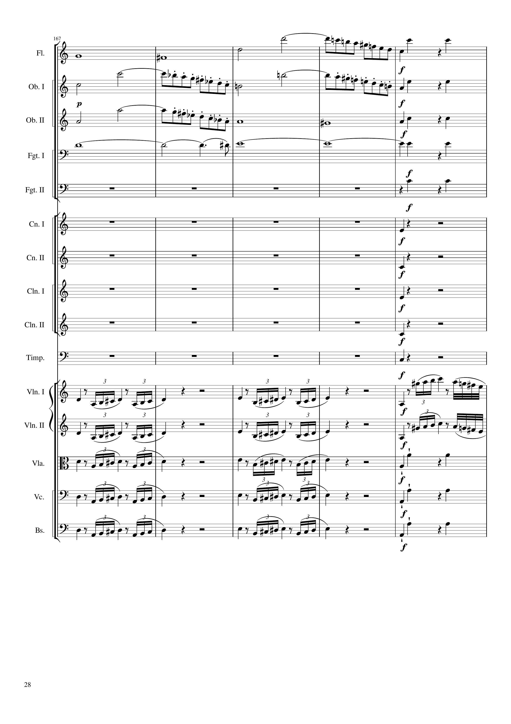
harm
mel
rhythm+harm
mel
mel
rhythm+harm
mel
harm
rhythm+harm
harm
rhythm+harm
rhythm+harm
rhythm+harm
rhythm+harm
rhythm+harm
rhythm+harm
rhythm+harm
mel
mel
mel
mel
mel
rhythm+harm
mel
rhythm+harm
mel
rhythm+harm
1144
1164

Slide 29
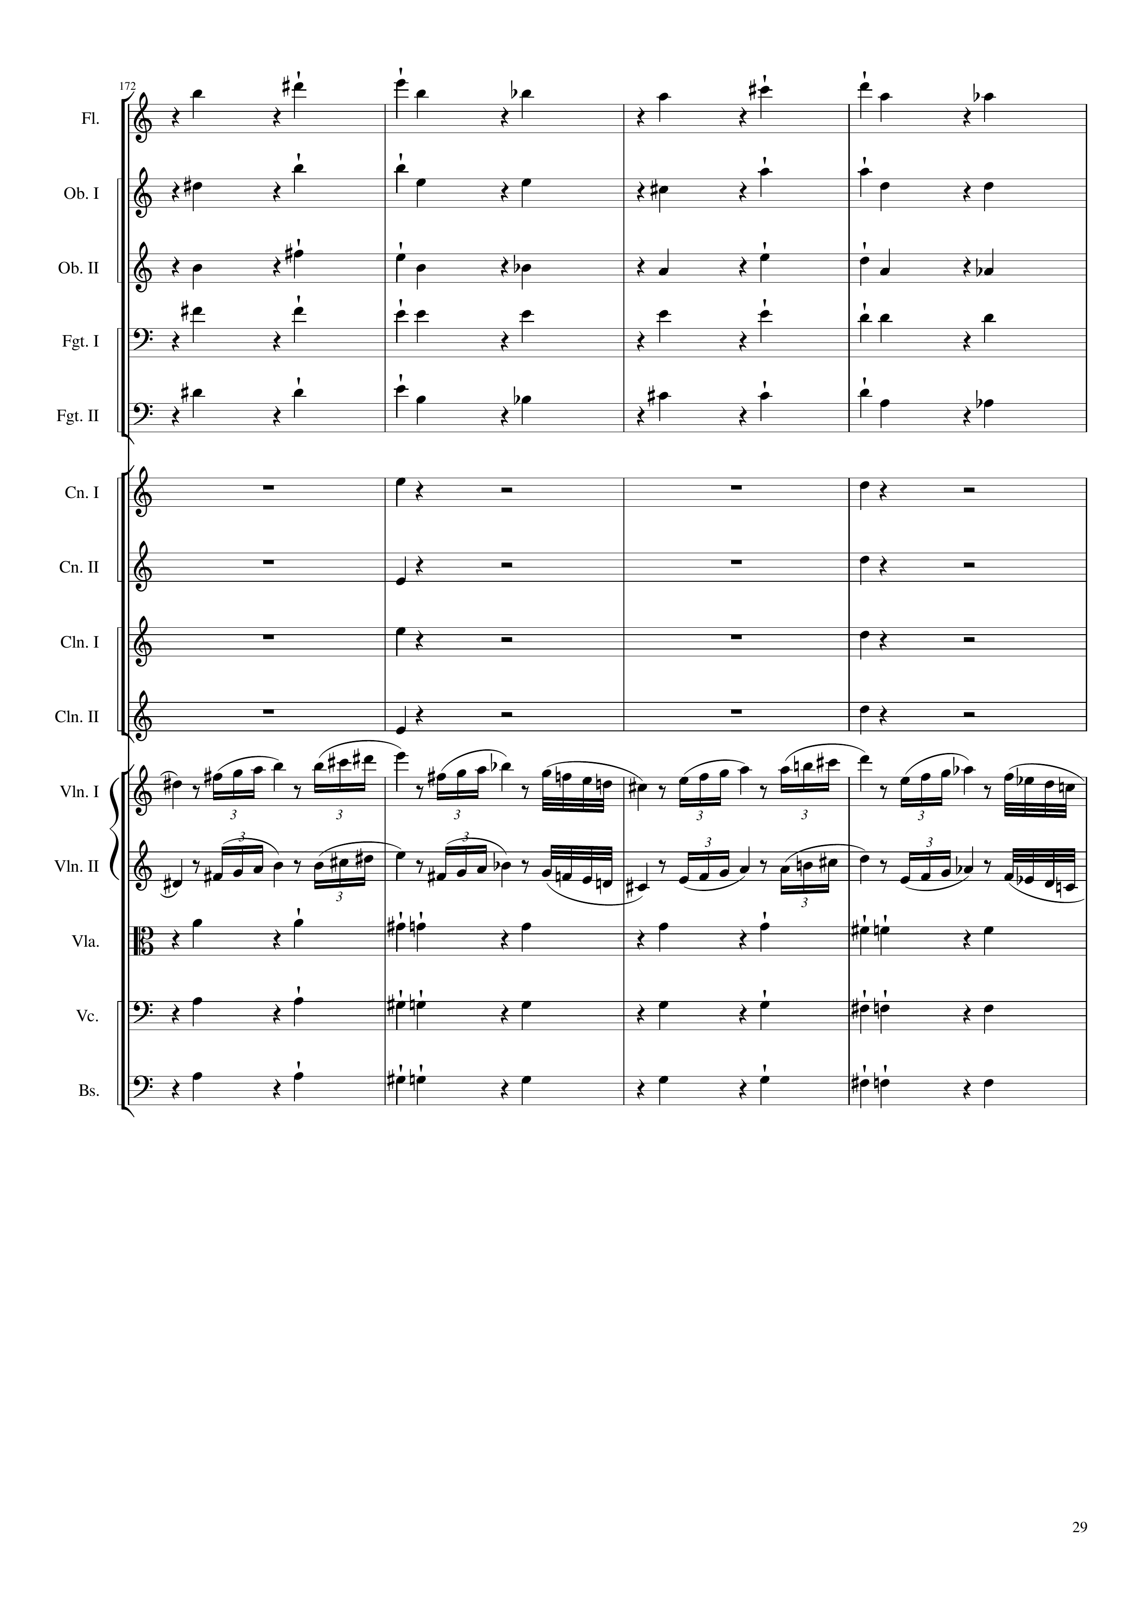
rhythm+harm
rhythm+harm
rhythm+harm
rhythm+harm
rhythm+harm
rhythm+harm
rhythm+harm
rhythm+harm
rhythm+harm
mel
mel
rhythm+harm
rhythm+harm
rhythm+harm
1164
1180

Slide 30
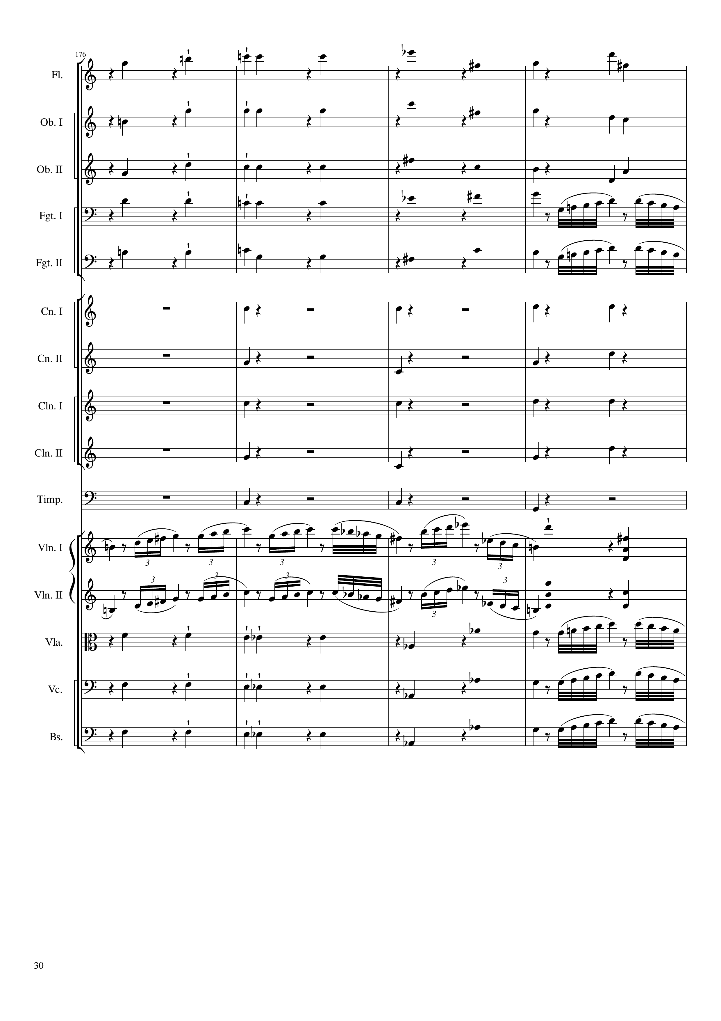
rhythm+harm
rhythm+harm
rhythm+harm
rhythm+harm
mel
rhythm+harm
mel
rhythm+harm
rhythm+harm
rhythm+harm
rhythm+harm
rhythm+harm
mel
mel+rhythm+harm
mel
mel+rhythm+harm
rhythm+harm
mel
rhythm+harm
mel
rhythm+harm
mel
1180
1196

Slide 31
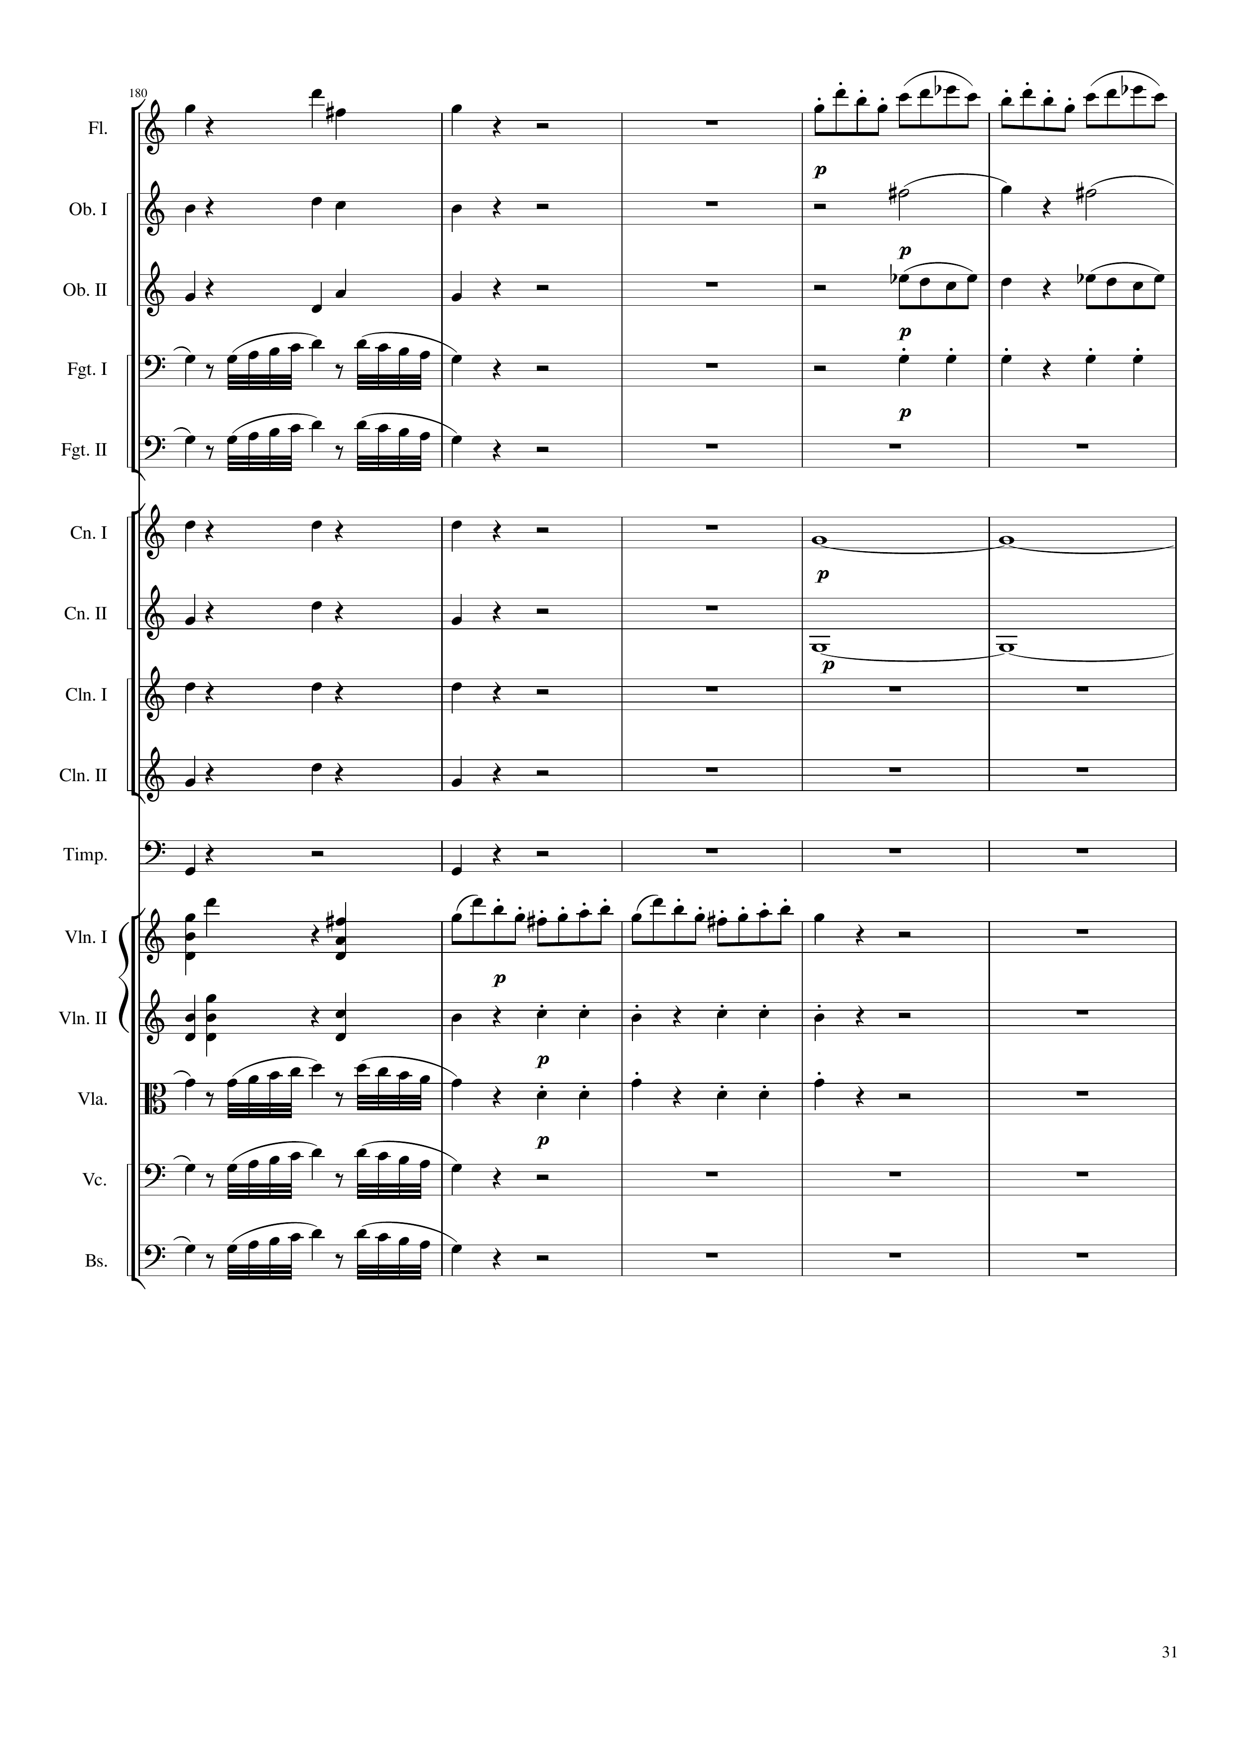
rhythm+harm
mel
rhythm+harm
rhythm+harm
rhythm+harm
rhythm
mel
rhythm
mel
rhythm+harm
harm
rhythm+harm
harm
rhythm+harm
rhythm+harm
rhythm+harm
mel+rhythm+harm
mel
mel+rhythm+harm
rhythm
mel
rhythm
mel
mel
1196
1216

Slide 32
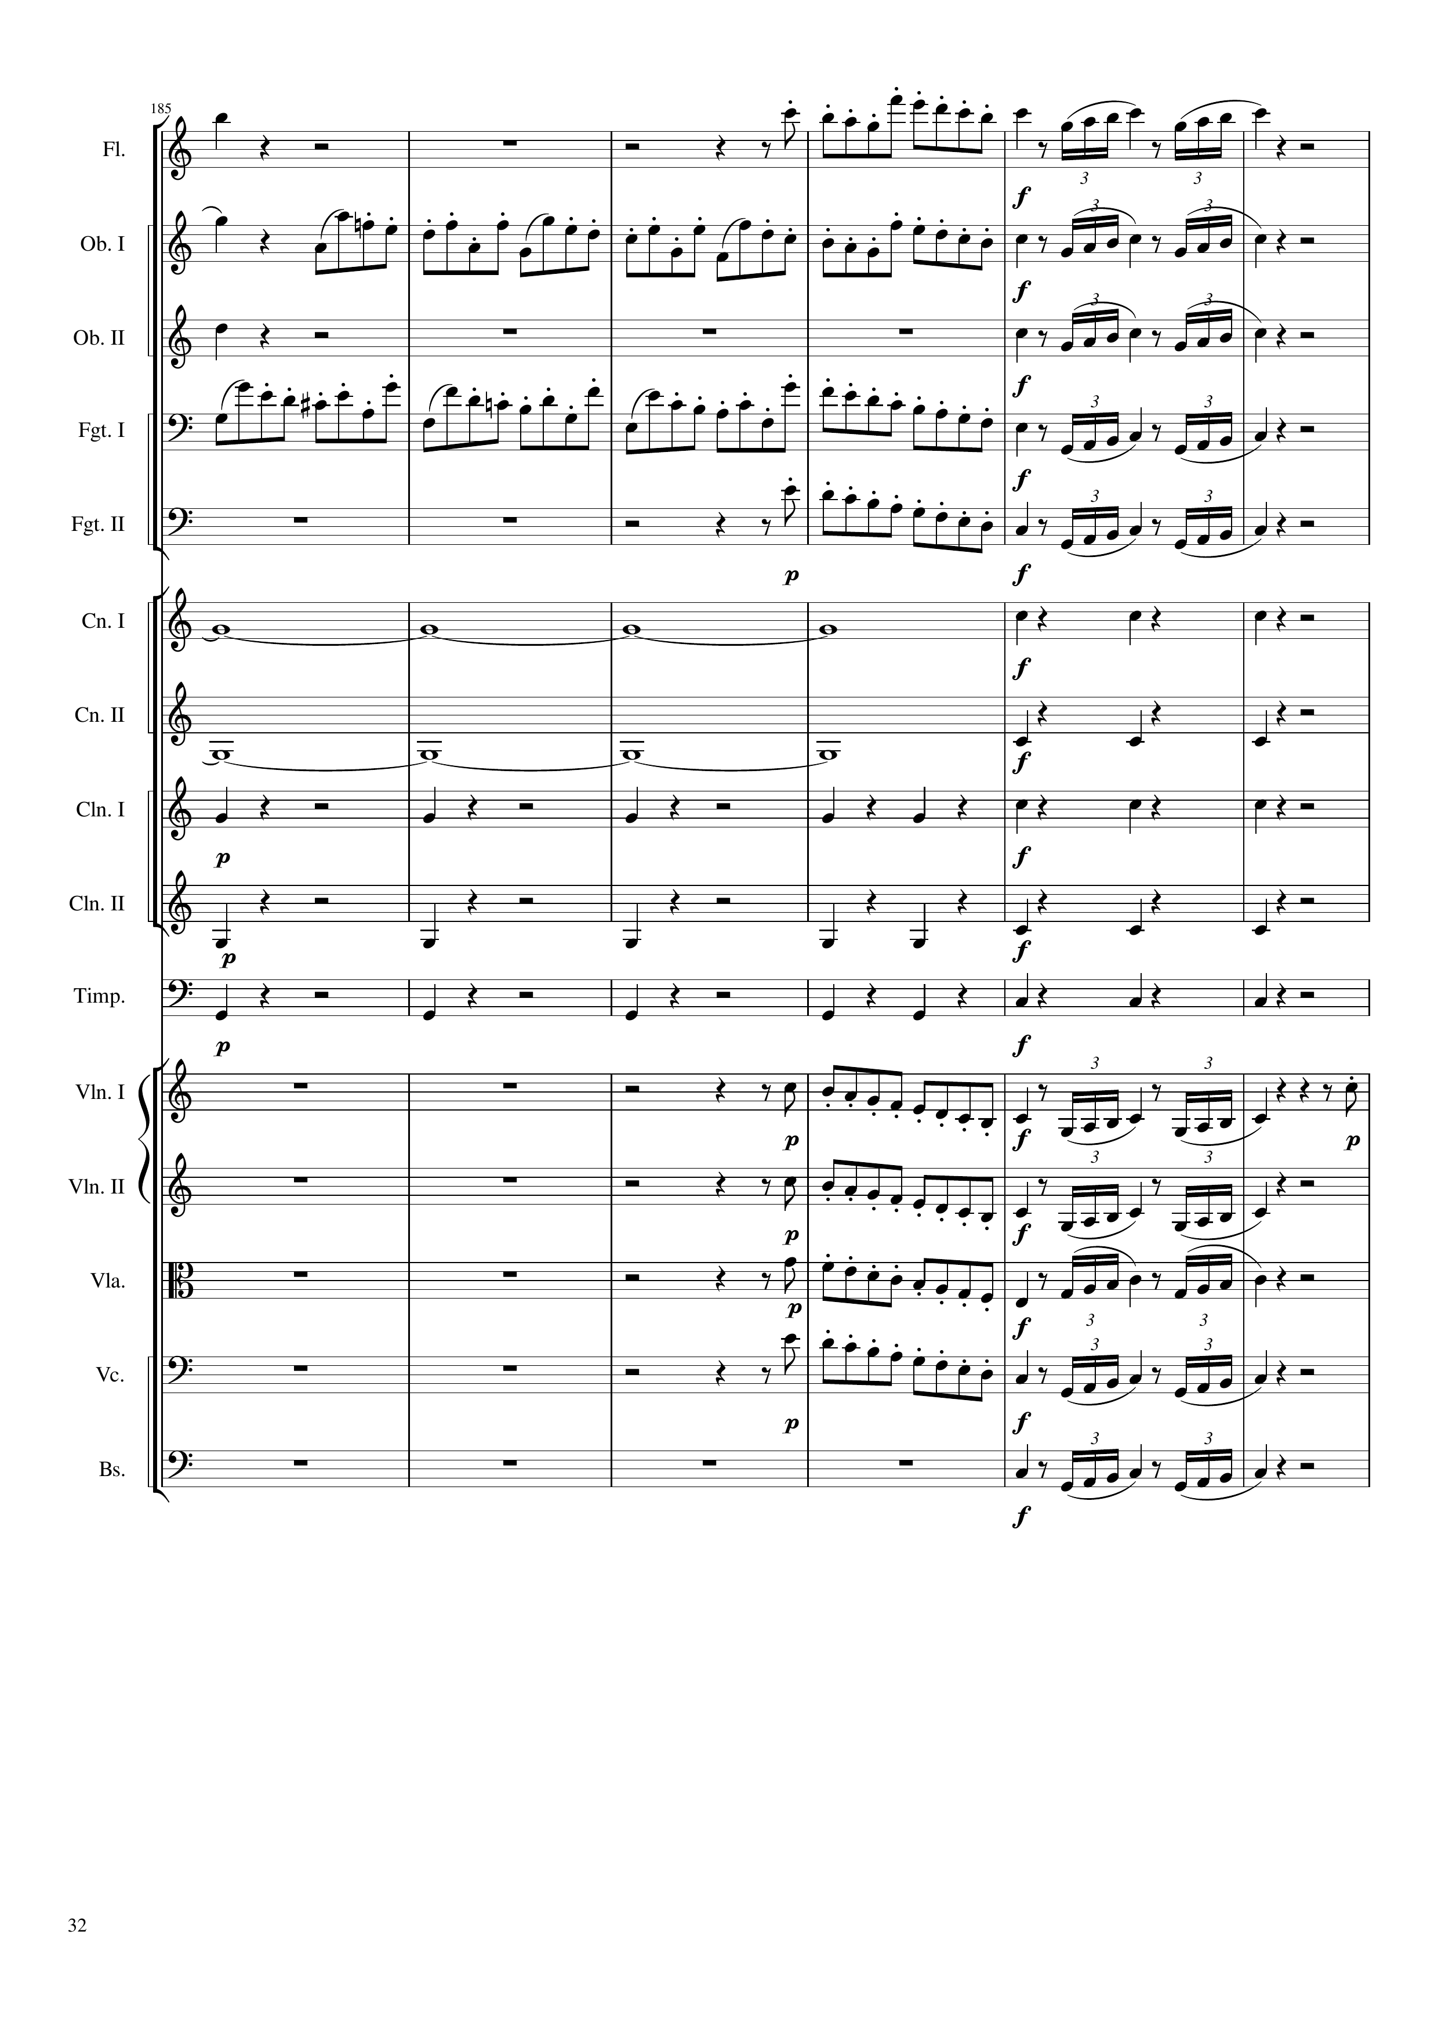
mel
mel
mel
rhythm+harm
mel
mel
rhythm
mel
mel
mel
mel
mel
harm
rhythm+harm
harm
rhythm+harm
rhythm+harm
rhythm+harm
rhythm+harm
rhythm+harm
rhythm+harm
rhythm+harm
mel
mel
mel
mel
mel
mel
mel
mel
mel
1216
1240
Notes:
9:33

Slide 33
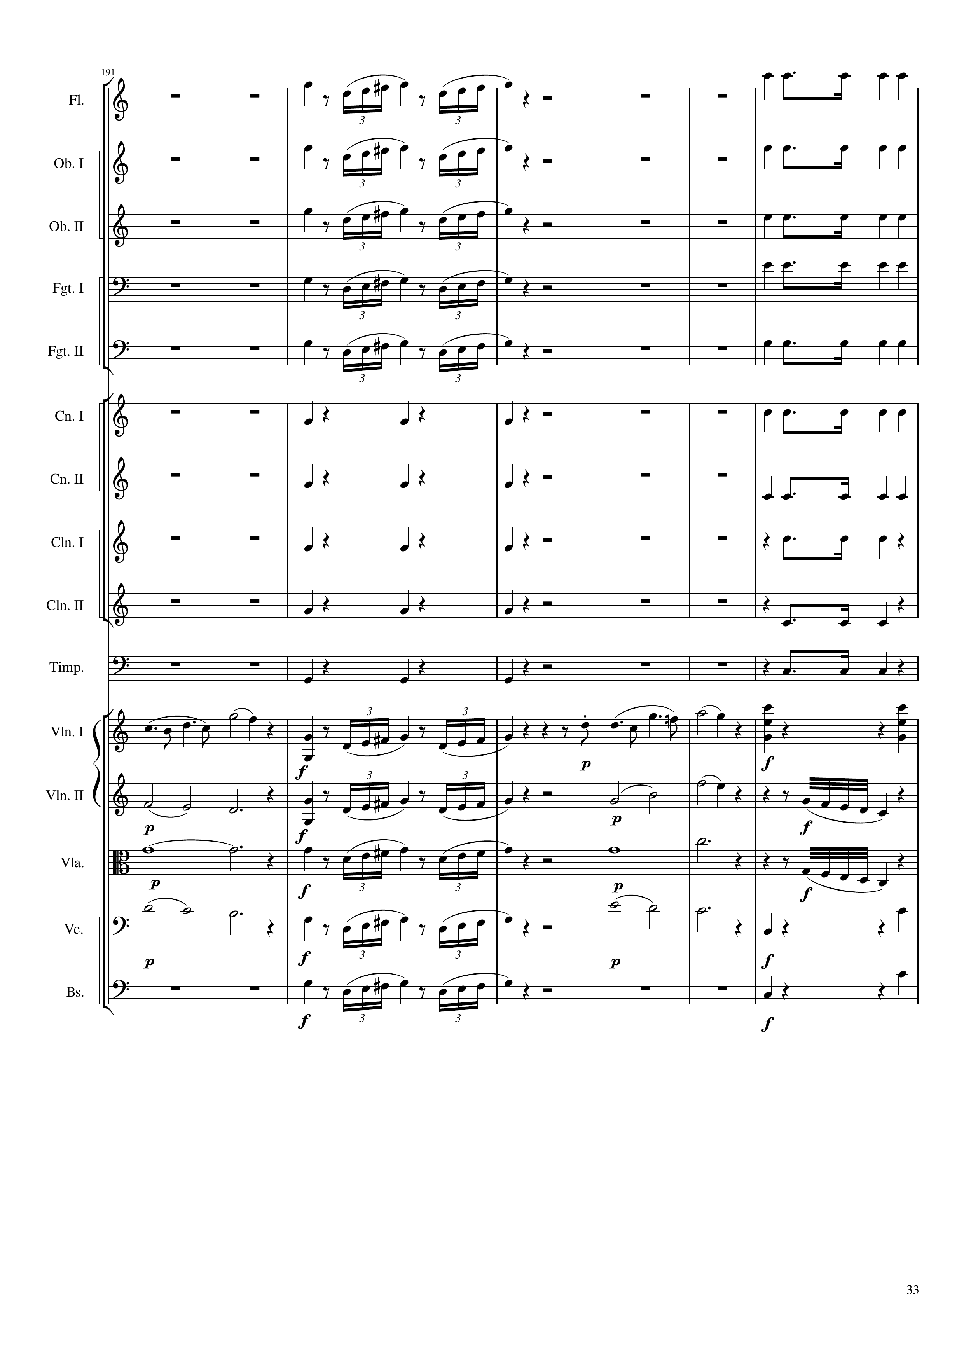
mel
rhythm+harm
mel
rhythm+harm
mel
rhythm+harm
mel
rhythm+harm
mel
v
rhythm+harm
rhythm+harm
rhythm+harm
rhythm+harm
rhythm+harm
rhythm+harm
rhythm+harm
rhythm+harm
rhythm+harm
rhythm+harm
rhythm
mel
mel+rhythm+harm
harm
mel
harm
mel
harm
mel
harm
mel
harm
mel
harm
rhythm
mel
rhythm
1240
1268

Slide 34
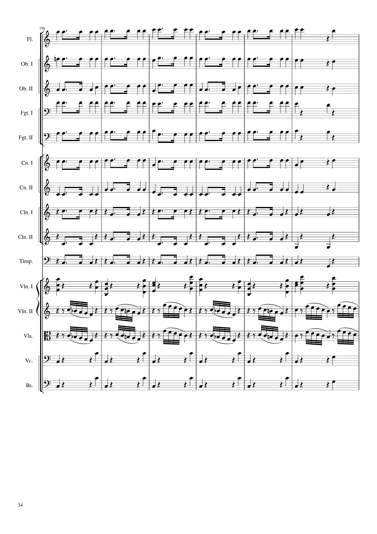
rhythm+harm
rhythm+harm
rhythm+harm
rhythm+harm
rhythm+harm
rhythm+harm
rhythm+harm
rhythm+harm
rhythm+harm
rhythm
rhythm+harm
mel+rhythm+harm
mel
mel
rhythm
rhythm+harm
rhythm
rhythm+harm
1268
1292

Slide 35
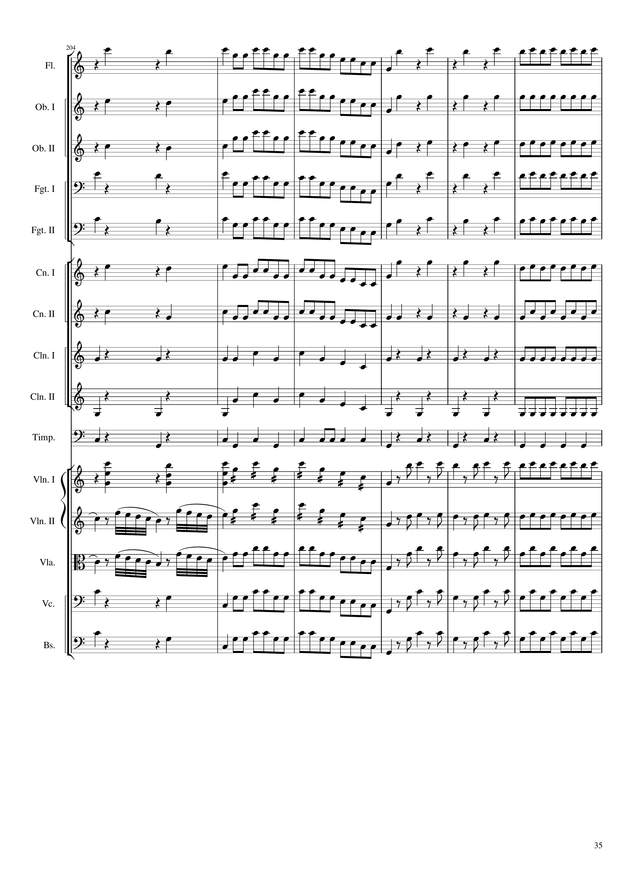
rhythm+harm
mel+rhythm
rhythm+harm
mel
rhythm+harm
mel+rhythm
rhythm+harm
rhythm
rhythm+harm
mel+rhythm
rhythm+harm
mel
rhythm+harm
mel+rhythm
rhythm+harm
mel
rhythm+harm
mel+rhythm
rhythm+harm
mel
rhythm+harm
mel+rhythm
rhythm+harm
mel
rhythm+harm
mel+rhythm
rhythm+harm
mel
rhythm+harm
mel
rhythm+harm
rhythm
rhythm+harm
mel
rhythm+harm
rhythm
rhythm+harm
rhythm
rhythm+harm
rhythm
mel+rhythm+harm
mel+rhythm
mel
mel
mel+rhythm
mel
mel
mel+rhythm
mel
rhythm+harm
mel+rhythm
mel
rhythm+harm
mel+rhythm
mel
1292
1316

Slide 36
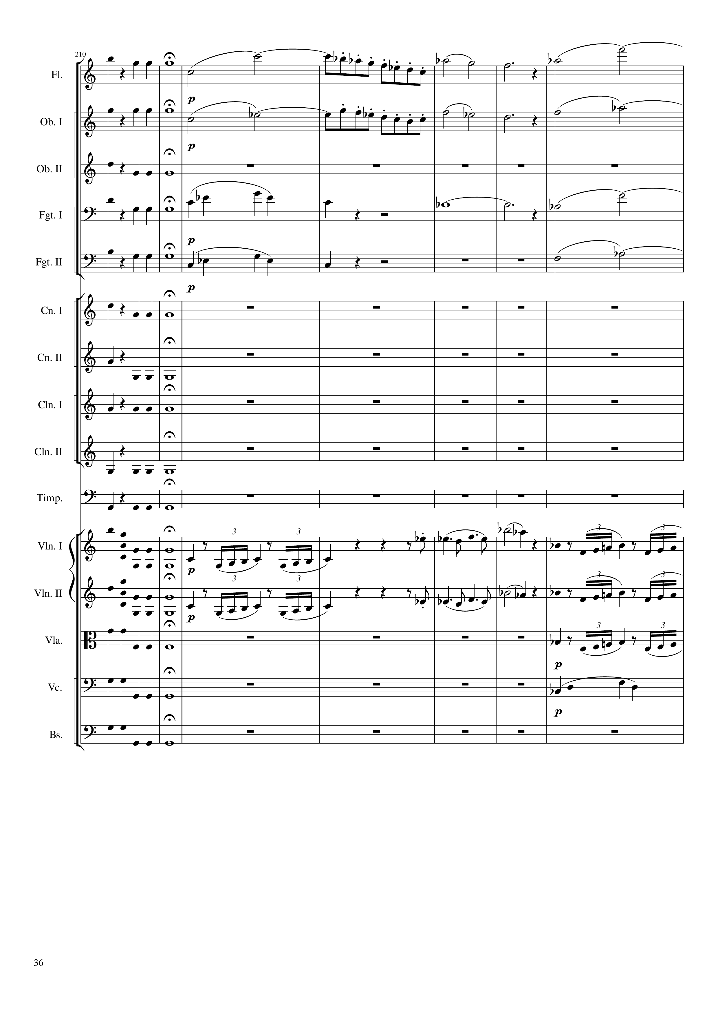
mel
mel
rhythm
mel
mel
mel
rhythm
harm
mel
mel
rhythm
mel
mel
mel
rhythm
rhythm
rhythm
mel
mel
mel
mel
mel
mel
mel
rhythm
mel
1316
1324
1344
Notes:
10:16

Slide 37
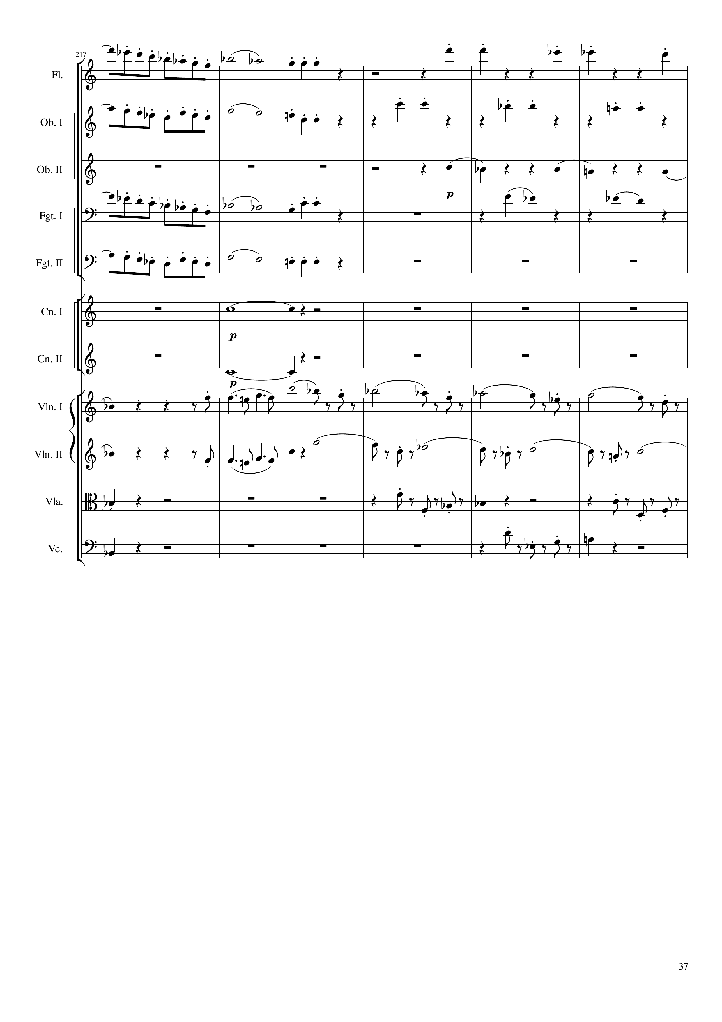
mel
rhythm
mel
rhythm
rhythm
mel
rhythm
mel
harm
harm
mel
mel
mel
rhythm
rhythm
rhythm
1344
1356
1368

Slide 38
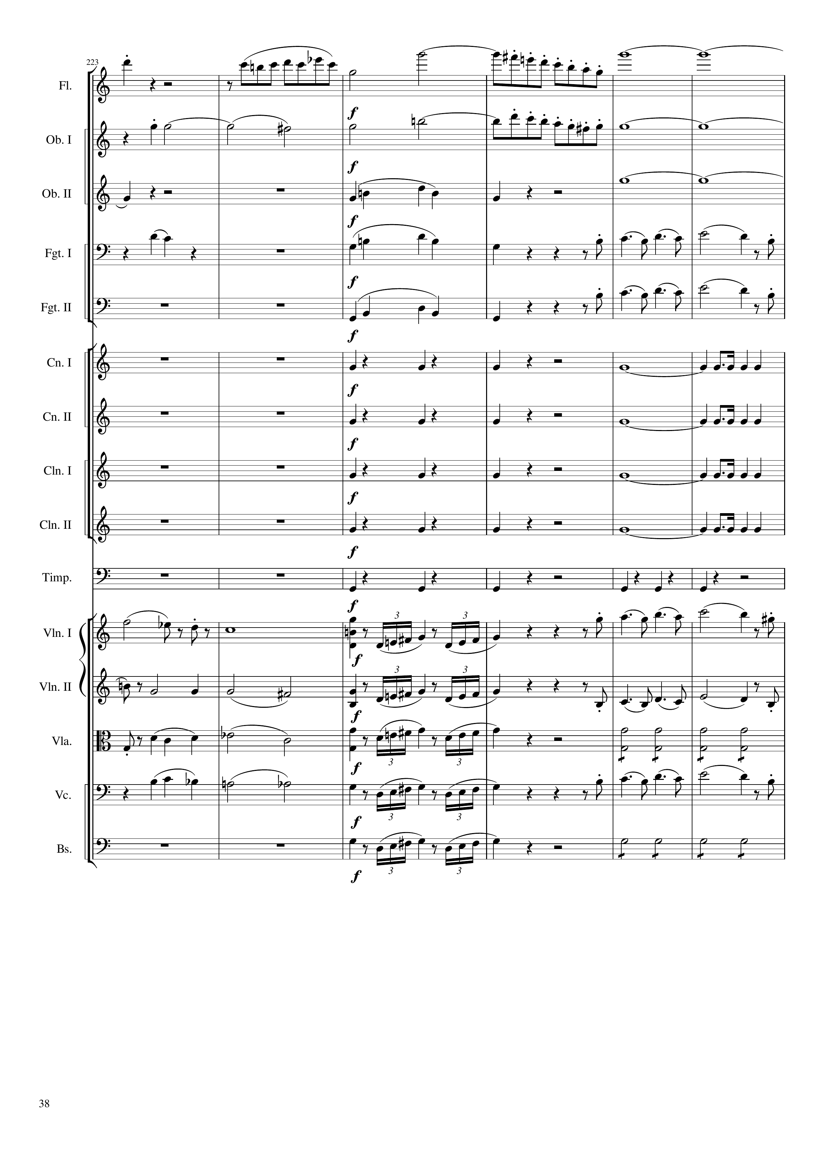
rhythm
mel
harm
rhythm
harm
mel
harm
rhythm
rhythm
harm
rhythm
rhythm
mel
rhythm
mel
rhythm+harm
rhythm
rhythm+harm
rhythm
rhythm+harm
rhythm
rhythm+harm
rhythm
rhythm+harm
rhythm
mel
mel
mel
mel
mel
mel
rhythm
mel
mel
rhythm
mel
mel
mel
mel
rhythm
1368
1376
1384
1392

Slide 39
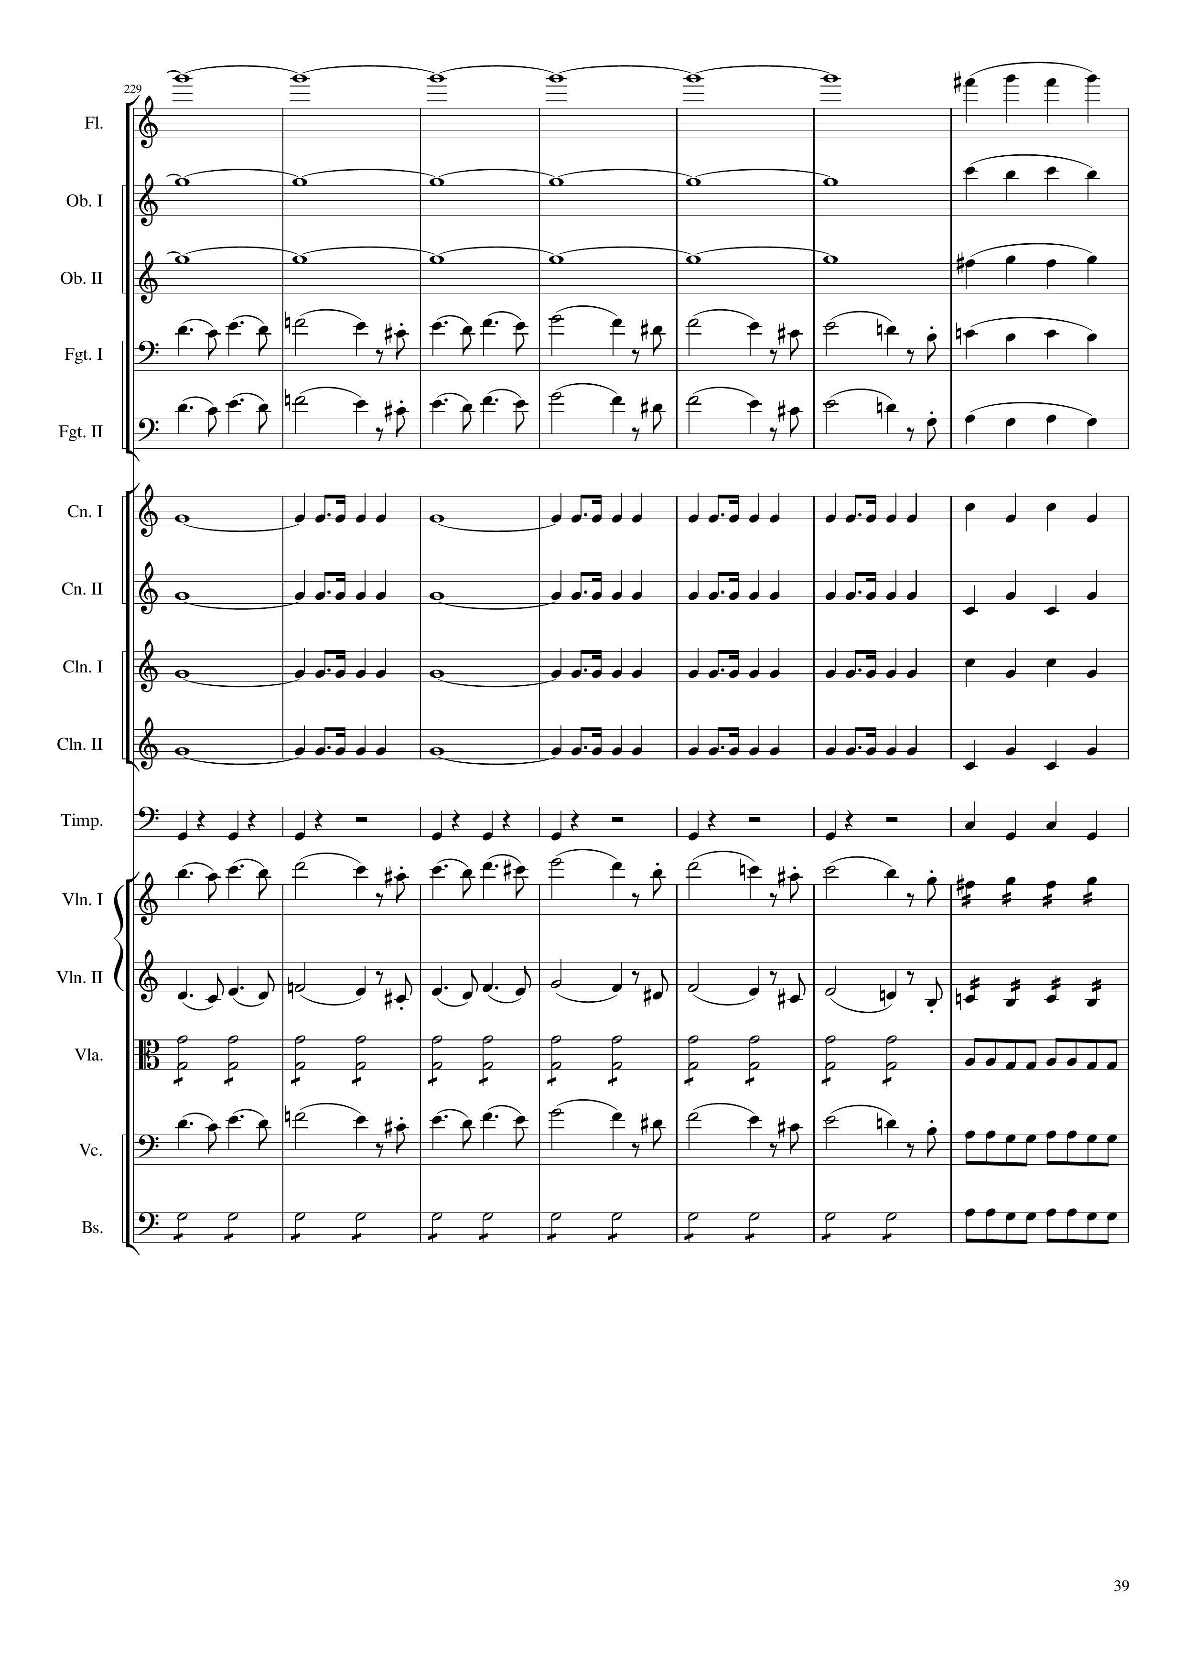
harm
mel
harm
mel
harm
mel
mel
mel
rhythm
rhythm
rhythm
rhythm
rhythm
mel
mel+rhythm
mel
mel+rhythm
rhythm
mel+rhythm
mel
mel+rhythm
rhythm
mel+rhythm
1392
1420

Slide 40
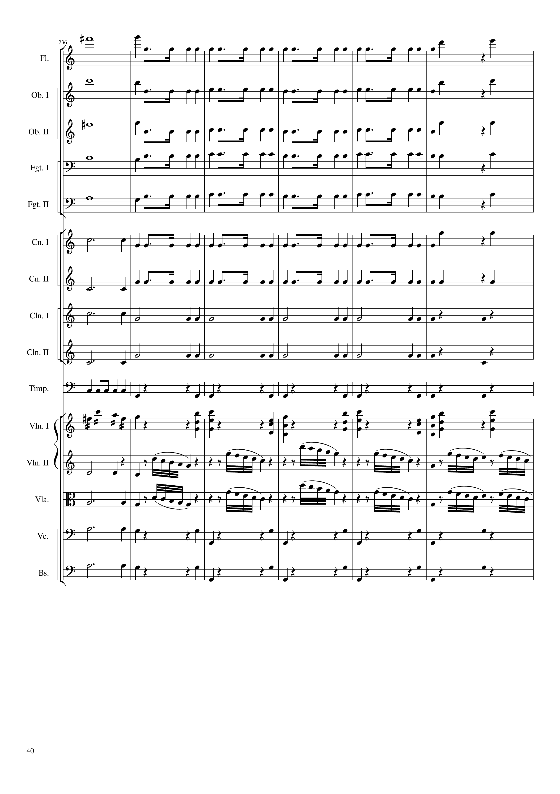
mel
rhythm+harm
mel
rhythm+harm
mel
rhythm+harm
mel
rhythm+harm
mel
rhythm+harm
rhythm
rhythm+harm
rhythm
rhythm+harm
rhythm
rhythm
rhythm+harm
rhythm
mel+rhythm
mel+rhythm+harm
mel+rhythm
mel
mel+rhythm
mel
mel+rhythm
rhythm
mel+rhythm
rhythm
1420
1444

Slide 41
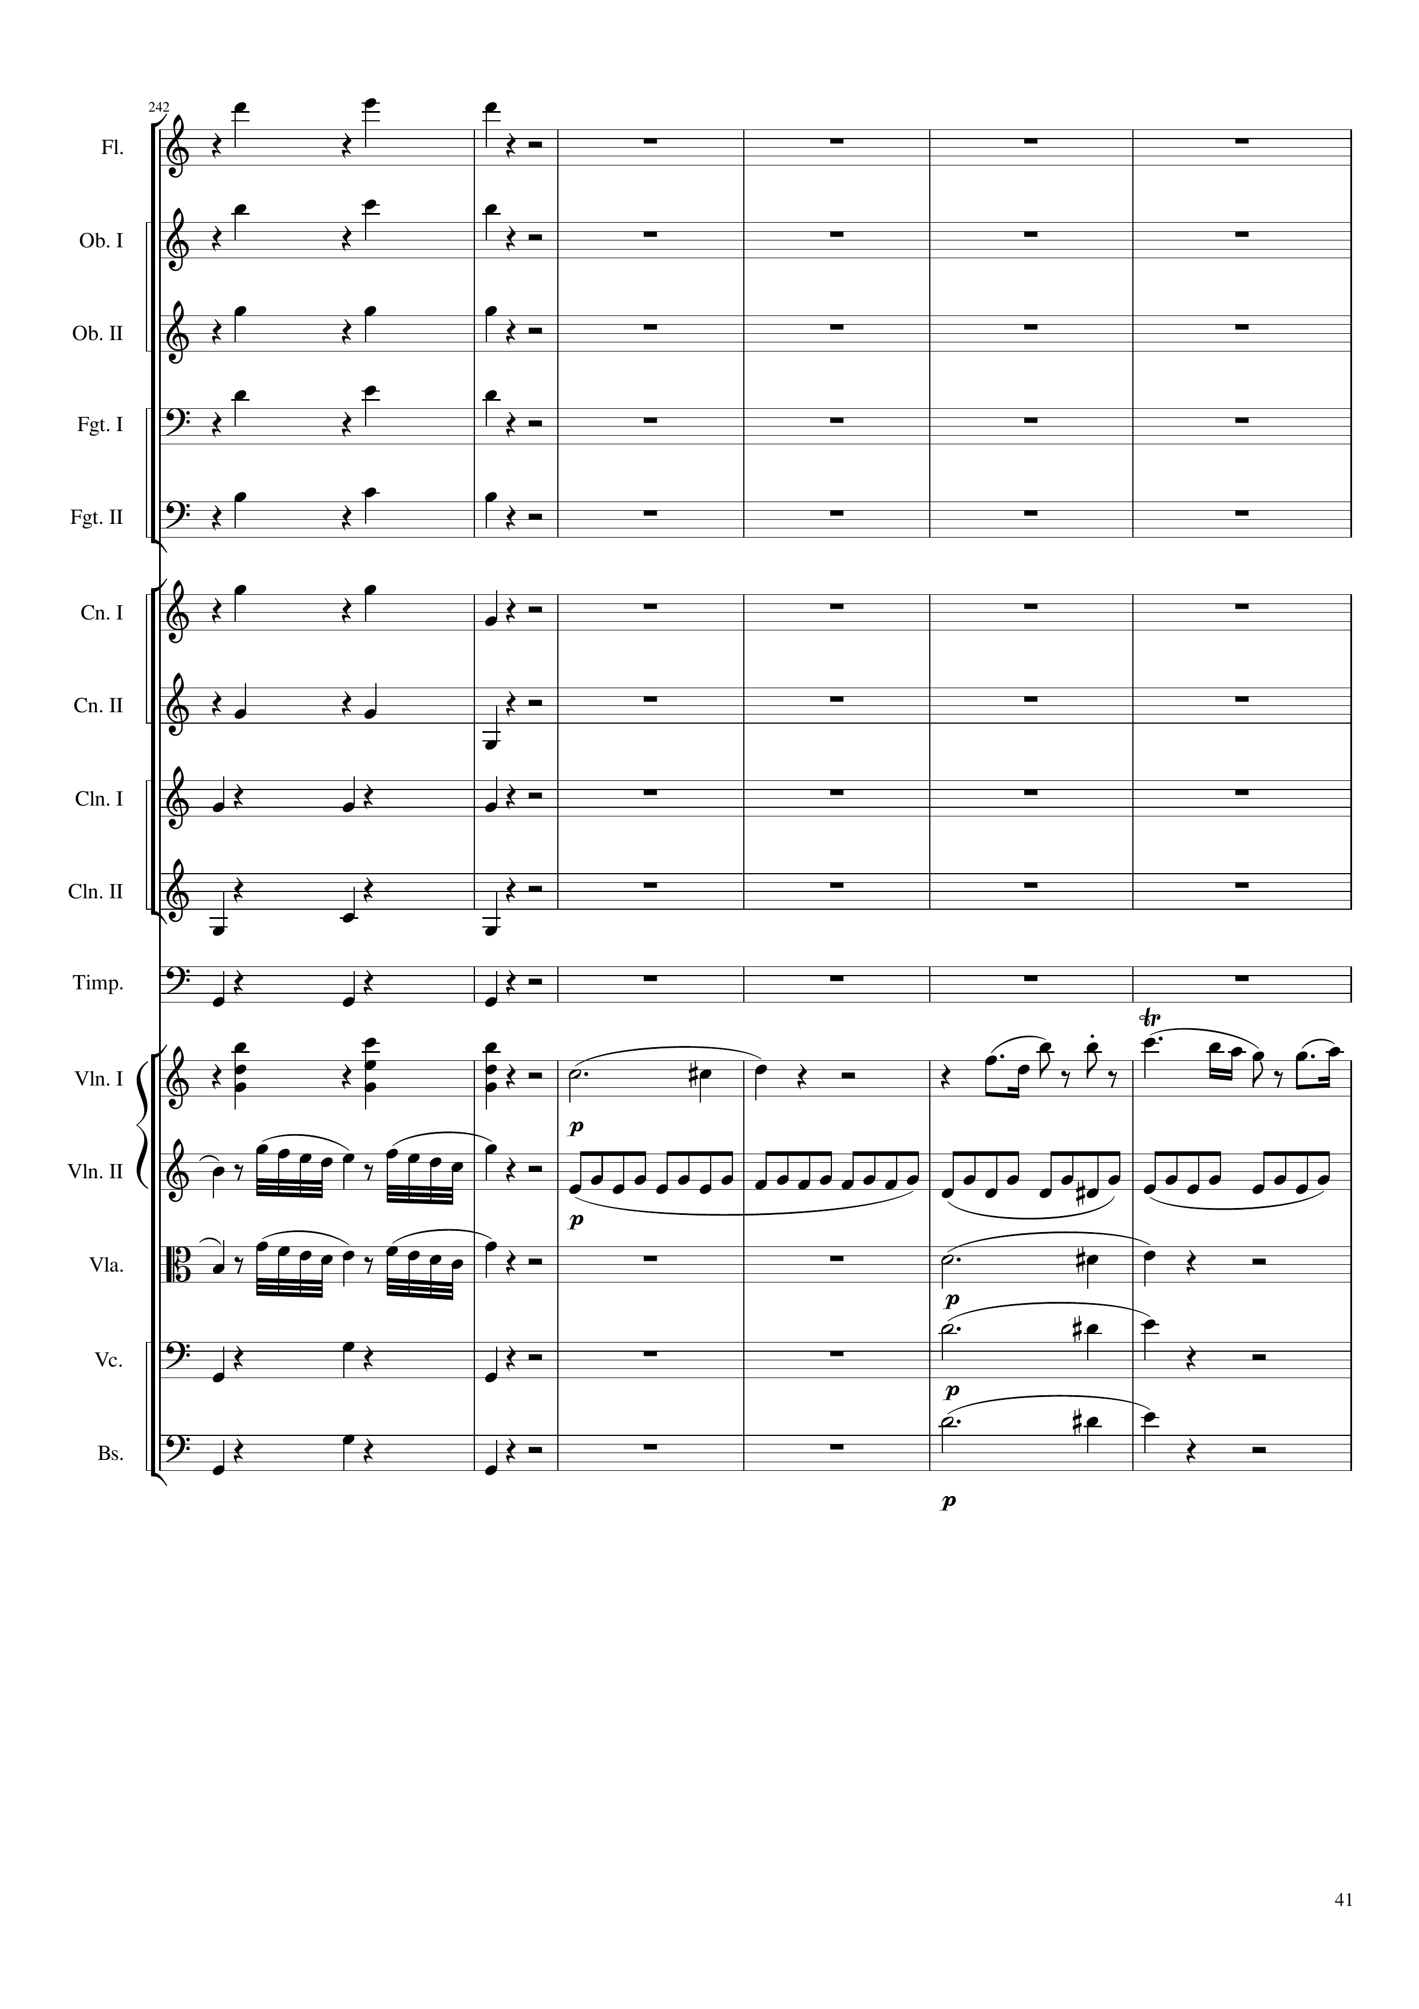
rhythm+harm
rhythm+harm
rhythm+harm
rhythm+harm
rhythm+harm
rhythm+harm
rhythm+harm
rhythm
rhythm+harm
rhythm
mel+rhythm+harm
mel
mel
rhythm
mel
mel+harm
rhythm
mel+harm
rhythm
mel+harm
1444
1452
1468
Notes:
11:15

Slide 42
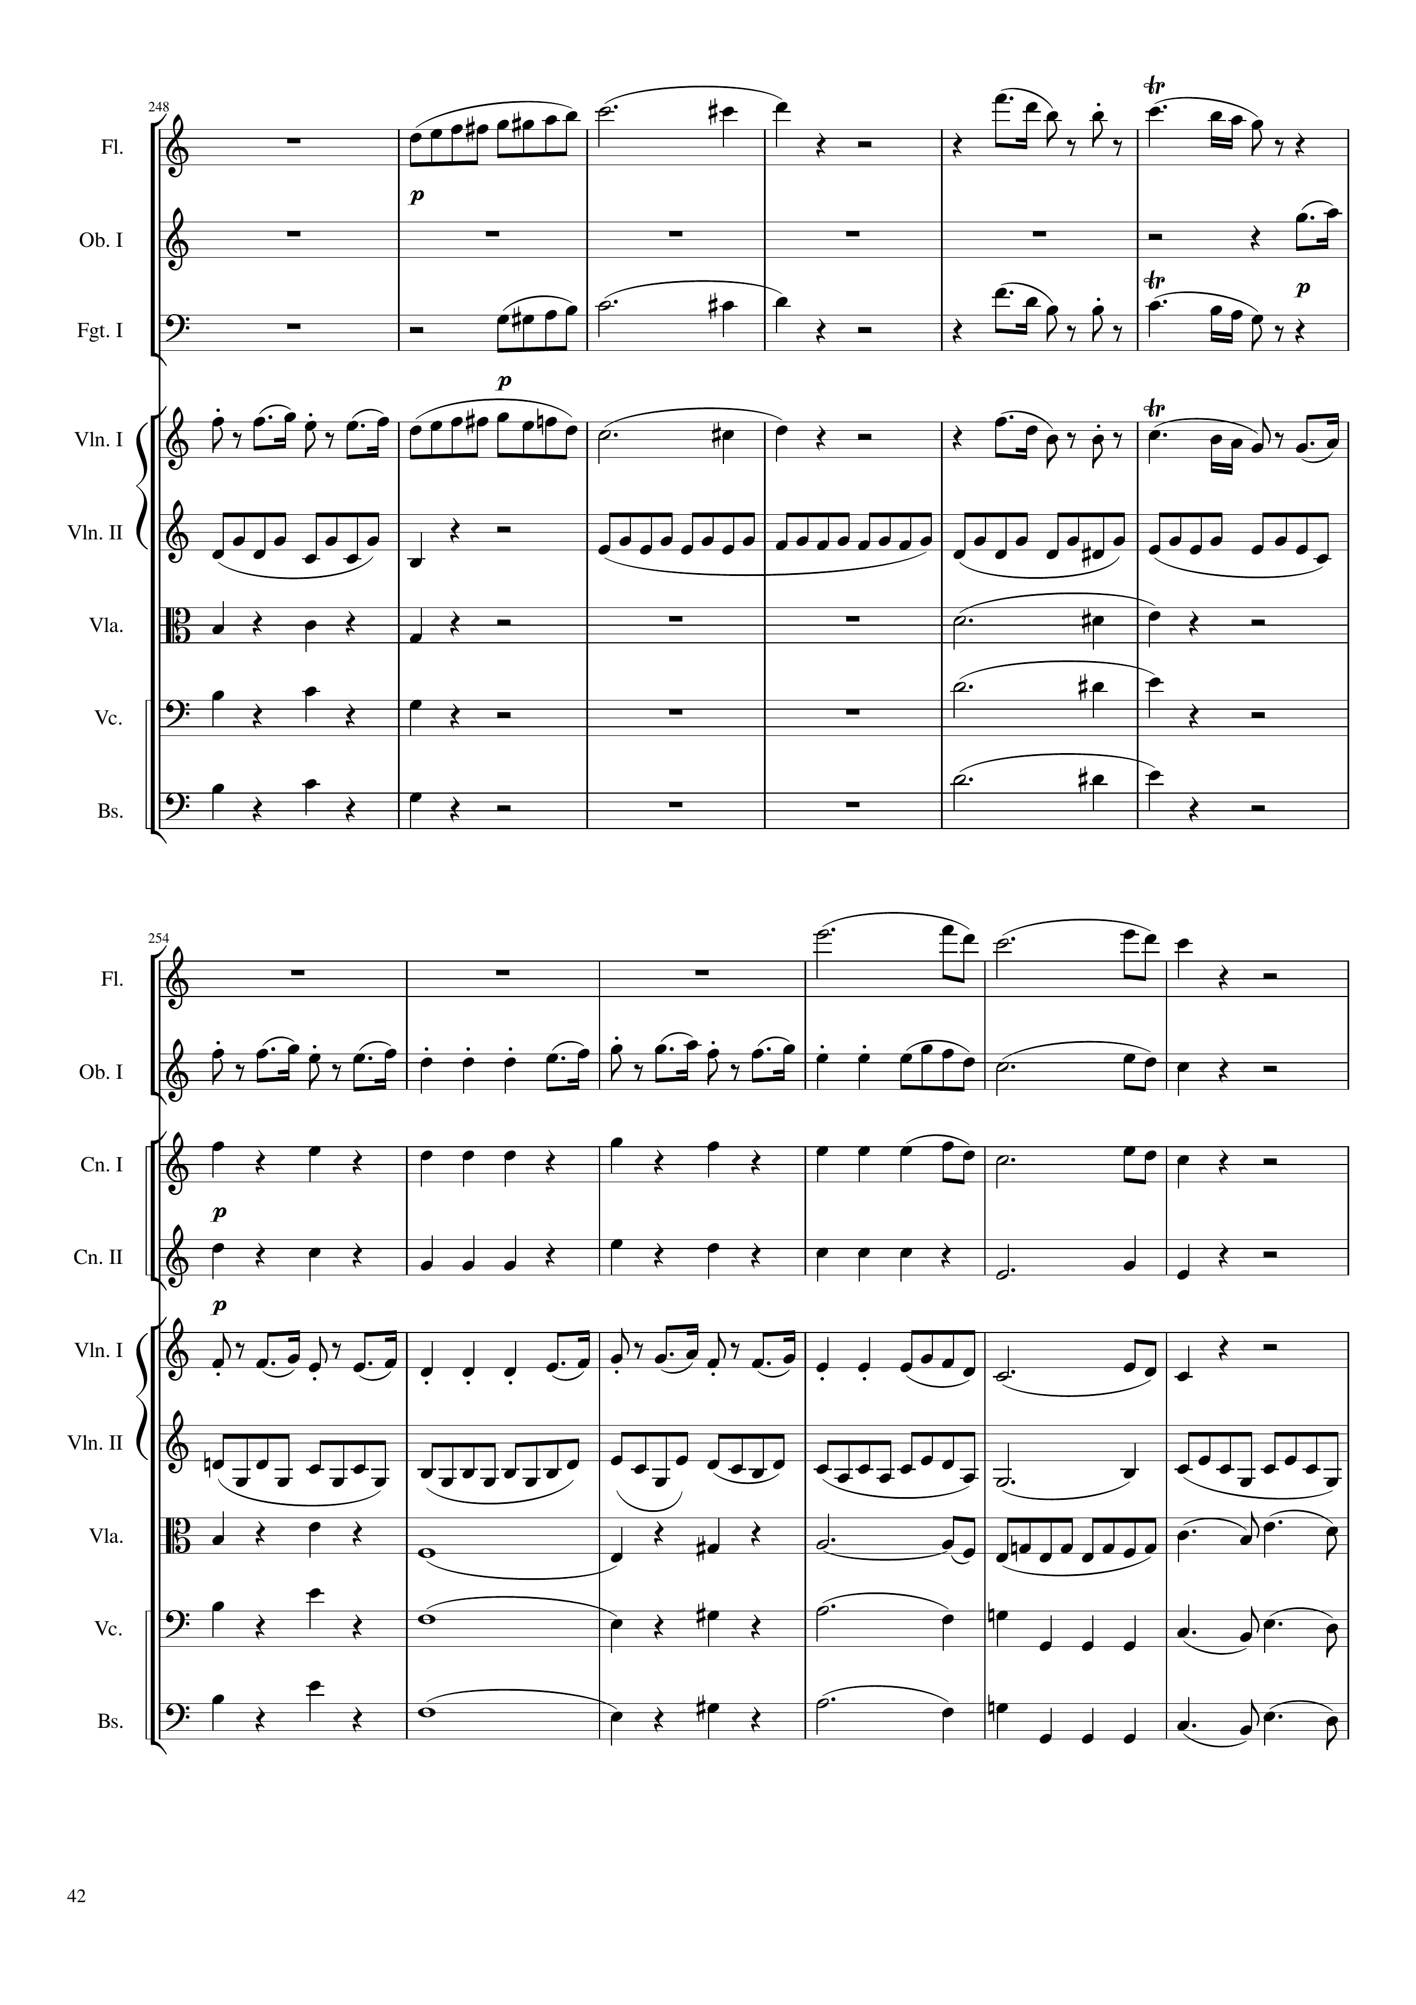
mel
mel
mel
mel
rhythm
rhythm+harm
mel+harm
rhythm+harm
mel+harm
rhythm+harm
mel+harm
1468
1492
mel
mel
rhythm+harm
mel
rhythm+harm
mel
rhythm
rhythm+harm
mel
rhythm+harm
mel
rhythm+harm
mel
1492
1516

Slide 43
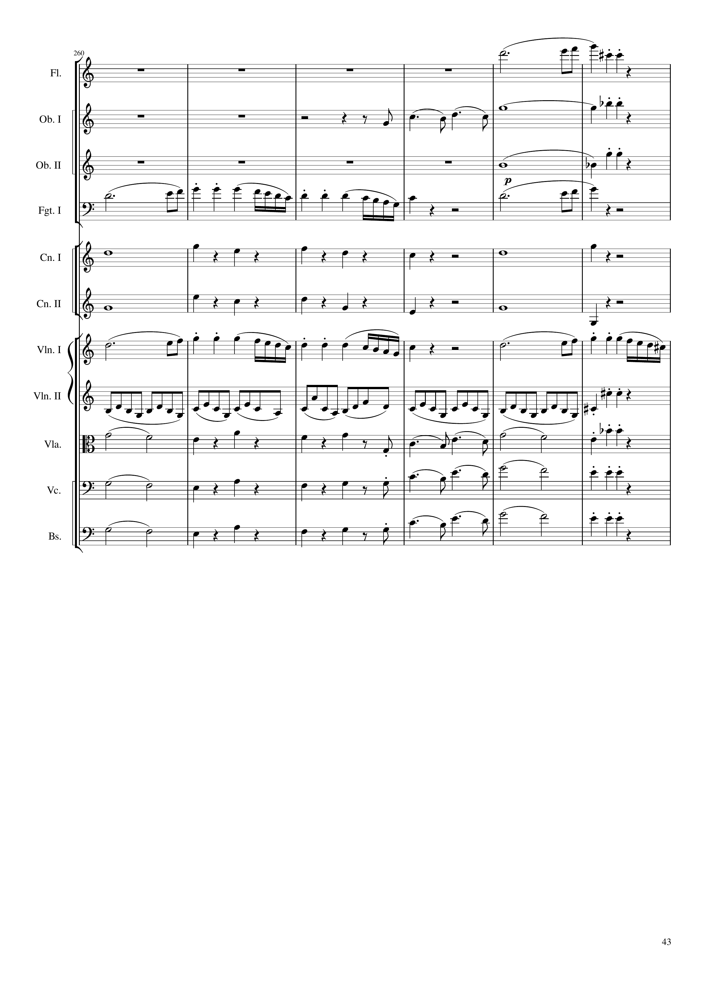
mel
rhythm+harm
mel
rhythm+harm
mel
rhythm+harm
mel
rhythm+harm
rhythm+harm
mel
rhythm
rhythm+harm
mel
rhythm+harm
mel
rhythm+harm
mel
rhythm+harm
mel
rhythm+harm
mel
rhythm+harm
mel
rhythm+harm
1516
1540

Slide 44
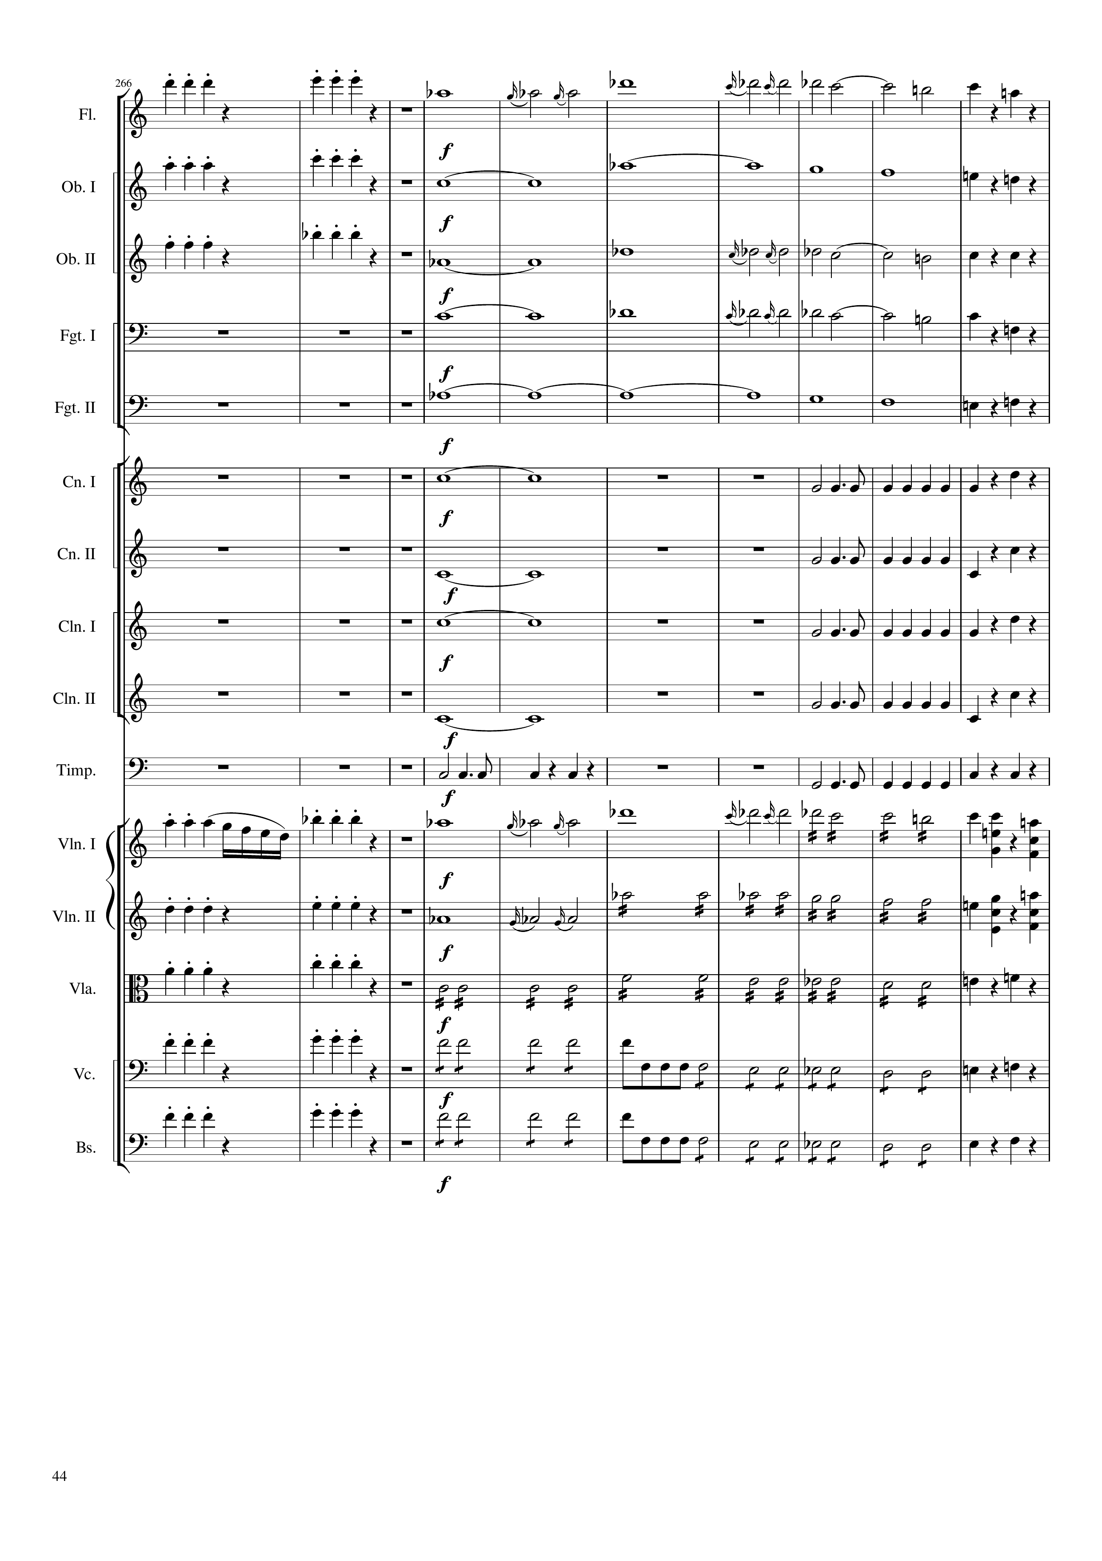
rhythm+harm
mel
rhythm+harm
rhythm+harm
harm
rhythm+harm
rhythm+harm
harm
mel
rhythm+harm
harm
mel
rhythm+harm
harm
rhythm+harm
harm
rhythm
rhythm+harm
harm
rhythm
rhythm+harm
harm
rhythm
rhythm+harm
harm
rhythm
rhythm+harm
rhythm
rhythm
rhythm+harm
mel
mel
mel+rhythm
rhythm+harm
rhythm+harm
mel
mel+rhythm
rhythm+harm
rhythm+harm
rhythm
rhythm+harm
rhythm+harm
rhythm
rhythm+harm
rhythm+harm
rhythm
rhythm+harm
1540
1548
1552
1580

Slide 45
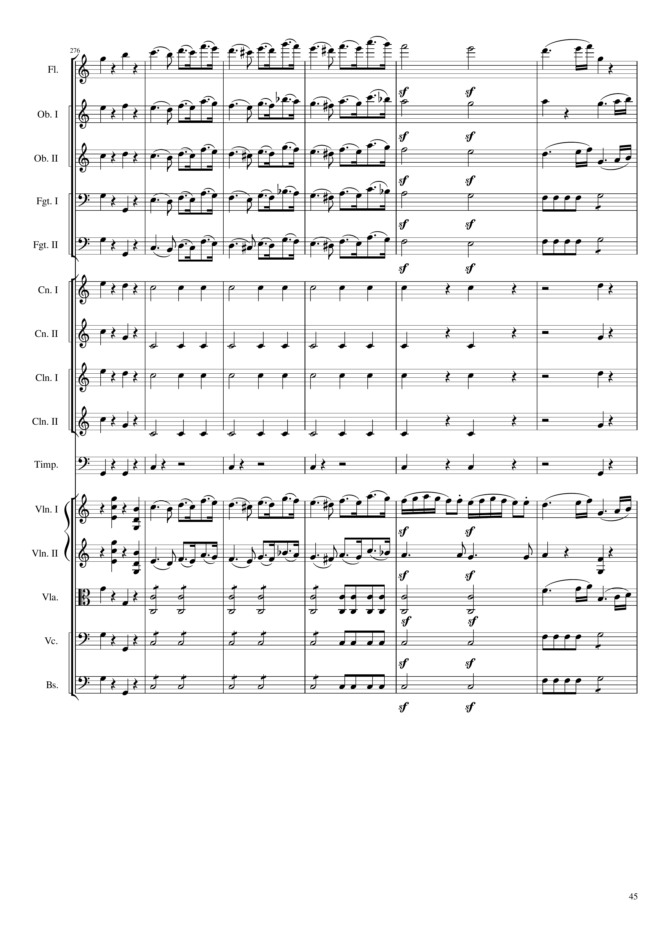
rhythm+harm
mel
rhythm+harm
mel
rhythm+harm
mel
rhythm+harm
mel
rhythm+harm
rhythm+harm
mel
rhythm+harm
rhythm+harm
rhythm
rhythm+harm
rhythm+harm
rhythm
rhythm+harm
rhythm+harm
rhythm
rhythm+harm
rhythm+harm
rhythm
rhythm+harm
rhythm+harm
rhythm
rhythm+harm
rhythm+harm
mel
rhythm+harm
mel
rhythm+harm
rhythm+harm
rhythm
rhythm+harm
mel
rhythm+harm
rhythm
rhythm+harm
rhythm+harm
rhythm
rhythm+harm
1580
1604

Slide 46
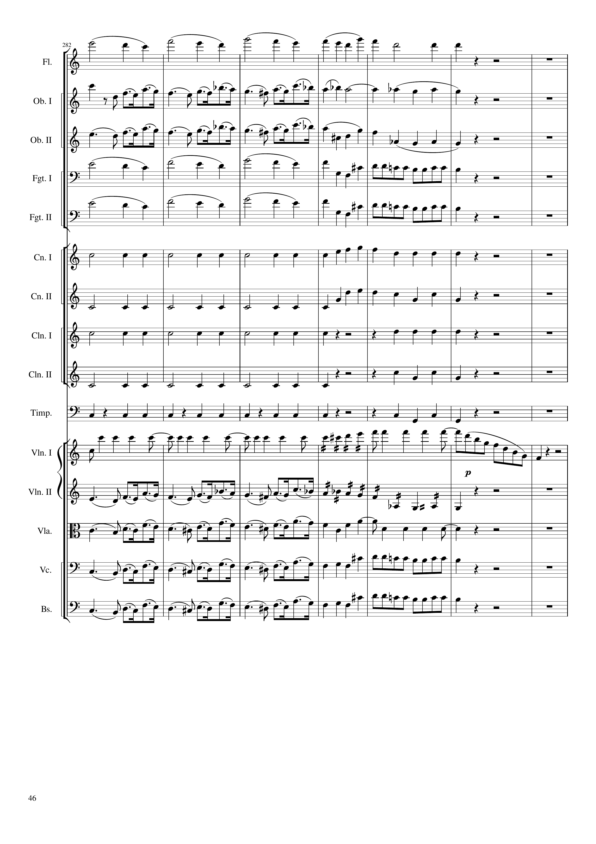
harm
rhythm+harm
mel
rhythm+harm
mel
rhythm+harm
harm
rhythm+harm
harm
rhythm+harm
rhythm
rhythm+harm
rhythm
rhythm+harm
rhythm
rhythm+harm
rhythm
rhythm+harm
rhythm
rhythm+harm
rhythm
mel+rhythm
mel
rhythm+harm
mel
rhythm+harm
mel
rhythm+harm
mel
rhythm+harm
1604
1616
1632

Slide 47
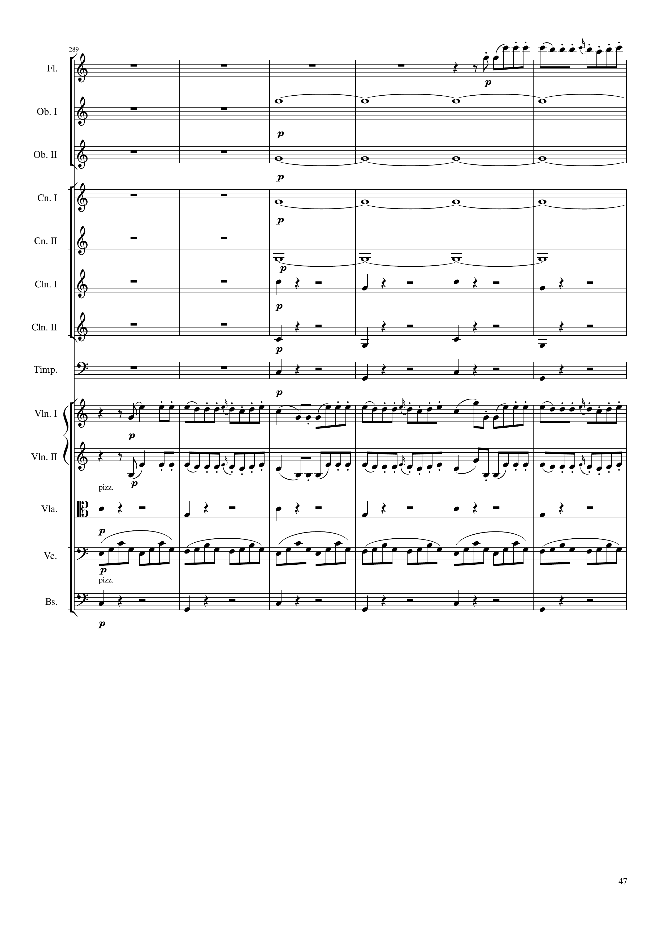
mel
harm
harm
harm
harm
rhythm+harm
rhythm+harm
rhythm+harm
mel
mel
rhythm+harm
rhythm
rhythm+harm
1632
1656

Slide 48
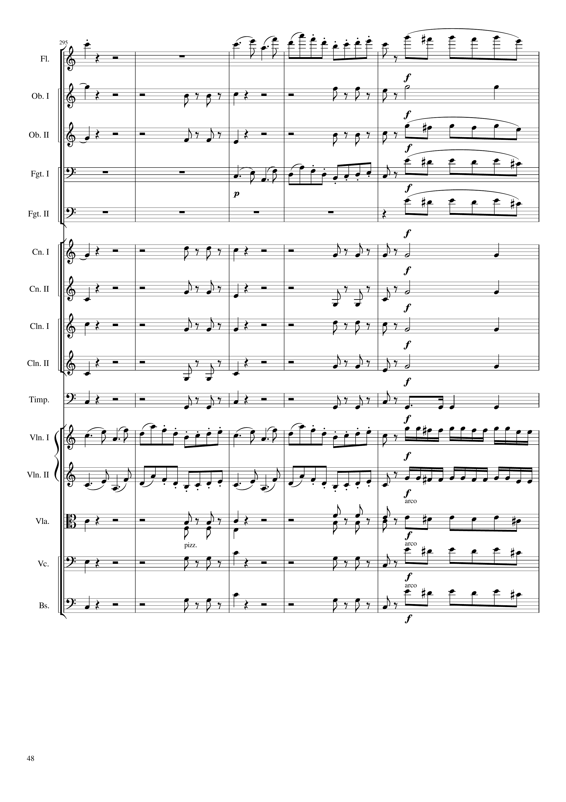
mel
mel
mel
harm
rhythm+harm
rhythm+harm
harm
rhythm+harm
mel
mel
mel
mel
harm
rhythm+harm
rhythm+harm
harm
rhythm+harm
rhythm+harm
rhythm+harm
rhythm+harm
rhythm+harm
rhythm+harm
rhythm+harm
rhythm+harm
rhythm+harm
rhythm+harm
rhythm
mel
mel+rhythm
mel
mel+rhythm
rhythm+harm
rhythm+harm
mel
rhythm
rhythm+harm
mel
rhythm+harm
rhythm+harm
mel
1656
1676

Slide 49
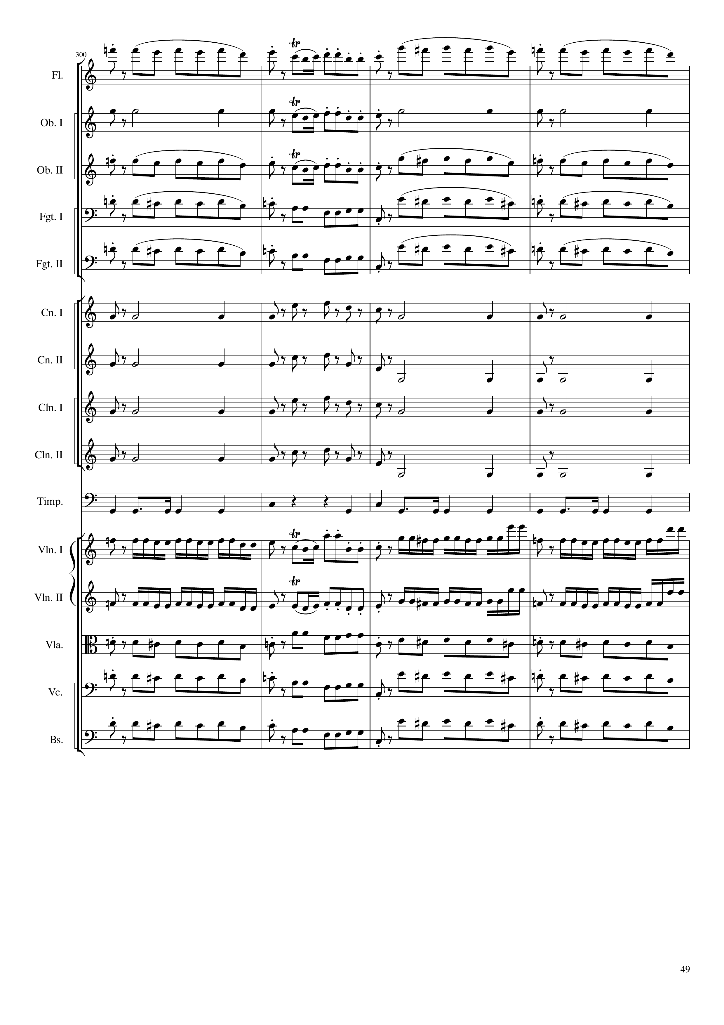
mel
mel
mel
rhythm+harm
mel
rhythm+harm
mel
mel
mel
mel
rhythm+harm
mel
mel
rhythm+harm
mel
rhythm+harm
rhythm+harm
rhythm+harm
rhythm+harm
rhythm
mel+rhythm
mel
mel+rhythm
mel+rhythm
mel
mel+rhythm
mel
rhythm+harm
mel
mel
rhythm+harm
mel
mel
rhythm+harm
mel
1676
1692

Slide 50
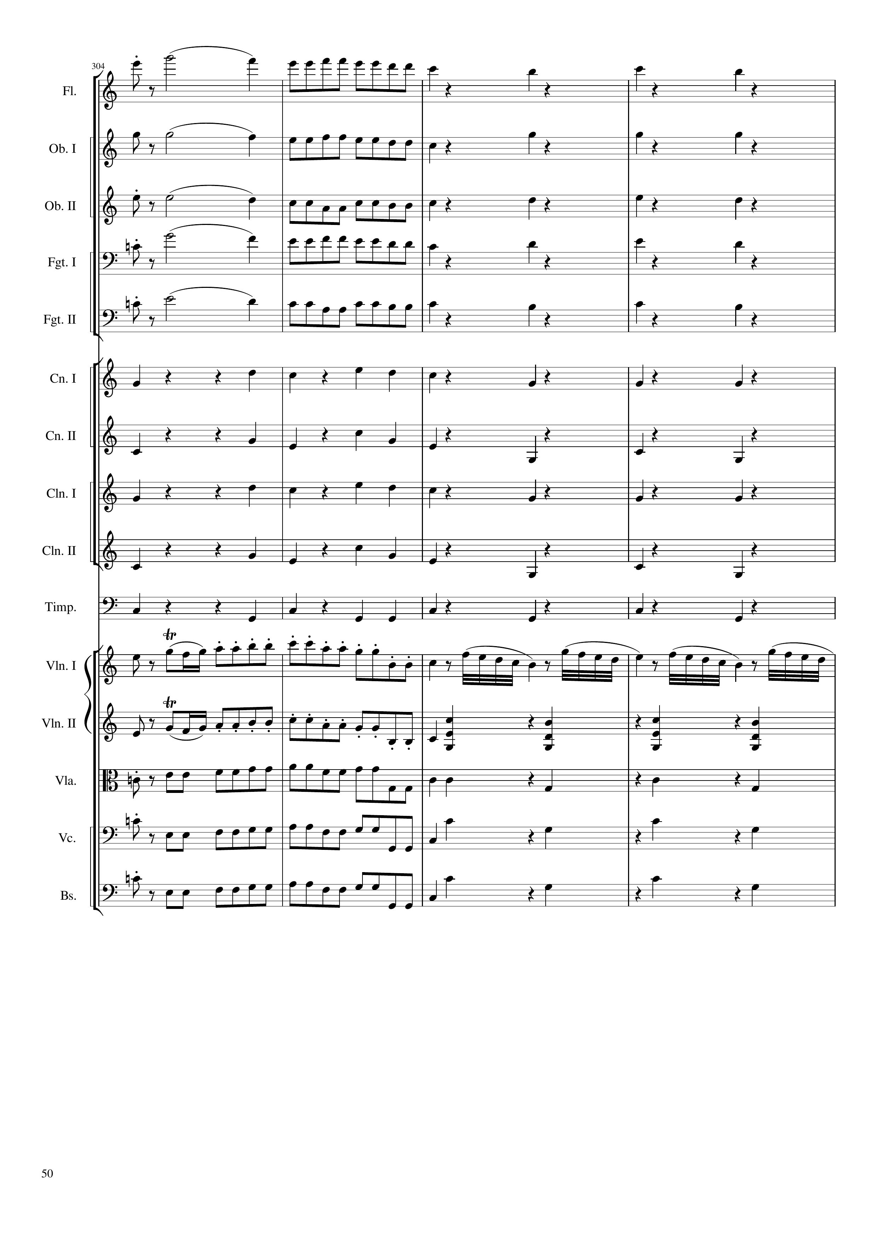
mel
mel
rhythm+harm
rhythm+harm
mel
rhythm+harm
mel
mel
rhythm+harm
mel
mel
rhythm+harm
mel
mel
rhythm+harm
rhythm+harm
rhythm+harm
rhythm+harm
rhythm+harm
rhythm+harm
rhythm+harm
rhythm+harm
rhythm+harm
rhythm
rhythm+harm
mel+rhythm
mel
mel+rhythm
mel
rhythm+harm
mel
mel
rhythm+harm
mel
mel
rhythm+harm
mel
mel
rhythm+harm
1692
1708

Slide 51

rhythm+harm
rhythm+harm
rhythm+harm
rhythm+harm
rhythm+harm
rhythm+harm
rhythm+harm
rhythm+harm
rhythm+harm
rhythm+harm
mel
rhythm+harm
rhythm+harm
rhythm+harm
rhythm+harm
rhythm+harm
1708
1732

